Slide 1

Program Review Days 2013
Introduction to portfolio of System development, Components,
Materials and Operation Diagnostics projects – Energy R&D
Nikolaos Lymperopoulos, Project Manager
http://www.fch-ju.eu/

Slide 2
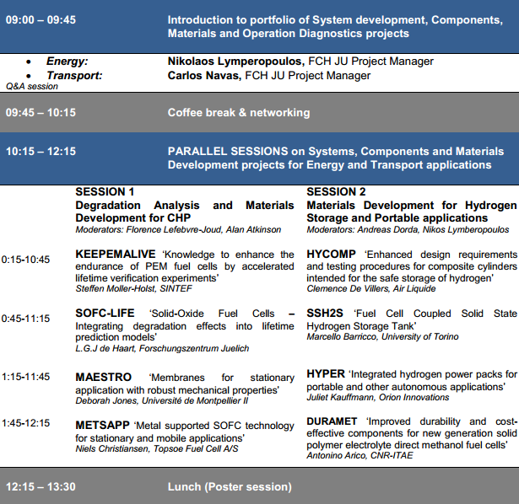
Agenda Day 2
Morning

Slide 3
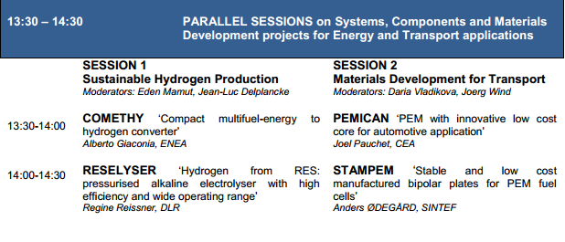
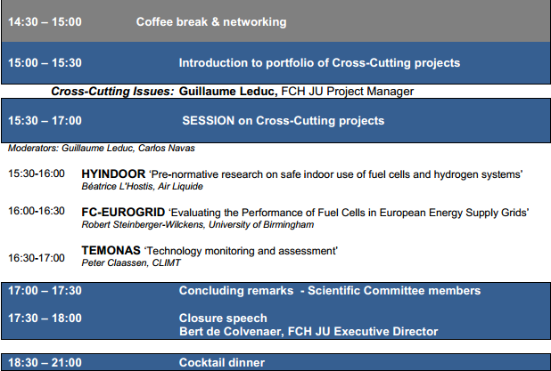
Agenda Day 2
Afternoon

Slide 4
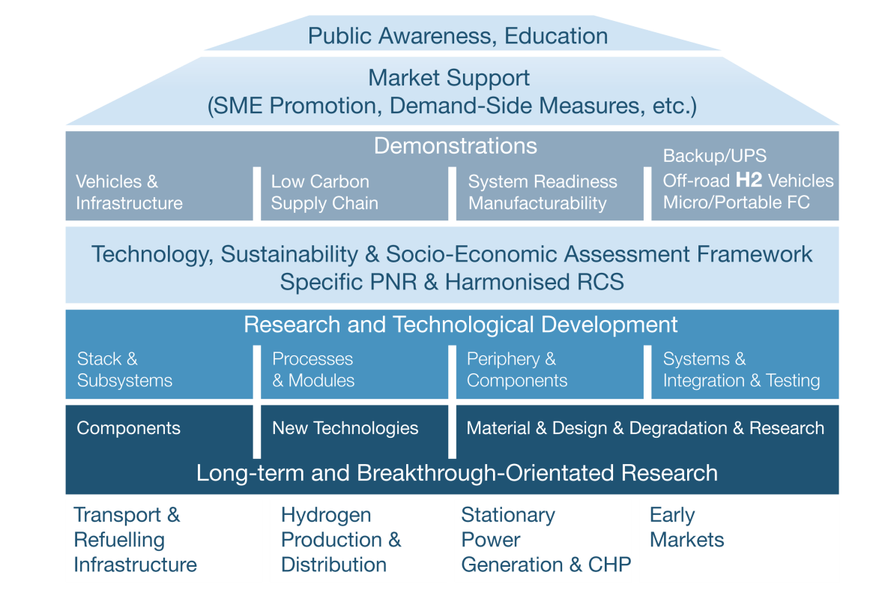
FCH for ENERGY: 89 projects
RTD:
62 projects
DEMO:
27 projects
Field demonstration
7 projects
Validation of integrated
systems readiness
5 projects
Materials development
for cells, stacks and BoP
21 projects
Portable
7 projects
Operation diagnostics
and control
5 projects
Proof-of- concept
Systems
4 projects
Fundamentals of
Degradation
9 projects
H2 storage
3 projects
Components
Improvement
6 projects
Sustainable H2 production
22 projects
Technology Readiness Level, TRL

Slide 5
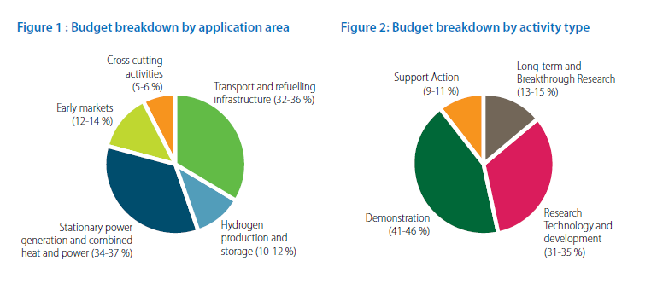
MAIP objectives
  470 M€ FCH JU Budget distribution
FCH JU Support
H2 Production & Storage 10.4% (50.9M€)
Materials for CHP 15% (70.6M€)
Materials for portable 3% (13.6M€)

Slide 6
AA2 Sustainable H2 Production
MAIP objectives
  Develop cost-competitive, energy efficient, sustainable H2 production processes
  Various feedstocks
  Centralised (large scale) or distributed (small scale)
  Short-term: meet demand with mature technologies
  Longer-term: variety of technologies exploiting mainly renewable energy sources
  Hydrogen storage in gaseous, liquid and solid form

Slide 7
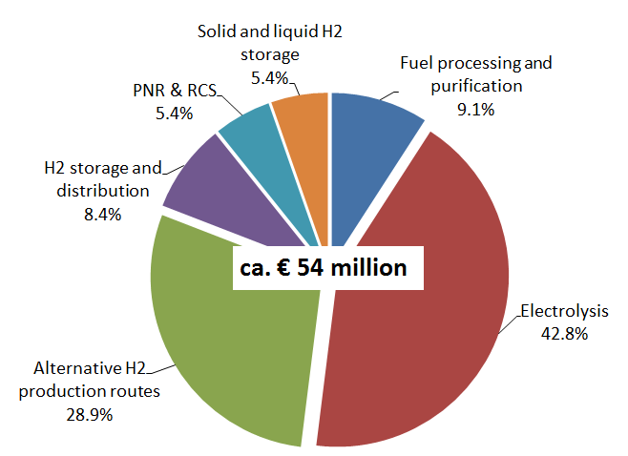
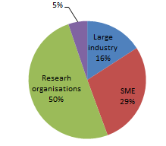
AA2 Sustainable H2 Production
MAIP Coverage
  Total R&D: 28 projects, 50.9M€
  Low Cost, low Temp electrolysis: 4 projects, 6 M€
  High temp electrolysers: 4 projects, 10.1 M€
  Materials for PEM electrolysers: 2 projects, 4 M€
  Biomass to H2: 1 project 2.2 M€
  High Temp thermochemical water decomposition:
  3 projects, 5.3 M€
  Low temp H2 prod. processes: 4 projects, 8.1 M€
  H2 Storage & Distribution: 3 projects, 4.5 M €
  PNR & RCS: 2 projects, 2.9M €
  Solid and Liquid Storage: 2 projects, 2.9 M €
  Fuel processing, and gas purification: 3 projects, 4.9 M€

Slide 8
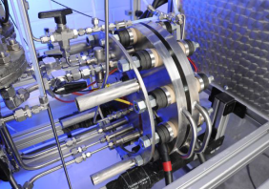
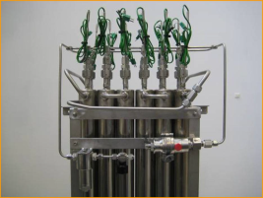
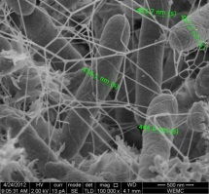
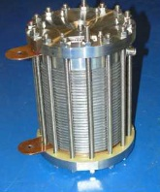

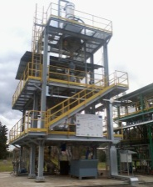
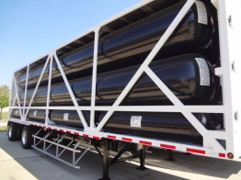
AA2 Sustainable H2 Production
Main Technical Achievements
  Alkaline electrolysers with advanced membranes, η>80%, 1000 on/off cycles, 3,000€/(Nm3/hr)
  Development of large scale PEM electrolysers aiming for MW scale commercial units
  SOE electrodes operating at 700ºC, 15% increased performance @ 0.9A/cm2
  Advanced catalysts for steam reforming at 400-550ºC
  Thermochemical water splitting using solar energy: simulations - pilot-scale demonstration
  1-10kg/day H2 production from thermophilic fermentation of 2nd gen biomass
  50% reduction of energy consumption for the liquefaction of hydrogen through up-scaling and optimisation.
  Improved designs and testing procedures for pressurised hydrogen tanks
  Hydrogen delivery with 400bar composite tanks
  5 wt% H2 in MH tanks capable of 20Nl/min for 2h, integrated with FC
RESelyser
SSH2S
HYTIME
PRIMOLYSER
DELIVERHY
SOL2H2
UNIfHY

Slide 9
AA3 Stationary CHP
Degradation & Materials MAIP objectives
  Improve FC stack and BoP components
  R&D on:
    Degradation and lifetime fundamentals
    New and improved materials
    Control and diagnostic tools
    Components and sub-systems
    Novel cell & stack architectures
  Step change in endurance, robustness, durability, cost

Slide 10
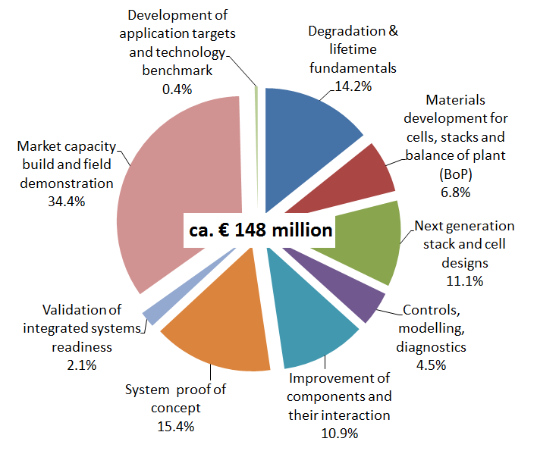
AA3 Stationary CHP
Degradation & Materials
MAIP Coverage
  Degradation: 11 projects, 21.1 M€
  Materials development for cells, stacks and BoP:
  5 projects, 10.1 M€
  Next generation stack and cell design: 7 projects, 16.5 M€
  Control and diagnostics: 4 projects, 6.7 M€
  Improvement of components, 7 projects, 16.2 M€
  Total for R&D: 34 projects, 70.6 M€

Slide 11
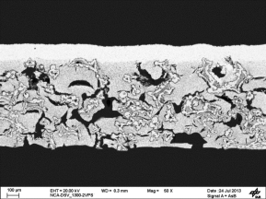
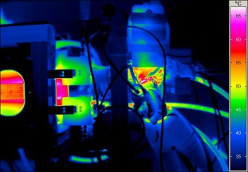
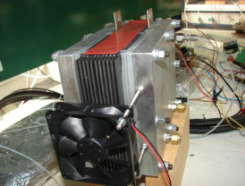
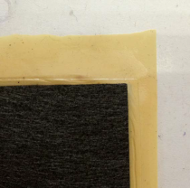
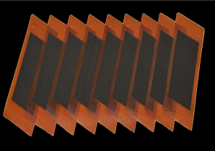
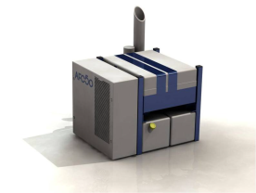
AA3 Stationary CHP
Degradation & Materials
Achievements
  160-200ºC PEM stacks with >20,000 h lifetime and η>45%
  Metal supported tubular SOFC with >40,000 h lifetime
  Triode architecture of SOFCs for x10 power factor and η>55%
  AFCs with advanced stack design –> estimated 100MW @ 1,500-2,000 €/kW
  Ammonia fuelled 5kW AFCs for remote power
  Membranes and MEAs with improved mechanical properties
  Improving durability through accelerated testing procedures
EVOLVE
EUREKA
DeMStack
MAESTRO
CISTEM
ALKAMONIA

Slide 12
AA4 Early Markets
Portable Apps MAIP objectives
  Show the technology readiness of portable and micro FCs
  R&D on:
    Reduced cost of FC
    Improved efficiency & lifetime
    Enhanced fuel supply, reduced H2 delivery costs (supply concepts, on-board reforming)

Slide 13
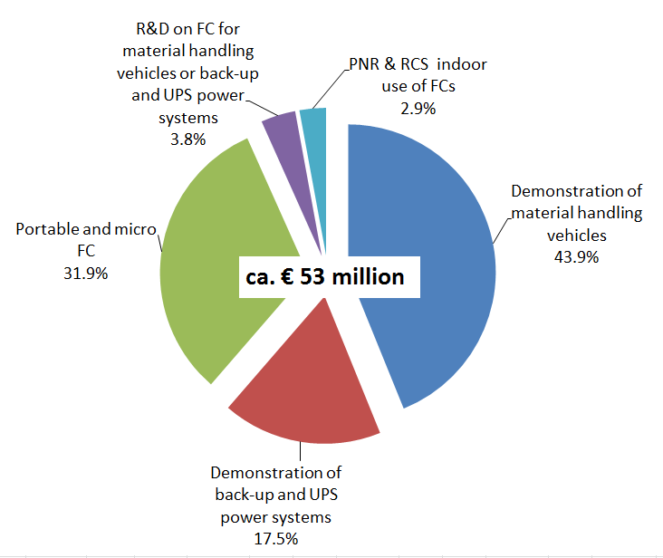
AA4 Early Markets
Portable Apps MAIP Coverage
  Fuel supply concepts for portables: 2 projects, 2.4 M€
  Durability of micro FCs: 1 project, 1.5 M€
  R&D of new portable FC systems: 4 projects, 7.7 M€
  R&D of 1-10kW FC systems: 1 project, 2 M€
  Total for R&D: 8 projects, 13.6 M€

Slide 14
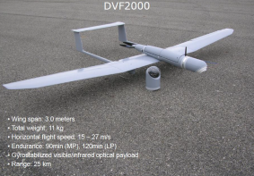
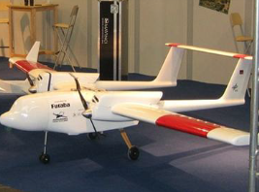
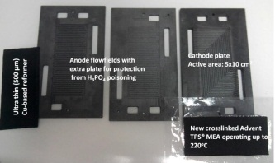

AA4 Early Markets
Portable Apps
Achievements
  Optimised DMFC componenents with reduced cross-over and 2x<degradation, PGM <0.5 mg cm2
  Miniaturised SOFCs & BoP for UAVs, resulting to doubling of flight times
  H2 based power packs (20kg/kW, 20l/kW))for portable apps
  Portable internal reforming methanol high temperature PEM
DURAMET
SUAV
HYPER
IRMFC

Slide 15
Conclusions: R&D in Energy
Comprehensive level of MAIP coverage
Conventional and innovative H2 production concepts supported
All FC technologies covered in CHP applications
PEM, DMFC, SOFC in portables

Slide 16
The Future
FCH 2 JU Objectives
  FCs for power production: η increase, cost reduction to levels competitive with conventional technologies
  H2 production: η increase, reduce capital cost
  Demonstrate the feasibility of using H2 to support the integration of RES into the energy systems

Slide 17
Thank you for your attention!
Further info:
FCH JU: http://fch-ju.eu
NEW-IG: http://www.new-ig.eu
N.ERGHY: http://www.nerghy.eu

