Slide 1
METSAPP
Metal supported SOFC technology for stationary and mobile applications
(GA number 278257)
Niels Christiansen
Topsoe Fuel Cell A/S

Slide 2
Project & Partnership
  General Overview
  Metal supported SOFC technology for stationary and mobile applications
  3 years (2012-2014)
  Budget
  Total: 7.886.781 EURO
  EU contribution: 3.396.470 EURO
  Danish top up support: 1.034.732 EURO
  Consortium
  Topsoe Fuel Cell A/S (DK)
  Sandvik Materials AB (SE)
  AVL List GmbH (AT)
  ICE Stroemungsforschung GmbH (AT)
  DTU Technical University of Denmark (DK)
  Chalmars University of Technology (SE)
  Karlsruhe Institute of Technology (DE
  University of St Andrews (UK)
  EC Joint Research Centre (NL)
Vertical integrated

Slide 3
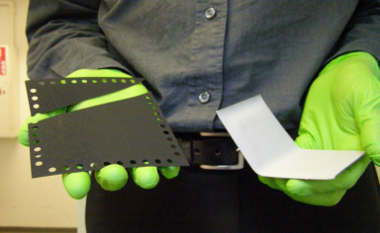
Project goals, targets, and milestones
The aim of the METSAPP project is to develop novel
cells and stacks based on a robust and reliable up-scale-able
metal supported technology with the following primary objectives:
Robust metal-supported cell design, ASR_{cell} < 0.5 Ωcm², 650ºC
Cell optimized and up-scaled to > 300 cm² footprint
Improved durability for stationary applications, degradation < 0.25%/kh
Modular, up-scaled stack design, stack ASR_{stack} < 0.6 Ωcm², 650ºC
Robustness of 1-3 kW stack verified
Cost effectiveness, industrially relevance, up-scale-ability illustrated.
Novel cathode
ScYSZ
Novel anode
Stainless
steel

Slide 4
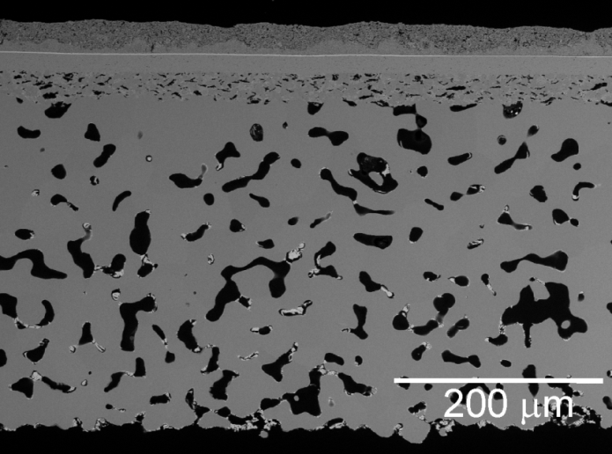
Next Gen SOFC development
Start platform
Novel ”beyond state of art” concept
EU METSOFC Cell
2008 -2011
5000 h lifetime
Mobile applications
EU METSAPP Cell
2012 – 2014
40.000 h lifetime
Stationary applications
ASR: 0.27 Ωcm² at 650 ºC
MIEC
MIEC
CGO
CGO
ScYSZ
ScYSZ
Cermet - Infiltrate
Ceramic- Infiltrate
FeCr
FeCr
Corrosion passivation infiltrated

Slide 5
Project concept
LEAN Development in a Complex Technology
Project groups (WPs) with a strong background and competences
Vertical integrated project structure (no overlap between partners)
Several links to other SOFC projects (EU, national, in-house)
Rapid cell and stack prototypes at optimal scale for test
Rapid critical optimization loops (critical iteration)
WP1
Project management
WP7&8
RTD coordination, exploitation and dissemination
WP3
Testing
WP4
Modelling,
reliability
and
durability
WP5
Stack
development
WP6
Alloys
and coatings
WP2
Cell development
Critical iteration (Lean spirals)
based on new acquired knowledge
Effective short cuts for rapid feedback of
information and results
Notes:
5

Slide 6
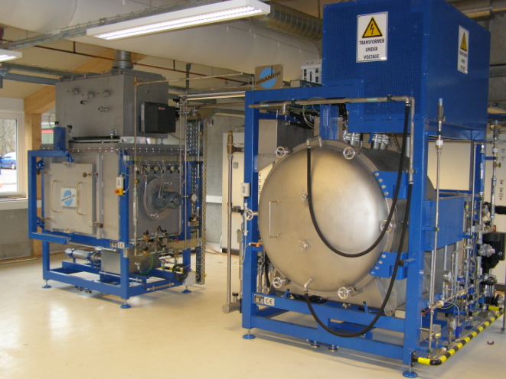
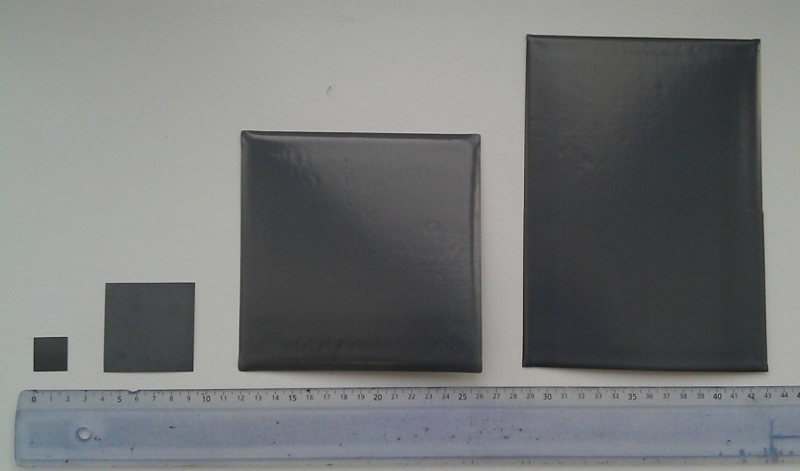
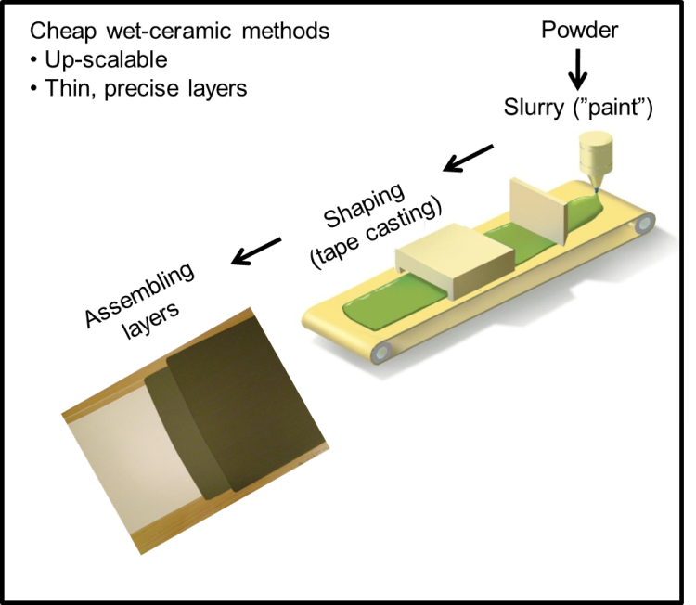
Project achievements - Cell processing
Challenges
Strategies
Co-processing of ceramics
and metals
Multi layer tape casting
Lamination
Sintering (atmospheric avoided)
Screen printing
Infiltration (nano structuring)
Fabrication routes
based on low-cost and upscalable processes
25 cm²
300 cm²
144 cm²
4 cm²
Year
6
2010
2011
2012

Slide 7
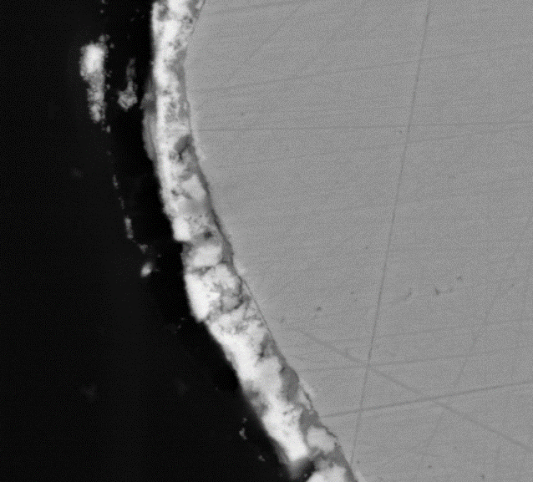
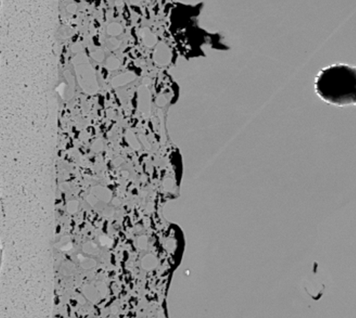
WP2 – Cell development
Material and Processing R&D
Tasks
2.1 Metal powder development
2.2 Development of cermet layer and nano-structured coatings
2.3 Development of novel anode designs
2.4 Integration of high performance cathodes
2.5 Integration of components to cells
2.6 Component and cell manufacturing
Novel anodes
  High electronic conductivity
  Enhanced electro-catalytic activity
  In-situ growth of catalytically active nano-particles
  Improved corrosion protection of metal components
7

Slide 8
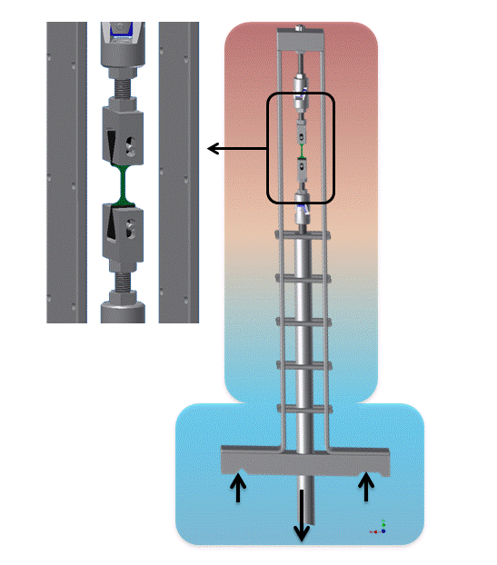
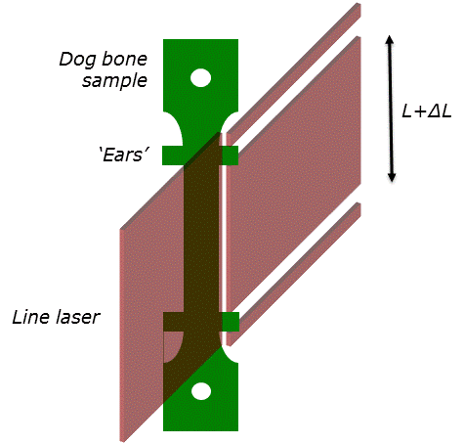
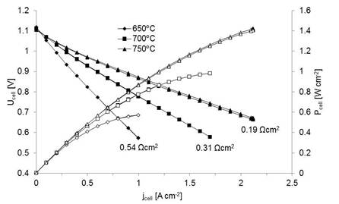
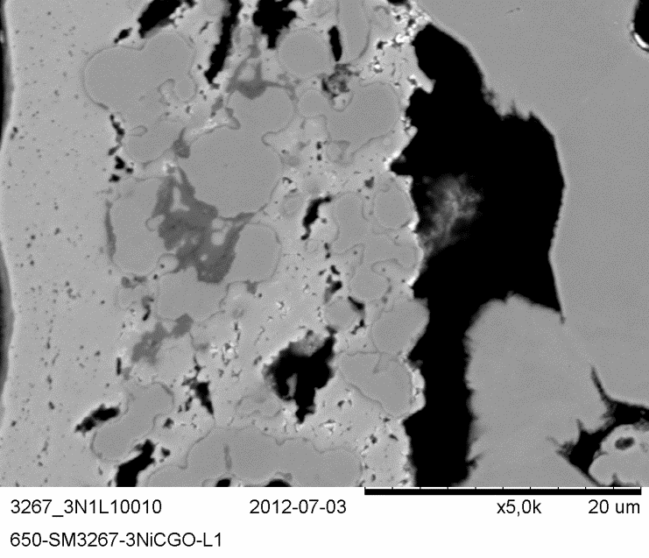
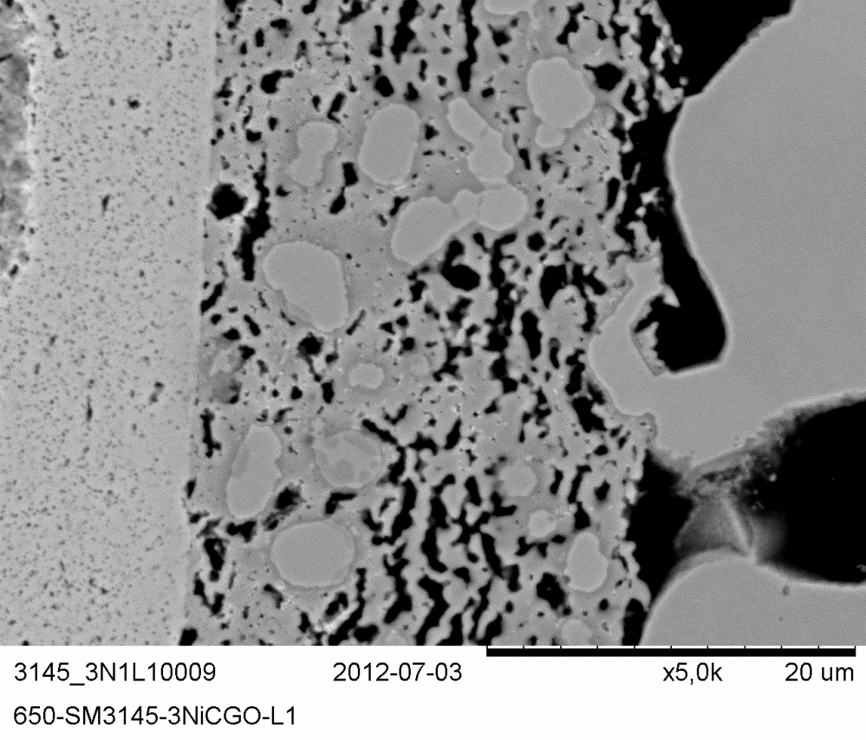
WP3 – Testing
Tasks
3.1 Corrosion testing
3.2 Mechanical testing
3.3 Electrochemical testing of MSCs
3.4 Analysis of the catalytic properties of MSCs
3.5 Long term stability and corrosion of MSCs
3.6 Accelerated testing on cell level
3.7 Accelerated testing on stack level
3.8 Performance monitoring of MSC-stacks
3.9 Vibration tests of MSC-stacks
New setup mechanical testing at high temperature constructed
Novel
anode
New cermet layer = less corrosion
Notes:
8

Slide 9
Fundamental electrochemical testing
Impedance spectra
-0.2
pH₂O / atm
0.080
4 Hz
0.136
Im(Z) / Ω∙cm²
0.244
-0.1
0.440
1.8 MHz
250 kHz
0.634
Identification of critical issues
10 mHz
0.819
0.0
0
0.1
0.2
0.30
0.40
0.5
Re(Z) / Ω∙cm²
METSAPP G1 cell SM 2922#2
1 cm² electrode area, H₂ + H₂O, air, 700°C, OCV
Distribution of Relaxation Times
0.09
0.08
P_{1A} gas diffusion in metal support
0.07
P_{2C} electrochemistry cathode
0.06
electrochemistry anode
Improvement of basic knowledge
0.05
0.04
P_{2A}
0.03
g(f) / Ω∙sec
P_{3A}
P_{hf} ?
0.02
0.01
0.00
10⁻¹
10⁰
10¹
10²
10³
10⁴
10⁵
10⁶
f / Hz
⇒ cell performance data and model parameters for task 4.2/4.3
Notes:
9

Slide 10
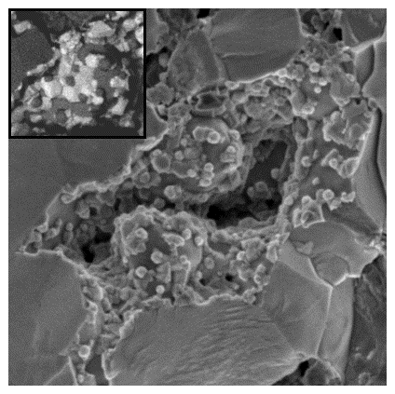
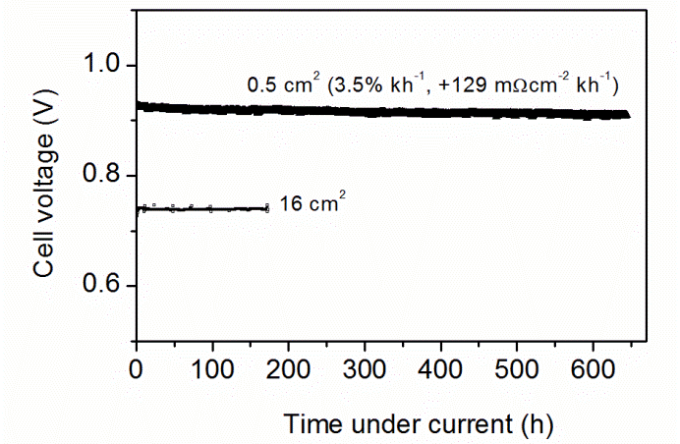
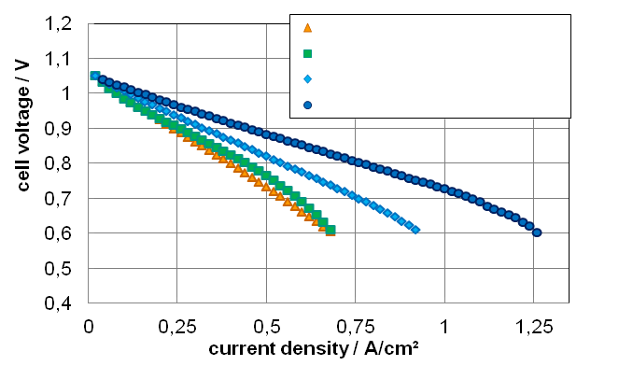
Cell performance and durability
Materials screening
anode infiltration A
anode infiltration B
anode infiltration C
anode infiltration D
STN/FeCr anode
Ni/CeO₂ nano infiltrated
Durability
(DTU)

Slide 11
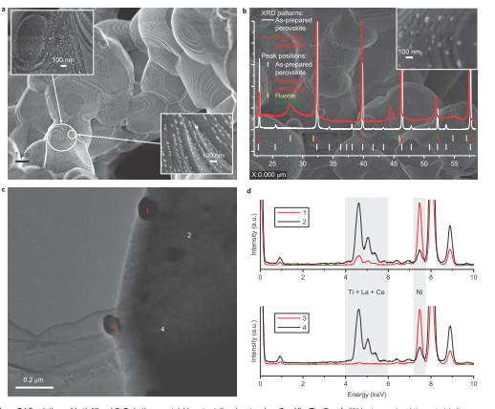
Break through in new anode materials
In situ growth of metal
nanoparticles
Exolution of both
Ni and CeO₂ nanoparticles
from
La_{0.8}Ce_{0.1}Ni_{0.4}Ti_{0.6}O₃
D. Neagu et al., In situ growth of
nanoparticles through control
of non-stoichiometry,
Nature Chemistry, October, 2013

Slide 12
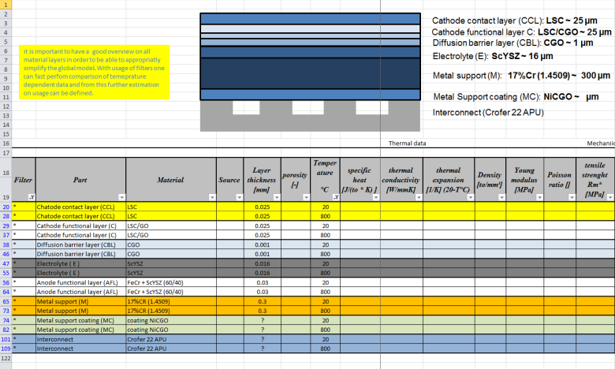
WP4 - Modelling, reliability and durability
WP4 – Tasks
4.1 Identification of material parameters
4.2 Electrochemical Modeling of MSCs
4.3 FEM-modelling and simulation of repeat units
4.4 FEM-modelling and simulation of internal reforming in MSCs
4.5 Failure mode identification and assessment
4.6 Failure mode model development
4.7 Development of accelerated test procedures
Material parameters identified and collected in an database (AVL)
Failure mode identification and prioritization.
  A total of 17 “high priority” failure modes have been identified.
  These modes are driven by 5 classes of damage drivers.
Notes:
12

Slide 13
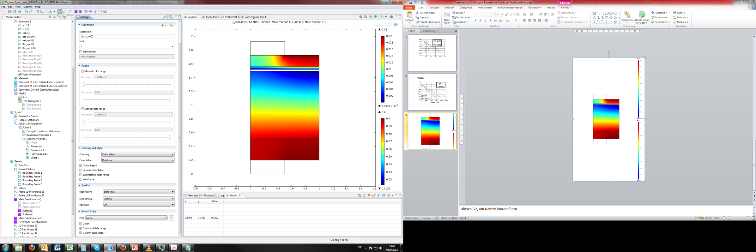
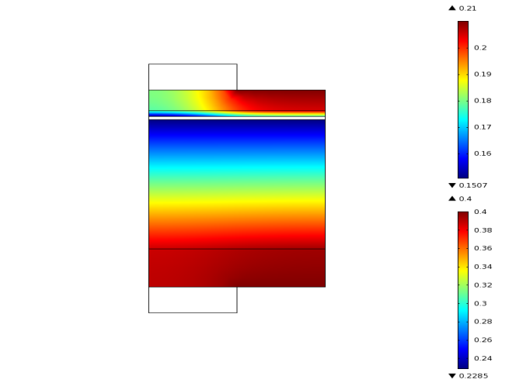

From fundamental modelling to stack design optimisation
FEM-modelling of stack repeat units
combined with detailed electrochemical model
0.02 atm
contact rib
gas channel
0.018
cathode
electrolyte
anode
cathode contact grid
pO_{2,cathode}
0.01
0.002
U_{cell} = 0.7 V
T = 800°C
1E-5 atm
0.40 atm
0.39
pH_{2,anode}
0.36
anode contact grid
0.32
(KIT)
contact rib
gas channel
0.31 atm

Slide 14
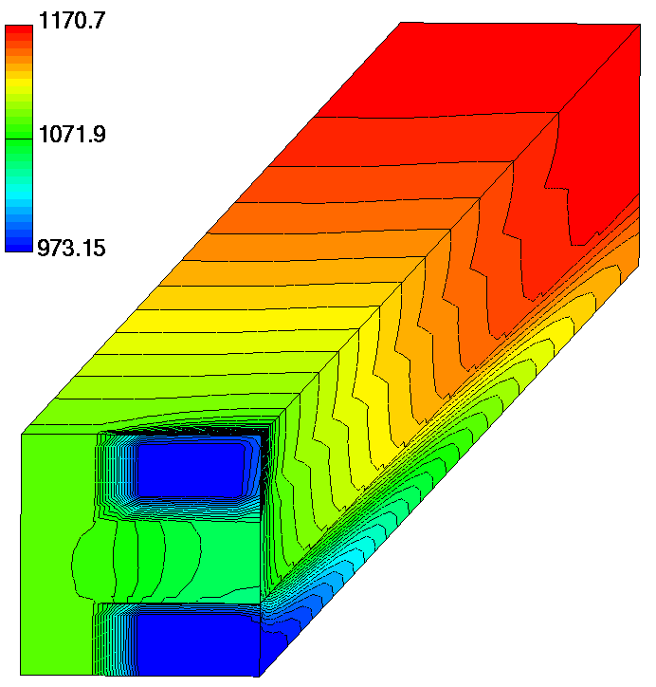
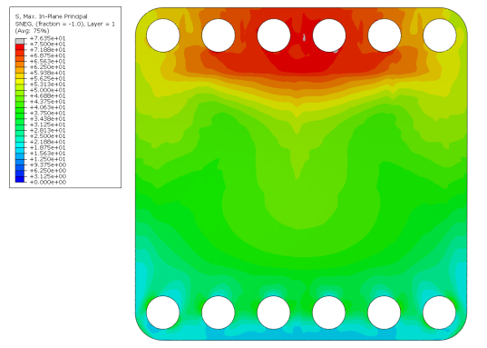
Critical failure modes
FEM-modelling and simulation of internal reforming
in metal supported cells
Determination of diffusion in anode (micro-structure).
Investigation of corrosion and influence on diffusion (in progress)
Next step: Understanding Creep of metal-support
Failure mode model development
Distribution of principal
mechanical stress in cell
Notes:
14

Slide 15
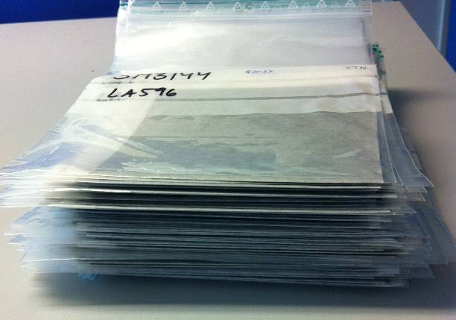
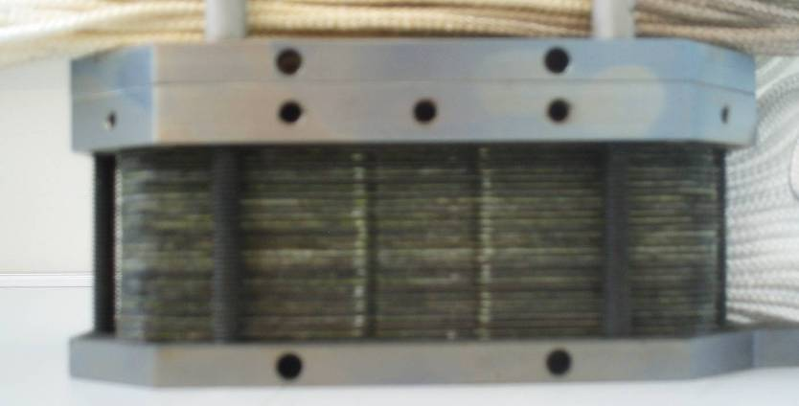
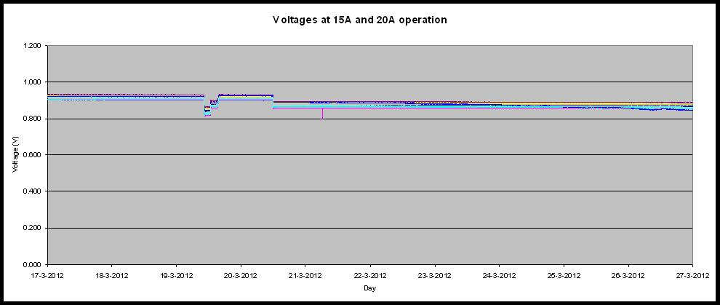
WP5 - Stack development
Cells
Stack conditioning procedure
leaky
short-circuiting
Too low compression…
More compression…
Too high compression
Stack
SoA cells, 250 hours
Correct procedure leads to stable operation and high performance

Slide 16
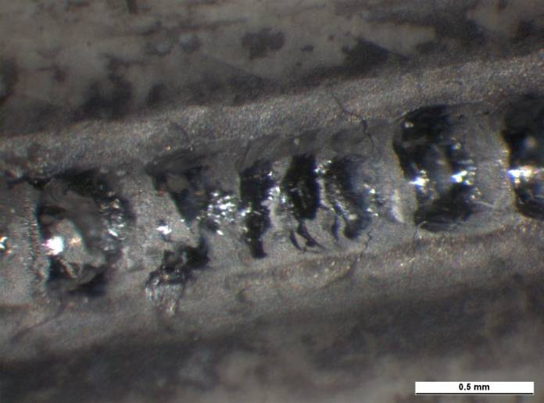
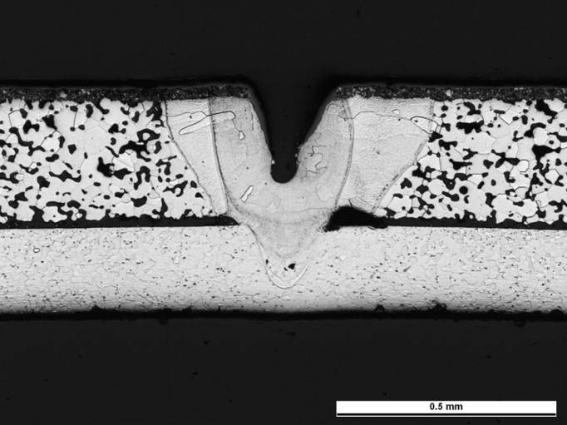
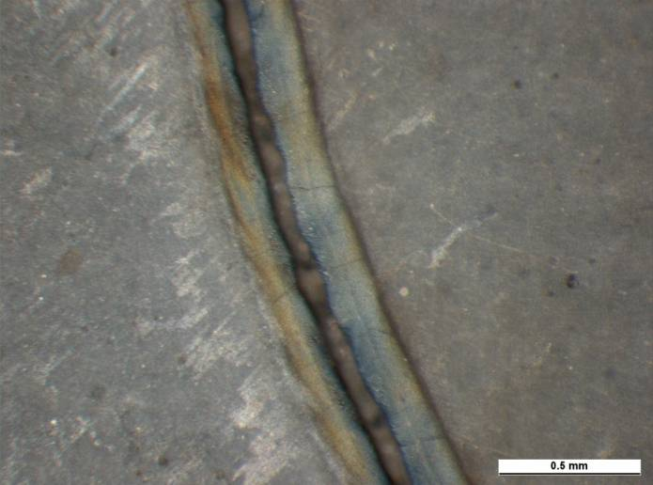
Laser welding of cells and stack components
Novel seal design
Weld in cross-section
Previous laser welding
Recent result with fiber laser
Target: Robust seal optimized for manufacturing

Slide 17
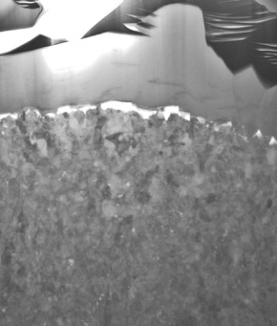
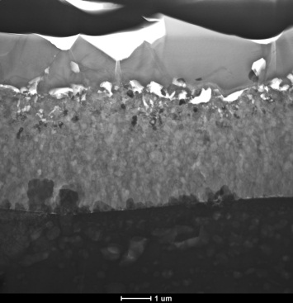
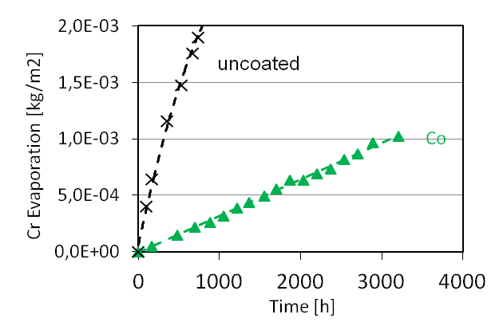
WP6 - Alloys and coatings
Metal interconnects need to be coated
640nm Co are sufficient to block Cr evaporation
10nm Ce coating reduces corrosion substantially
Co coated
Co/Ce coated
Accelerated test at 850°C in air + 3% H₂O
2µm
Less corrosion → longer lifetime
Thinner scale → lower ASR values

Slide 18
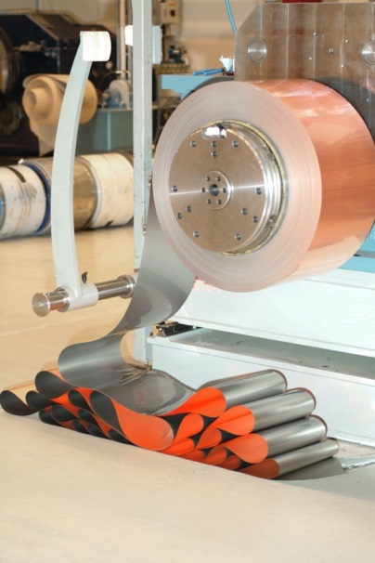
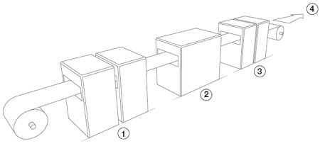
Upscaled PVD coating of strip steels
Novel cost effective coated interconnect concept
Large scale continuous thin film (PVD) coating production established at Sandvik (roll to roll process)

Slide 19
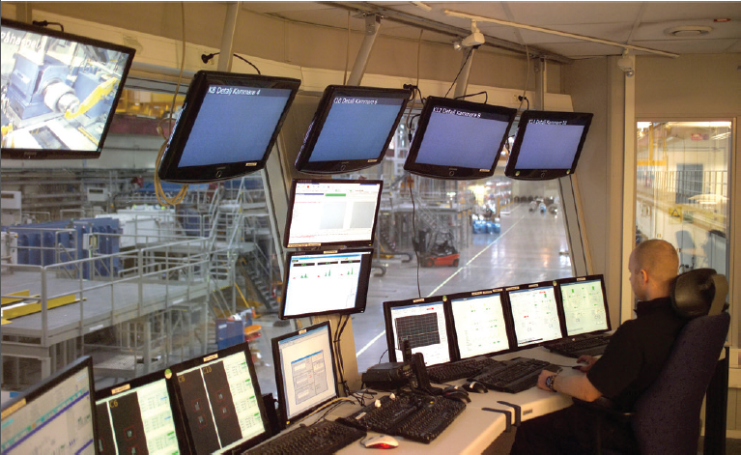

New industrial steels and coatings
Interconnectors for SOFC
  Specialized Steel – Sandvik SanergyHT
  Standard Ferritic Steel – AISI441, 430
  Continuous PVD Coatings
Bipolar plates for PEMFC
  Standard Steel – 316L, 304L
  Continuous PVD Coatings

Slide 20
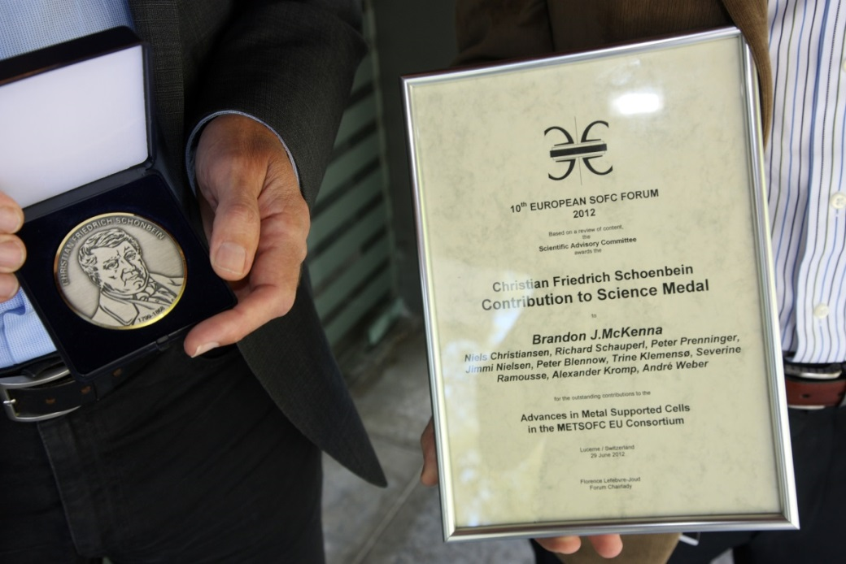
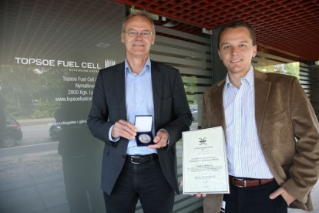
Dissimination & public awareness
10th European SOFC Forum 2012
Schoenbein Contribution to Science Medal 2012
D. Neagu et al.,
In situ growth of nanoparticles through control of non-stoichiometry,
Nature Chemistry, October, 2013
”For an outstanding contribution to:
Advances in Metal Supported Cells”

Slide 21
Cooperation and future perspectives
METSAPP
Cooperation
with other projects
MIEC
CGO
EuroFC-Life
ProSOFC
SCOTAS
METPROCELL
DESTA
ScYSZ
Ceramic- Infiltrate
FeCr
2012-2014
Demonstration network
established

