Slide 1

Program Review Days 2013
Introduction to R&D projects in Transport
Carlos Navas, Project Manager
http://www.fch-ju.eu/

Slide 2
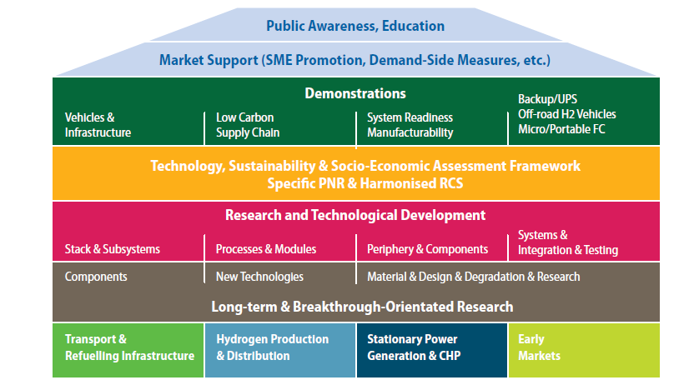
Multi-Annual Implementation Plan
2008 - 2013

Slide 3
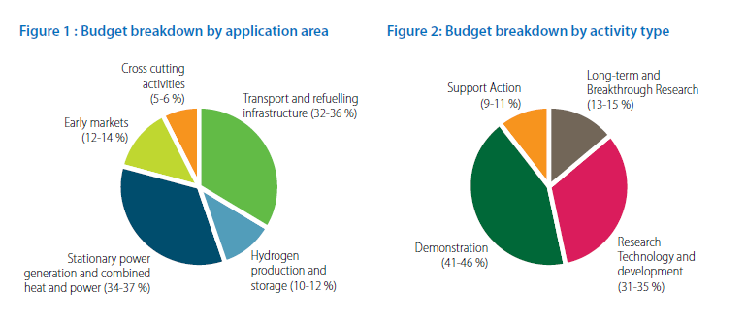
MAIP Objectives
  Budget distribution
Expected budget of 42.5M€
Covering:
Membranes
Catalysts
Bipolar Plates
Manufacturing and process development
Methodology and tools
System components
Advanced components for HRS

Slide 4
FCH JU Funding

Slide 5
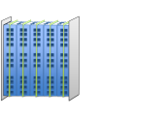

MAIP Coverage
MEA
9 projects
Modelling
1 project
Stack
2 projects
Advanced HRS
1 project
Bipolar Plates
2 projects
H₂ Storage
2 projects
H₂

Slide 6
FCH JU Funding Breakdown
Total FCH JU support = 44.8M€
for 17 projects

Slide 7
MAIP coverage
 | MEA |  |  |  |  |  |  |  |  | Bipolar Plates |  | Stack & Subsystems |  | Modelling & Simulation | H2 storage |  | HRS
MAIP R&D areas | PEMICAN | ARTEMIS | CATHCAT | IMMEDIATE | IMPACT | IMPALA | CATAPULT | SMARTCAT | NANOCAT | STAMPEM | COBRA | AUTOSTACK | AUTOSTACK-CORE | PUMAMIND | SSH2S | COPERNIC | PHAEDRUS
Membranes | X | X | X | X | X |  |  | X |  |  |  | X | X
Catalysts | X | X | X | X | X |  | X | X | X |  |  | X | X
GDL* |  |  |  | X | X | X |  |  |  |  |  | X | X
Bipolar plates |  |  |  |  |  |  |  |  |  | X | X | X | X
Manufacturing & process development |  |  |  |  |  |  |  |  |  | X |  | X | X |  |  | X
Methodology & Tools | X | X |  |  | X | X | X |  |  |  |  |  |  | X
BoP components |  |  |  |  |  |  |  |  |  |  |  |  |  |  | X | X
HRS (adv.) |  |  |  |  |  |  |  |  |  |  |  |  |  |  |  |  | X
* Not identified in the MAIP

Slide 8
Achievements & Status (1)
  MEAs
PEMICAN
ARTEMIS
IMPACT
IMMEDIATE
IMPALA
CATHCAT
CATAPULT
NANOCAT
SMARTCAT
2010
2011
2012
2013
2014
2015
2016
1. Broad range of approaches for membranes, catalysts and GDL
2. Bulk of results to come later

Slide 9
Achievements & Status (2)
  Bipolar Plates & Stack
STAMPEM
Technical targets to date (ICR and corrosion) reached
COBRA
Under negotiation
AUTOSTACK
Concept dev.
AUTOSTACK
- CORE
Stack development
2010
2011
2012
2013
2014
2015
2016
Advanced coatings for metallic BPs
Development of EU stack platform

Slide 10
Achievements & Status (3)
  Modelling, Storage and HRS
PUMAMIND
SSH2S
4.5 wt% H₂- stable cycling w/ hydrides
COPERNIC
Improve manufacturing & reduce costs (cylinders)
PHAEDRUS
Functionality of all components proven
2010
2011
2012
2013
2014
2015
2016
Cell level modelling
Both solid state & CGH2
Electrochemical compression + PEM electrolysis + advanced dispensers

Slide 11
Conclusions: R&D in Transport
Comprehensive level of MAIP coverage:
  All areas identified receive funding
  Level of support in line with expectations
Strong focus on FC components (MEA, BP)
R&D supported mostly in calls 2011 & 2012 (74% of total)
  Bulk of impact to come 2015+

Slide 12
Thank you for your attention!
Further info:
FCH JU: http://fch-ju.eu
NEW-IG: http://www.new-ig.eu
N.ERGHY: http://www.nerghy.eu

