Slide 1
H2moves Scandinavia
Lighthouse Project for the Demonstration of Hydrogen Fuel Cell Vehicles and Refuelling Infrastructure in Scandinavia
Grant agreement number 245101
Dr. Ulrich Bünger
Ludwig-Bölkow-Systemtechnik GmbH

Slide 2
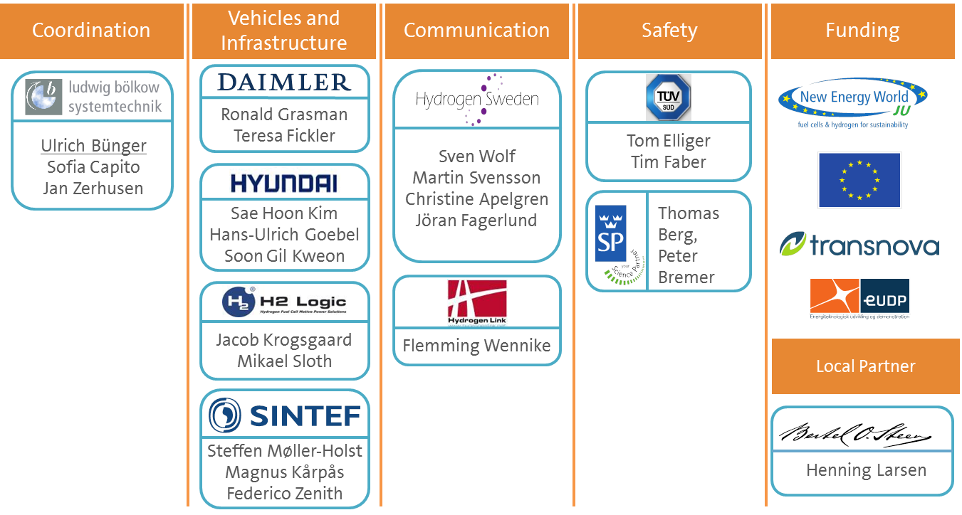
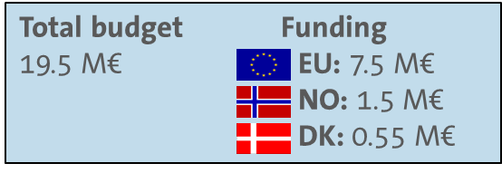
H2moves Scandinavia
0. Project & Partnership description
  European Lighthouse Project for the Demonstration of Hydrogen Fuel Cell Vehicles and Refuelling Infrastructure in Scandinavia
  01/2010 – 12/2012

Slide 3
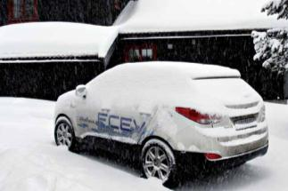
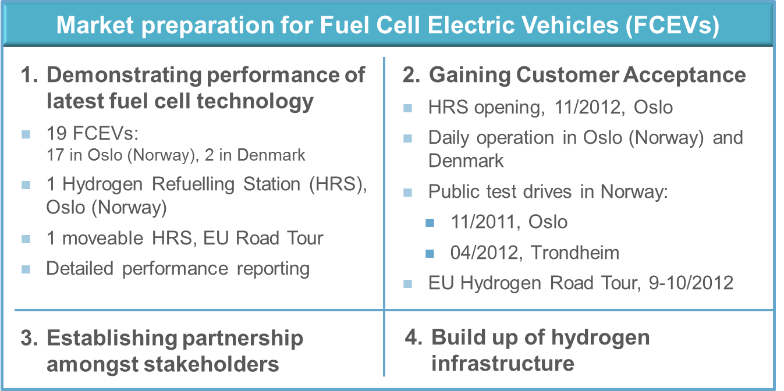
H2moves Scandinavia
1. Achievements overview

Slide 4
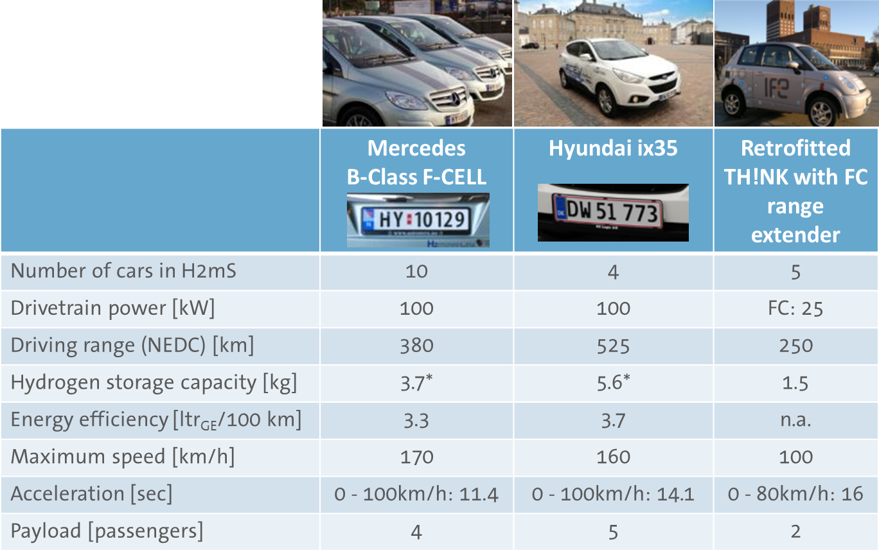
H2moves Scandinavia
1. FCEVs in daily operation since 11/2011
* about 1kg_{H2}/100 km

Slide 5
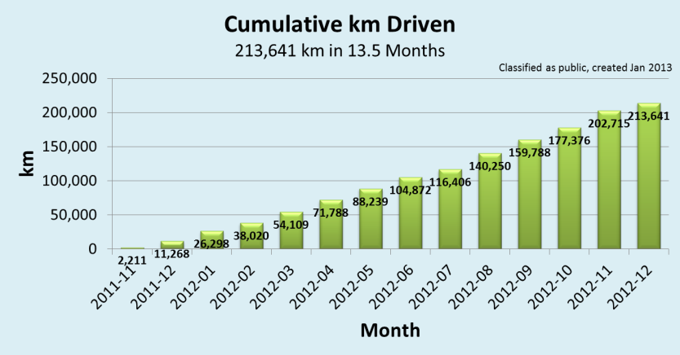
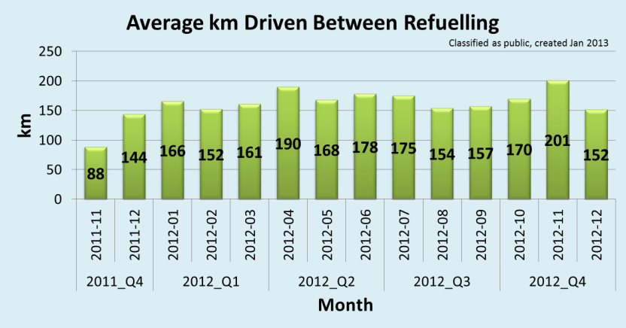
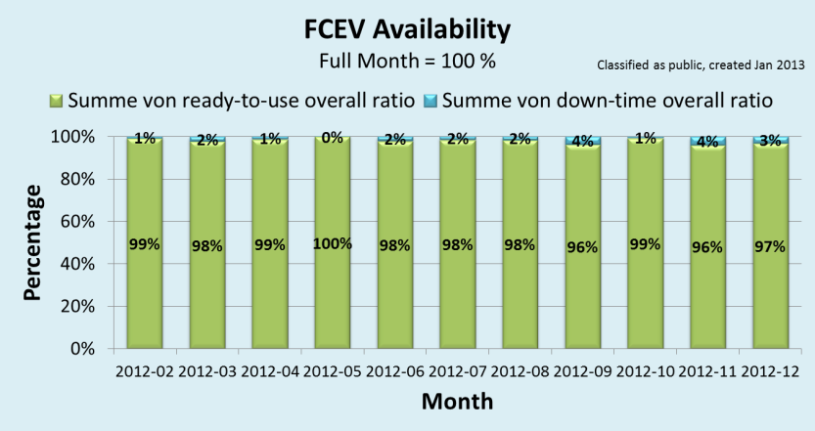
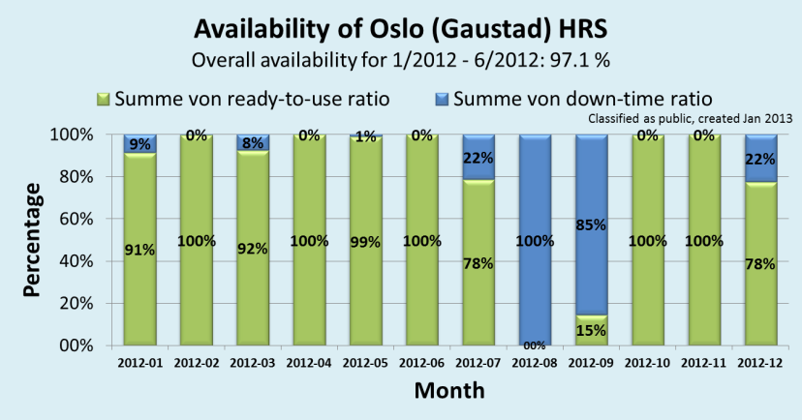
H2moves Scandinavia
1. FCEV and HRS demonstration results
FCEVs drove around the world more than five times. Savings of about 24.5 tons CO2 equivalent.
Decreasing range anxiety:
128 km ➔ 160 - 180 km
Excellent performance: 98% overall availability.
Downtime due to compressor failure. Overall 79 % availability between 1.1.2012 – 31.12.2012.

Slide 6
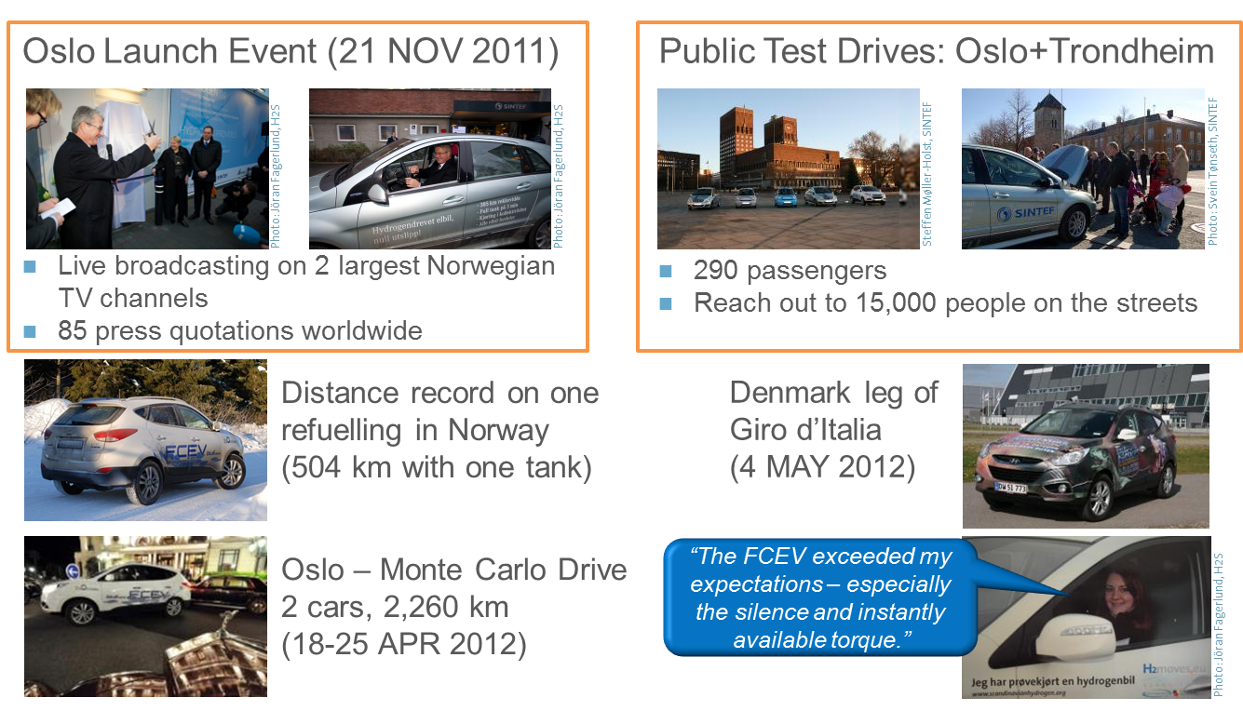
H2moves Scandinavia
1. Public events to gain customer acceptance

Slide 7
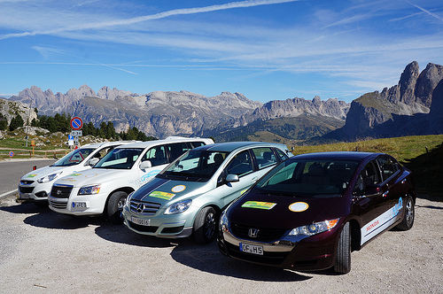
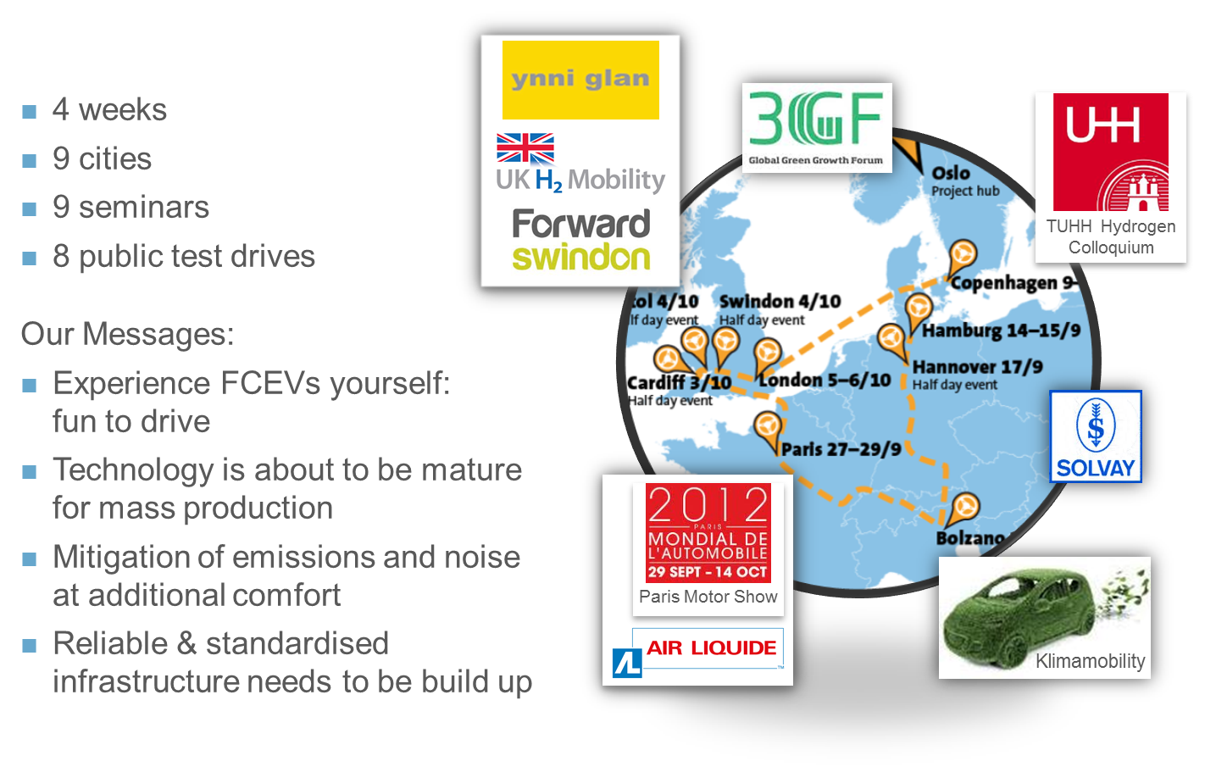
H2moves Scandinavia
1. EU Road Tour to gain customer acceptance

Slide 8
H2moves Scandinavia
1. European Hydrogen Road Tour 2012
 | Hamburg | Hannover | Bolzano | Paris | Cardiff | Bristol | Swindon | London | Copenhagen | Total
Workshop | X | X | X |  | X | X | X | X | X | 8
Participants: VIP event Public event Total | 40 130 170 | 80 - 80 | 140 900 1040 | 40 850 890 | 50 100 150 | 20 - 20 | 50 150 200 | 50 200 250 | 140 110 250 | 610 2440 3050
Panel discussion | X | X | X | X | X |  | X | X |  | 7
VIP testdrive | X | X | X | X | X | X | X | X | X | 9
Testdrive | X | X | X | X | X | X | X | X | X | 9
Ride &Drive: Drivers Riders Total | 59 60 119 | 39 30 69 | 312 300 612 | 112 74 186 | 21 14 35 | 18 10 28 | 29 20 49 | 48 46 92 | 82 26 108 | 720 580 1300
Refuelling* | HRS | MHRS |  | MHRS |  |  | HRS |  | MHRS
Press event |  | X | X | X | X | X | X | X | X | 8
H2mS presentation | X | X | X | X | X | X | X | X | X | 9
Video | X | X | X | X | X | X | X | X | X | 9
Other |  |  | Dolomite Rally | Invisible car |  |  |  |  | MoU
8 workshops
with
3,050 participants
7 panel discussions
9 test drives
with
1,300 drivers
8 press events
9 presentations
9 videos
* HRS – stationary hydrogen refuelling station, MHRS – moveable hydrogen refuelling station (H2 Logic: Hannover, Copenhagen, Air Liquide: Paris)

Slide 9
H2moves Scandinavia
1. Alignment to MAIP/AIP
  Targets Application Area “AA1 - Transportation and Infrastructure”:
  - 2010: ~10 additional road vehicles (single site) plus mobile deployment to sites
  with existing refuelling infrastructure capable of refuelling up to 50 vehicles
  - 2015: ~ 500 LDVs (mainly cars) at 3 additional sites with 3 new stations
  AIP 2008 Call text: “At least 5 vehicles shall be provided and be operational for onsite demonstration by 2010 accompanied by at least one additional fully integrated filling station capable of serving 100 vehicles (together with the existing station). ”
  ➔H2mS: 17+2 FCEVs in 1(2) sites with existing hydrogen refuelling station with
  additional refuelling station capable of refuelling up to 50 vehicles. Solid
  overperformance of H2mS!

Slide 10
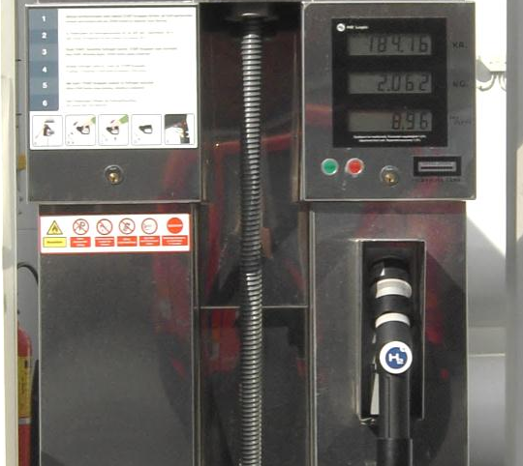
H2moves Scandinavia
1. Alignment to MAIP/AIP
  AIP 2009 targets:
  - Total cost fuel cell system < 100 €/kW ü achievable in long-term
  - System lifetime > 5,000 h ü expected this generation*
  - Refuelling time < 5 min ü YES, <4 min achieved
  - Hydrogen price at pump < 13 €/kg ü price: ca. 12€, cost: NO
  - Demo of at least 10 vehicles at 1 demo site ü YES, achieved for OSL
  - HRS functionality and end-user acceptance ü YES (WP 7)
  - Certification procedures ü YES (WP 2)
  - Regional collaboration ü Transnova (NO) EUDP (DK)
  - Role of MSMs/SMEs ü through H2 Logic
  - Raise public awareness (expect. mgmt.) ü EU Road Tour, test drives
*6,000 hrs achieved in lab under real life cycle;
demo vehicles seem to validate lab tests

Slide 11
H2moves Scandinavia
1. Gaps / bottlenecks
  Slow start, project suffered massively from difficult pioneering role (other causes were economic crises and BEV hype)
  Project negotiation too slow and bureaucratic (national processes much simpler, spec. in Scandinavia)
  Funding of service type activities unattractive (coordination/management, communication, performance reporting)
  AND
  FCH JU funds were welcome and – together with national funds – helped to sustain the momentum in FC&H when losing a strategic industry partner

Slide 12
H2moves Scandinavia
1. Cross-cutting issues
  Contributions to Training and Education:
    Workshop staff from Daimler, Hyundai, and SINTEF trained
    Pupils and students attended public seminars and events including test drives
  Contributions to RCS:
    Assessment of state of the art of Scandinavian certification procedures for FCEVs and HRSs
  Contribution to Dissemination & public awareness:
    European Hydrogen Road Tour 2012
    Test drives in Oslo and Trondheim (Norway)
    Record drive Oslo-Monaco, participation in Giro d’Italia and EcoDolomites
  Publications and presentations:
    Zero Conference, Oslo, November 2011
    Renewable Energy Conference RERC, Trondheim, April 2012
    WHEC, Toronto, Juni 2012
    4th Austrian Hydrogen Conference, Graz, September 2012
    Scandinavian Delegation to South Korea October 2012

Slide 13
H2moves Scandinavia
2. Next-Generation Hydrogen Refuelling Stations
  Fuel quality assurance
    Hydrogen quality standards for PEMFC-grade H₂ are extremely stringent
    No laboratory in Europe can guarantee that accuracy!
    Find easily measured "canary components" that allow inferring concentration of
    more difficult ones, considering information about each production method
    Result: easier, cheaper and faster fuel quality assurance
  Smart hydrogen production from electrolysis
    Electricity prices vary widely in yearly, weekly and daily cycles
    With expansion of wind power, oscillations will grow even larger
    Result: optimal strategy to produce hydrogen by electrolysis in electricity market
  Finding hydrogen stations
    With few refuelling stations, finding them may be a problem for consumers
    Position of mobile stations and status of fixed stations must be available
    Most people have a mobile phone, many a smartphone with GPS
    Result: smartphone apps, Web maps, and SMS service to find nearest H₂ station

Slide 14
H2moves Scandinavia
2. Enhancing cooperation
SHHP/HyNOR: Collaboration among Scandinavian stakeholders
HyTEC: Exchange of best practice between lighthouse projects
EU Hydrogen Road Tour
  Joint facilitation in Hamburg (CEP) and Lower Saxony, South Tyrol (IIT), France, UK (e.g. Unni Glan, Forward Swindon, LHP), Denmark
  Firm statements by each region visited to extend its hydrogen refuelling network
South Korean company Hyundai is equal partner within H2moves Scandinavia
HyER: Facilitation of mid-term event and public test drive in Brussels

Slide 15
H2moves Scandinavia
2. Project future perspectives and advice to FCH-JU
Vehicle demonstration phase is continuing beyond project well into 2014.
HyOP continuing operation of Gaustad hydrogen refuelling station.
Project has helped to keep momentum on H2&FC in Scandinavia in challenging phase (economic crisis, industry leaving, distraction by BEVs).
Project start was bumpy for uncontrollable reasons. Yet, the project has substantially outperformed even at a reduced total budget of ≈ -25%.
Foster regional co-funding
Simplify administrative burdens
Better utilize project results :
  HRS APP has been developed but finds no echo at program level
  Develop instruments for better dissemination of project results after project end
Network among individual demonstration projects (utilize HyLights)

Slide 16
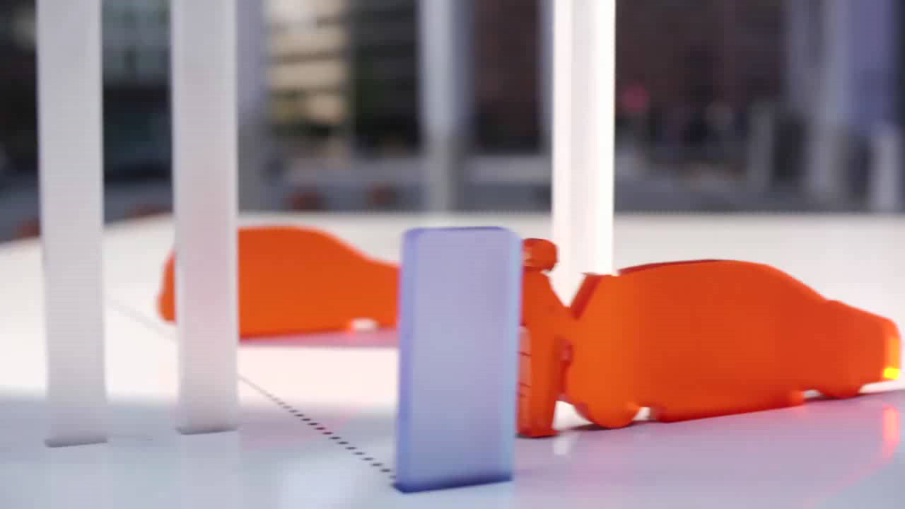
H2moves Scandinavia
2. Project future perspectives and advice

Slide 17
3. Useful References
H2moves Scandinavia – Public Technical Performance Report http://tinyurl.com/h2mS-Report
Official website: http://www.scandinavianhydrogen.org/h2moves
Videos on YouTube: http://www.youtube.com/user/H2movesScandinavia
Photos on Flickr: http://www.flickr.com/photos/h2moves_scandinavia
Facebook: http://www.facebook.com/H2movesScandinavia

