Slide 1
Programme
Review
Days 2017
Mirela Atanasiu
PRD 2017
23-24 November 2017

Slide 2
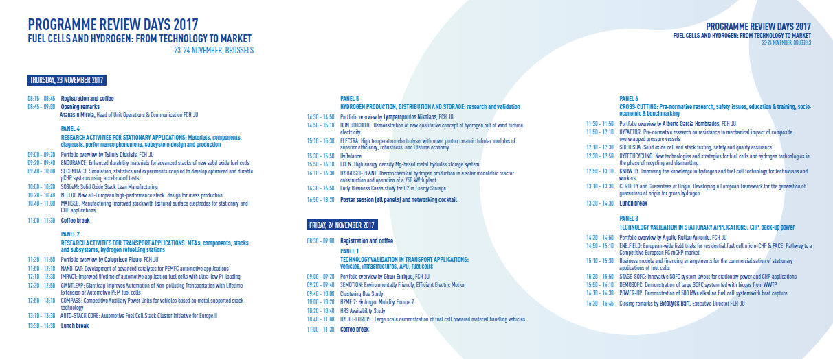

Agenda

Slide 3

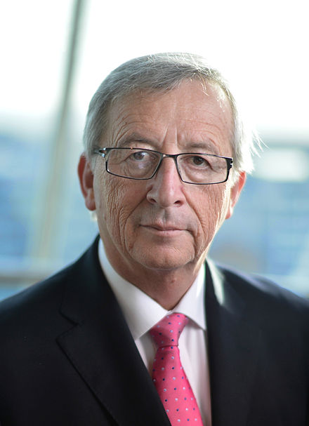

EU Climate and Energy Framework
Making energy more secure, affordable and sustainable
Jean-Claude Junker
President of the European Commission
“I want to reform and reorganise Europe’s energy policy in a new European Energy Union”
80-95% CO₂ reduction
40% CO₂ reduction
27% Renewables
27% Energy Eff
Energy Union dimensions
20% CO₂ reduction
20% Renewables
20% Energy Eff.
Security, solidarity and trust
Fully-integrated Internal Energy Market
Energy Efficiency
Climate action - decarbonising the economy
Research, innovation and competitiveness
2020
2030
2050
Notes:
The EU's energy union strategy is made up of five closely related and mutually reinforcing dimensions.
Security, solidarity and trust
Diversifying Europe's sources of energy and ensuring energy security through solidarity and cooperation between Member States.
A fully-integrated internal energy market
Enabling a free flow of energy throughout the EU through adequate infrastructure and without any technical or regulatory barriers – an efficient way to secure supply and give consumers the best energy deal.
Energy efficiency
Energy efficiency first - improved energy efficiency will reduce our dependence on energy imports, reduce emissions and drive jobs and growth.
Climate action - decarbonising the economy
An ambitious climate policy is integral to creating the Energy Union. Actions include the EU Emissions Trading System (EU ETS), strong but fair national targets for sectors outside the ETS to cut greenhouse gas emissions, a roadmap towards low-emission mobility and an energy policy which makes the EU world leader in renewables. The EU is committed to a quick ratification of the Paris Agreement, an ambitious new global climate change agreement approved in Paris in December 2015.
Research, innovation and competitiveness
Supporting breakthroughs in low-carbon and clean energy technologies by prioritising research and innovation to drive the transition of the energy system and improve competitiveness.

Slide 4



Strong public-private partnership with a focused objective
EU Institutional Public-Private Partnership (IPPP)
Fuel Cells & Hydrogen Joint Undertaking (FCH 2 JU)
Industry grouping
More than 130 members
50% SME
Research grouping
over 60 members
To implement an optimal research and innovation programme to bring FCH technologies
to the point of market readiness by 2020
Notes:
The Fuel Cells and Hydrogen Joint Undertaking (FCH JU) is a unique public private partnership supporting research, technological development and demonstration (RTD) activities in fuel cell and hydrogen energy technologies in Europe.
Its aim is to accelerate the market introduction of these technologies, realising their potential as an instrument in achieving a carbon-lean energy system.
The three members of the FCH JU are the EU (represented by the European Commission), fuel cell and hydrogen industries represented by Hydrogen Europe and the research community represented by Hydrogen Europe Research.

Slide 5


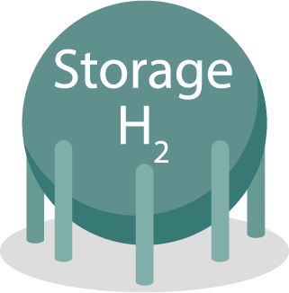












The hydrogen economy
Fuel cells, as an efficient conversion technology & Hydrogen, as a clean energy carrier
NG
Notes:
Fuel cells, as an efficient conversion technology & Hydrogen, as a clean energy carrier to reduce CO2 emissions, to reduce dependence on hydrocarbons and to contribute to economic growth, through a concentrated effort from all sectors for the benefit of all European citizens.

Slide 6


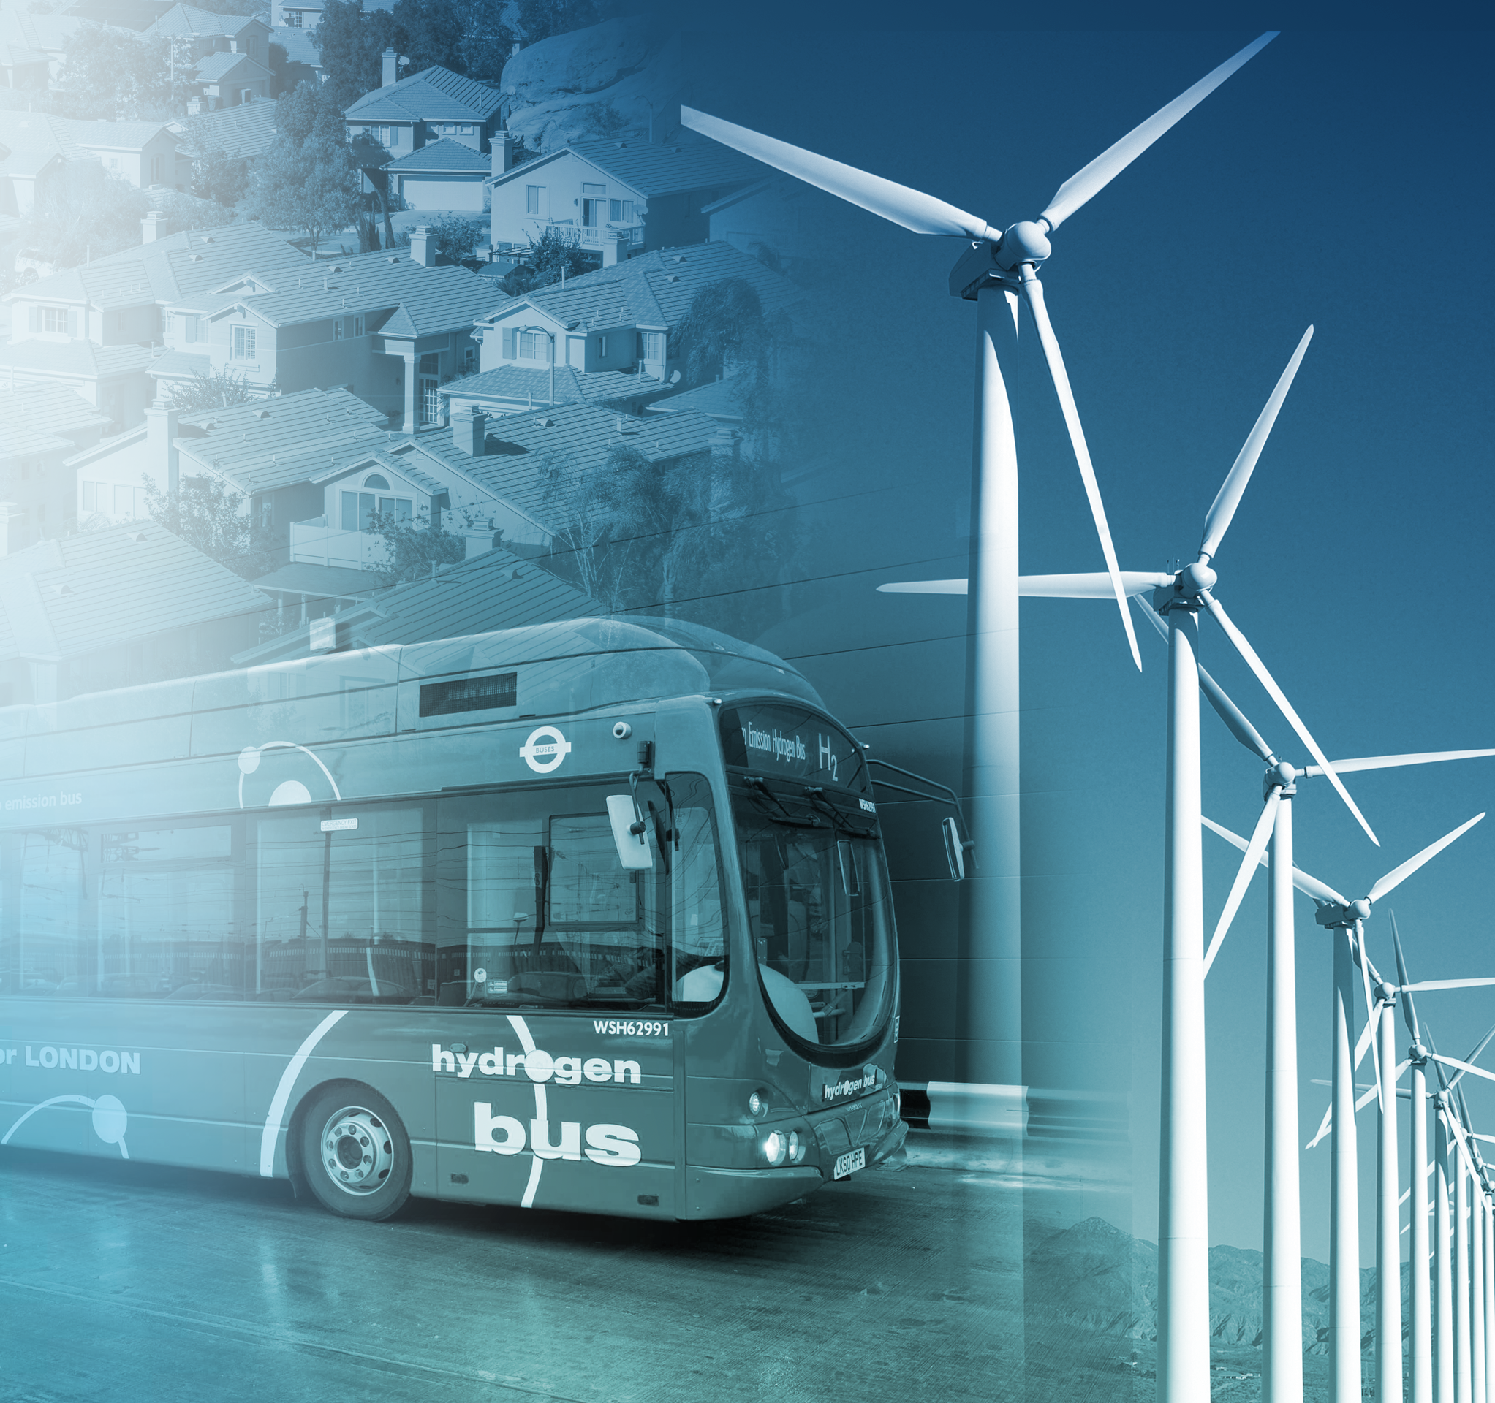



FCH 2 JU Objectives
Market readiness of a portfolio of clean, efficient and affordable solutions for our energy and transport systems
Clean Transport
Reduce fuel cell system costs for transport applications
H₂ storage for grid balancing
Demonstrate on a large-scale hydrogen’s capacity to harness power from renewables and support its integration into the energy system
Green hydrogen production
Increase efficiency and reduce costs of hydrogen production, mainly from water electrolysis and renewables
Minimal use of critical raw materials
Reduce platinum loading
Heat & electricity production
Increase fuel cell efficiency and lifetime
Notes:
(COUNCIL REGULATION (EU) No 559/2014 of 6 May 2014 establishing the FCH 2 JU)
The FCH 2 JU shall have as strategic objective to demonstrate by 2020 fuel cell and hydrogen technologies as one of the pillars of future European energy and transport systems, making a valued contribution to the transformation to a low carbon economy by 2050.
Vision 2020
To develop by 2020 to the point of market readiness a portfolio of clean, efficient and affordable solutions that fully demonstrate the potential of H2 as an energy carrier and fuel cell as energy convertor, as part of an energy system that integrates sustainable solutions and energy supplies with low carbon stationary and transport technologies.

Slide 7
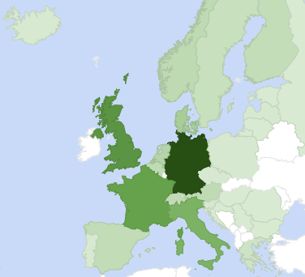

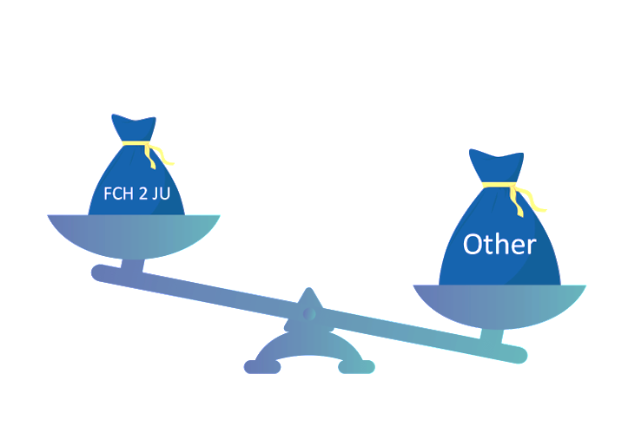



Attracting investment from industry and research
203 projects, 730 M€ public support, on both research and innovation activities
CSA
730
779
FCH JU Funding
IA
*
RIA
Million €
No. projects, M€
0
190 M€
* Other resources including private and national/regional funding
RIA=Research and Innovation action
IA=Innovation actions
CSA=Coordination and Support action
Notes:
Numbers verified by Knowledge Management team on 15/11/2017

Slide 8
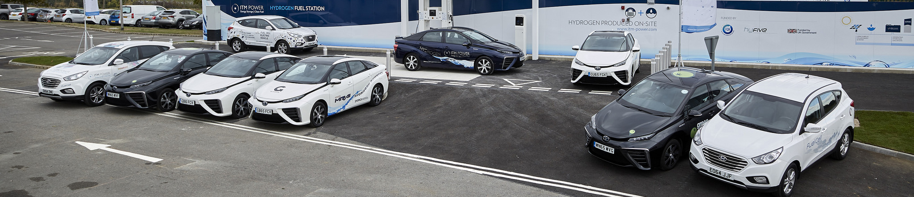
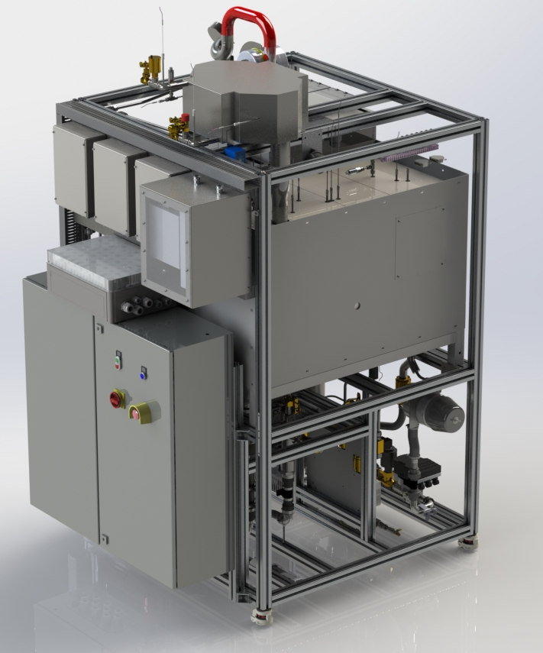
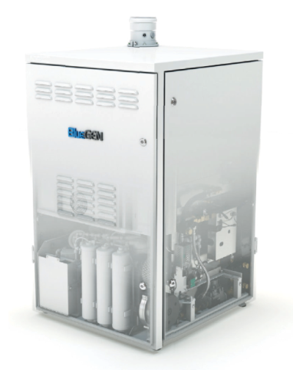
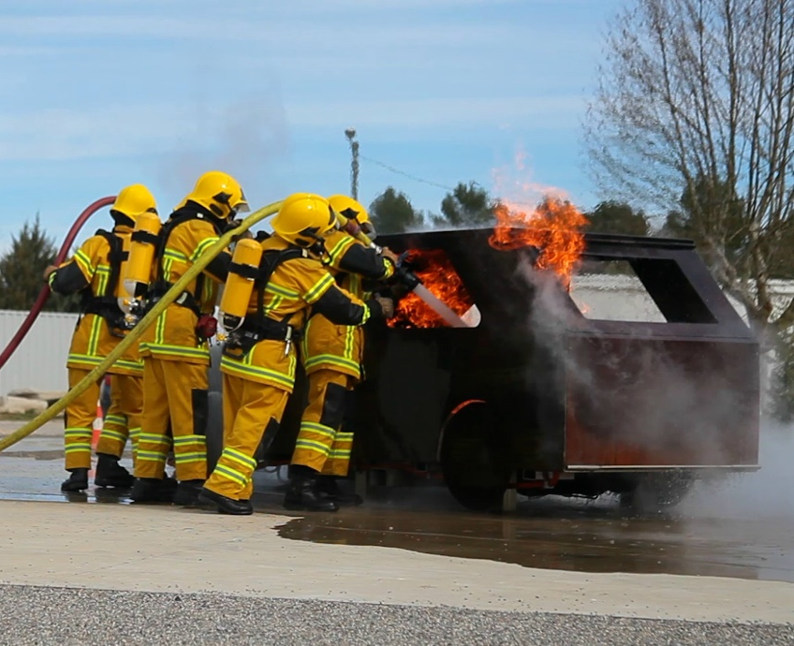
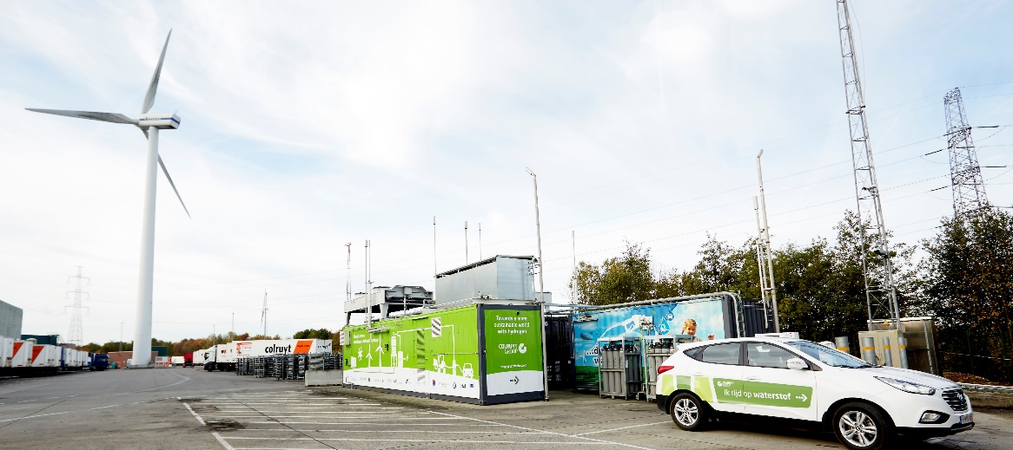
Complex portfolio of projects
From research to validation and field demonstration
Cross-
cutting
Panel 1 - Technology validation in transport applications
Panel 2 - Research activities for transport applications
Panel 3 - Technology validation in stationary applications
Panel 4 - Research activities for stationary applications
Panel 5 - Hydrogen production,
distribution and storage: research and validation
Panel 6 - Cross-cutting
    E N E R G Y
    T R A N S P O R T
203 projects
730 M€
Notes:
Numbers 203/730 verified by KM on 15/11/2017

Slide 9
Annual Programme Review 2017
Exceptional effort of a team of more than 100 projects consortia, JRC and Programme Office
Performed on the basis of the projects funded by the programme and carried out by external experts (by JRC as of 2017);
Analysis of a selected portfolio of projects, mainly those ongoing during June-October of the previous year (2016) against targets and Key Performance Indicators set by the Multi-Annual Work-Plan (MAWP) and Annual Work-Plans (AWPs);
Collection of annual input from projects, in addition to contractual documents and project reports; parallel exercise of annual data collection (dedicated templates in internal database TRUST); project posters also in exhibition;
Important effort of team of project officers and knowledge management to validate, clean and analyse/extract data for publication; however, substantial amount of data still confidential;
Great support from JRC colleagues in reviewing the portfolio and provide state-of-art data; HIAD database renamed;
Final report (around February 2018)

Slide 10



Mirela Atanasiu
Head of Unit – Operations and Communication
Mirela.Atanasiu@fch.europa.eu
For further information
www.fch.europa.eu
www.hydrogeneurope.eu
www.nerghy.eu
@fch_ju
Fch-ju@fch.europa.eu
FCH JU

