Slide 1

Programme Review Day
Brussels, 11/12 Nov 2013
Evaluating the Performance of Fuel Cells in European Energy Supply Grids
FC-EuroGrid
Contract number FCH JU 256810
Robert Steinberger-Wilckens
University of Birmingham

Slide 2
Project data
  duration 01.10.2010 – 31.12.2012
  total budget 805.931 €, funding 588.982 € (73%)
  The consortium consisted of 9 partners:
  University of Birmingham (UK) (coordinator)
  Forschungszentrum Jülich (DE)
  European Institute for Energy Research EIfER (FR/DE)
  E.ON Ruhrgas/E.ON NBT (DE) Grontmij AB (SE)
  Teknologian tutkimuskeskus VTT (FI) ENEA (IT)
  Institute of Power Engineering IEn (PL) EBZ GmbH (DE)
Notes:
2

Slide 3
Problem addressed
  MAIP builds on contributing to the 20-20-20 goals of the EU
  nevertheless, MAIP (and AIP) give no indications in AA 3 as to the minimum performance stationary fuel cells have to deliver in order to support the EU goals of increasing energy efficiency and reducing GHG emissions
  minimum KPI achievement should be required to achieve funding
  stationary fuel cell performance has to match and surpass CHP requirements
Notes:
3

Slide 4
Project Goals
  establish a methodology of assessment of stationary fuel cell environmental benefits in various electricity grid surroundings
  identify useful indicators, such as
  - amount of CO₂ avoided
  - amount of fossil energy avoided or substituted
  - total and electrical efficiency
  map the environmental benefits according to the electricity grid the installation is situated in
  identify gaps in the current development status and assess status in comparison with competing technologies
Notes:
4

Slide 5
Input Data: Power Generation
  Database of system data
Notes:
5

Slide 6
Input Data: Indicators
  Database of indicators: Structure
Notes:
6

Slide 7
Input Data: Fuel Use in Power Generation
  Database of indicators:
  fuels in electricity generation
Notes:
7

Slide 8
Benchmarking Approach
reference systems:
Single Family Home (SFH)
Multi Family Home (MFH)
- Calculation of system performance with 1-hour time steps
Comparison of key figures of merit
* system CO₂ emission
* primary energy use
* electrical and total efficiency
different operating strategies: (1) heat & (2) electricity following,
(3) economic optimisation
different CHP technologies: Stirling, ICE, PEFC, SOFC
Notes:
8

Slide 9
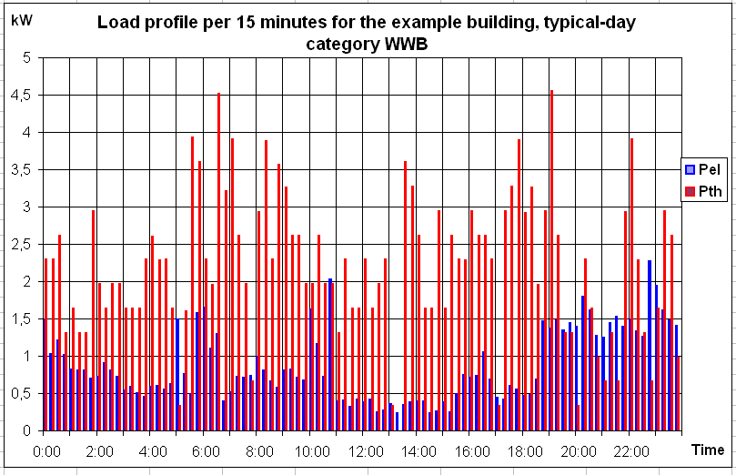
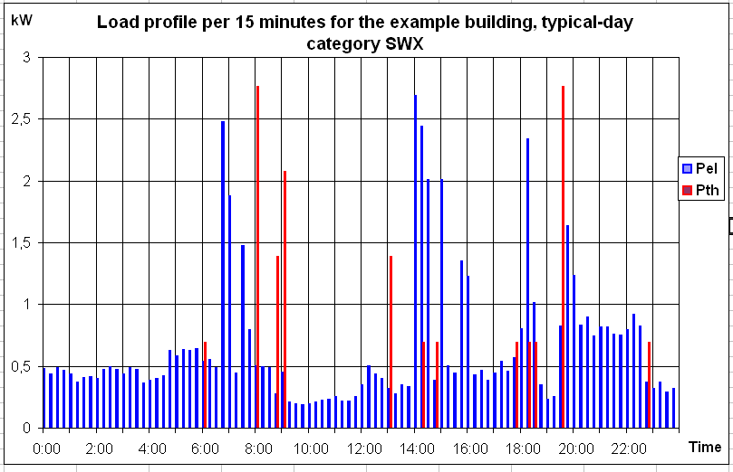
Simulation Calculations
  calculation of FC performance under ‘real’ operating conditions
winter workday (cloudy)
summer workday
Notes:
9

Slide 10
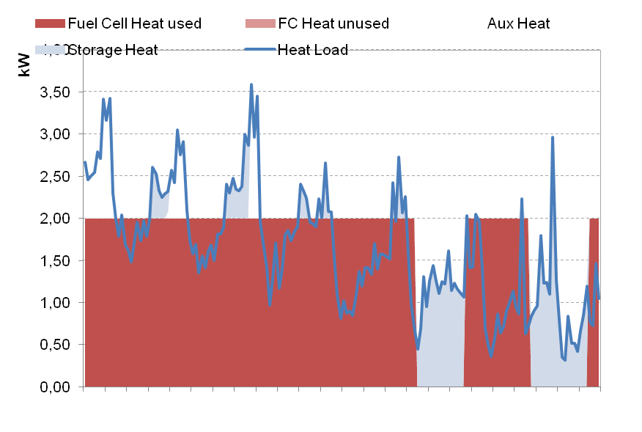
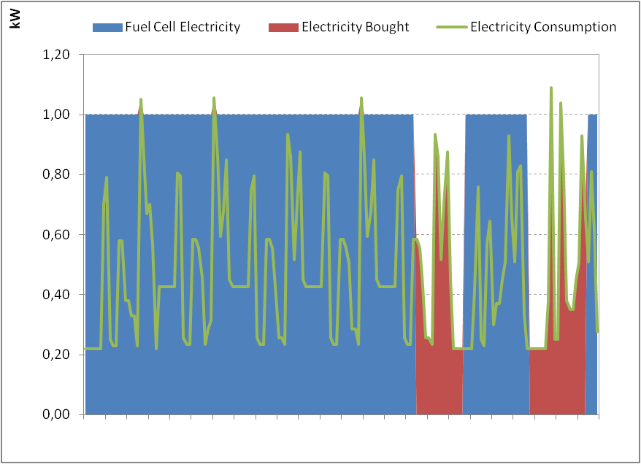
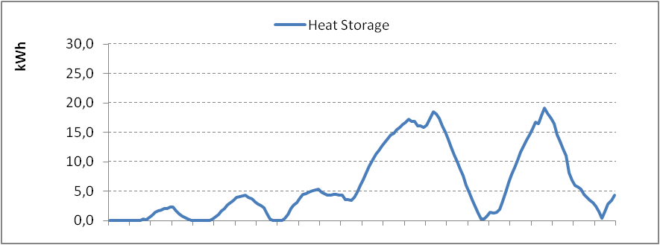
Simulation Examples
Notes:
10

Slide 11
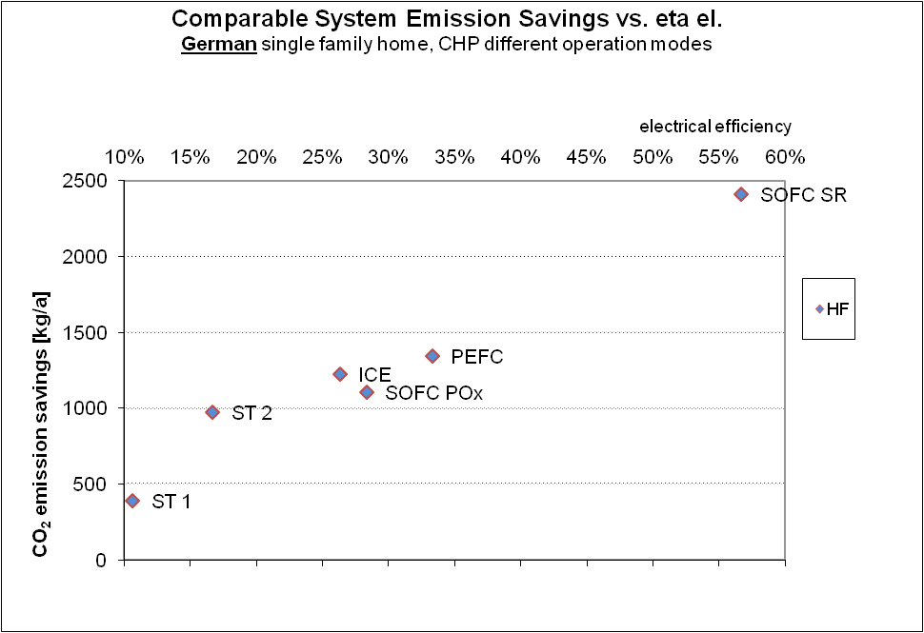
Project results
Notes:
11

Slide 12
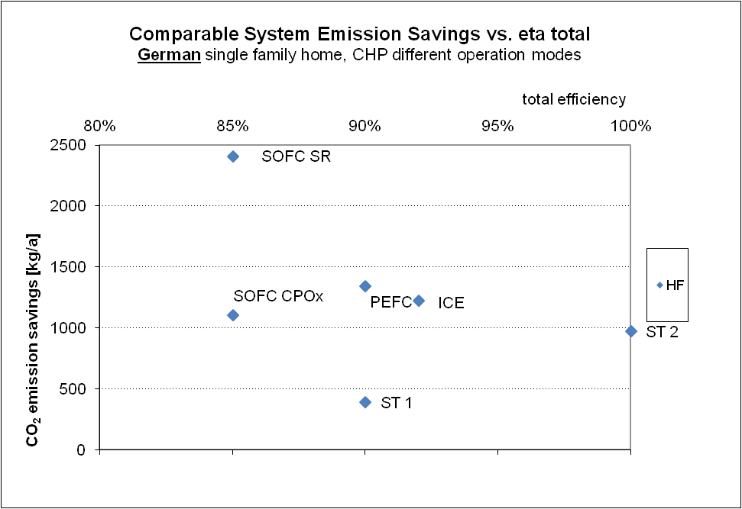
Project results (5)

Slide 13
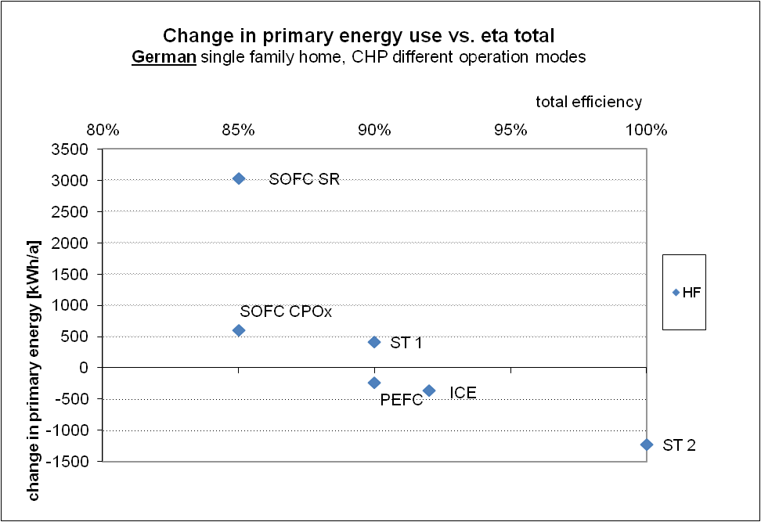
Project results (2)
Notes:
13

Slide 14
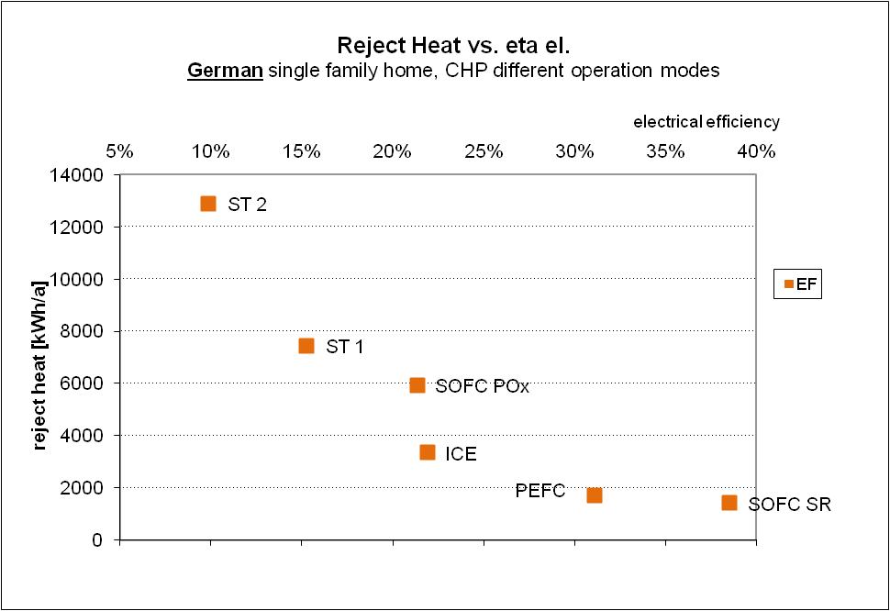
Project results (3)
Notes:
14

Slide 15
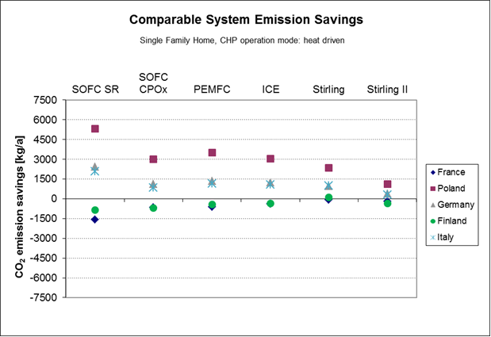
Project results (4)
g/kWh
90
730
563
176
448
Notes:
15

Slide 16
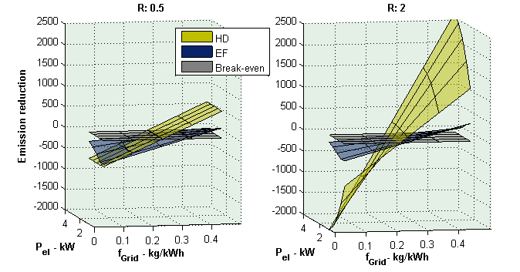
Sensitivity Analysis
R = E_{el} / Q
Notes:
16

Slide 17
Project status
complex simulation and evaluation system established
reporting being completed, including public documents
tool could be installed on a web page
funding for web page implementation being sought
Notes:
17

Slide 18
Summary
fuel cells can deliver emission reduction, primary energy savings and operating cost reduction in most European countries
in most cases, heat following mode will be preferred – unless virtual power plants are considered
high total and electrical efficiencies, power-to-heat and turn-down ratio are required
sensitivity analysis provides the break-even points where microCHP improves the emission and energy balance and how to prioritise technical development, depending on application

Slide 19
Thank You for your Attention !
Notes:
19

