Slide 1

Communication campaign
Most common issues identified :
Formalities and General aspects
Nora Ovcharova
FCH JU Financial Officer

Slide 2
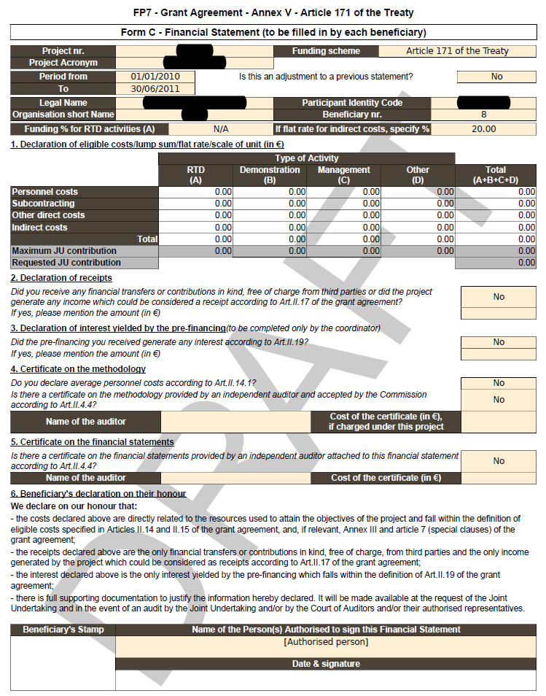
Form C
The tool used to report/declare costs incurred and to claim the requested FCH JU contribution
1 per participant & per reporting period
Filled in by each participant & submitted electronically via the Participant Portal/Force and as signed paper to the coordinator
Pre-populated with reimbursement rate, PIC, ICM per entity & linked to the Use of Resources section
Submitted both electronically and physically (signed originals) to the FCH JU by the coordinator
Information on how to access to the Participant Portal and use the financial reporting tool:
http://ec.europa.eu/research/participants/portal/ShowDoc/Participant+Portal/portal_content/help/use_of_resources.pdf

Slide 3
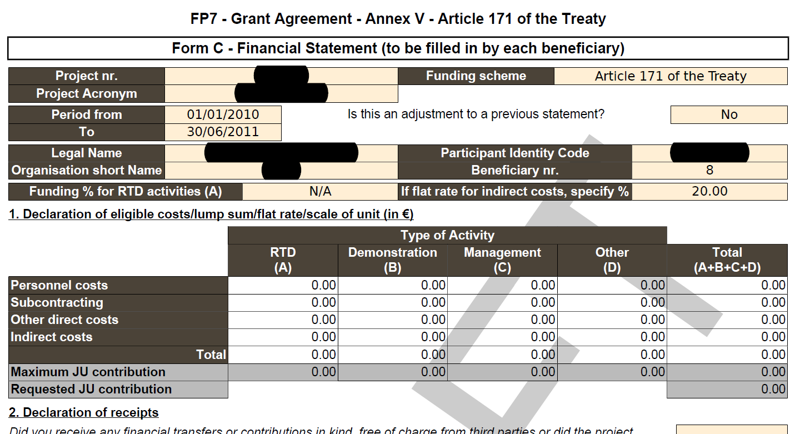

Form C cont’d
Pre-populated fields
Data concerning the project, the participant No, PIC, ICM & the reporting period comes automatically.
Fields to be completed
- Upon clicking on a {Direct Cost cell}, the USE OF RESOURCES dialog box appears asking for details about the costs incurred (asking for WP, cost type and units, amount & explanation on the cost.)
The REQUESTED FCH Contribution comes automatically as the MAX allowable contribution MODIFY as needed!!
Notes:
Explain the differences between «Maximum JU contribution» (calculated automatically according to the costs declared and reimbursement rates applicable) and «Requested JU contribution»
Highlight that if the requested contribution is not filled in we assume that the project has been carried out without needing FCH JU financial support.

Slide 4
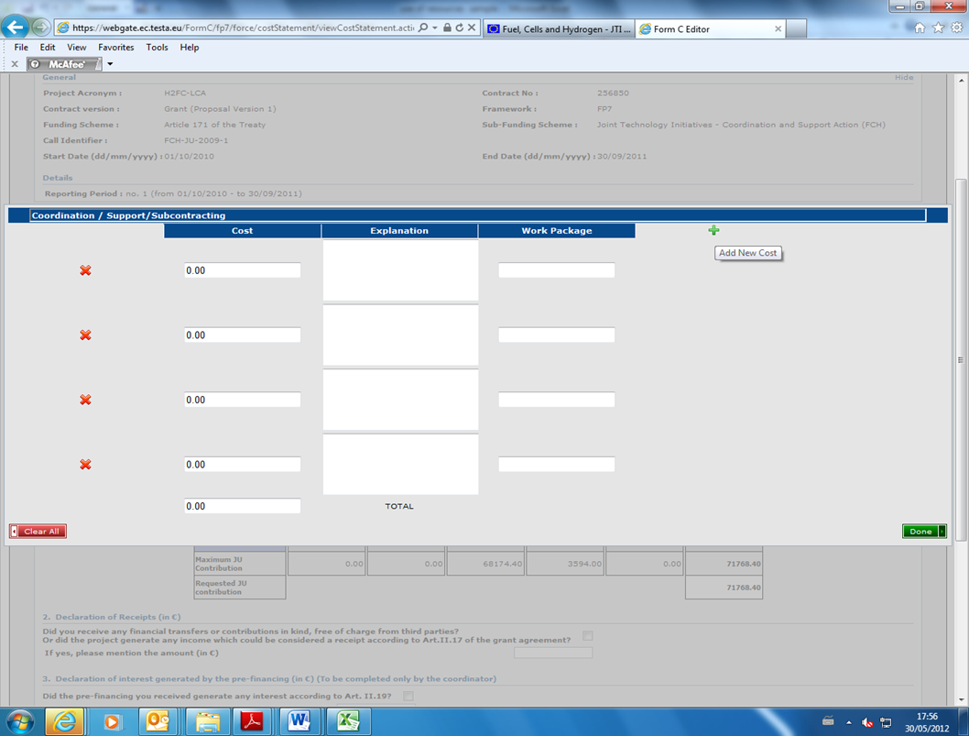
Form C /Use of Resources
Pop-up Screen – pls enter costs & details as per WP, unit of measure, equipment and depreciation method, consumables, travels…..
Pls provide detailed cost breakdown to help FCH decide on acceptability of costs, save clarification delays, & facilitate payment.
Transitional period during which both SESAM narratives and FORCE pop-up screen can be used for USE of Resources reporting, -“Convert” Button available

Slide 5
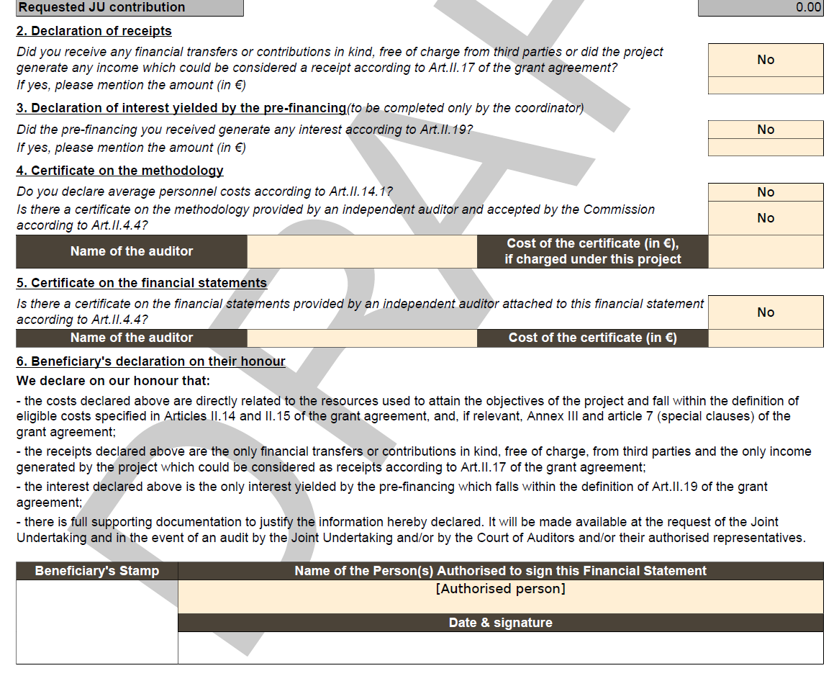
Form C Formalities
  Do not forget to declare the respective receipts & interest.!
  Do not forget to specify if Average personnel costs used – to be based on 1) CoM (Certificate on methodology (Form E), 2) CoMAV (Certificate on Methodology for Average personnel costs), or 3) NEW: by meeting the respective criteria as specified in Art.II.14.1.
  Ensure that the Form C is signed by the Authorised representative (AR) or enclose a Delegation letter if signed by another person.
  Date and stamp the Form C.
  Justify missing stamp - If no stamp used in normal business operations

Slide 6
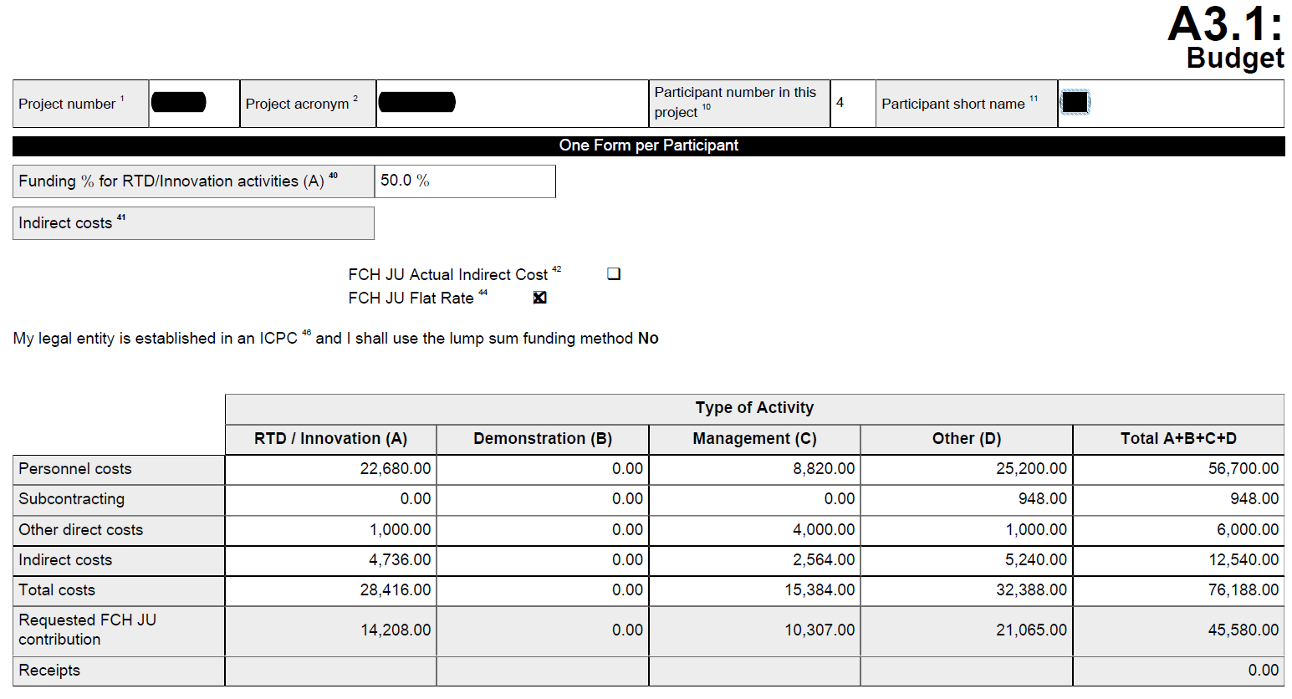
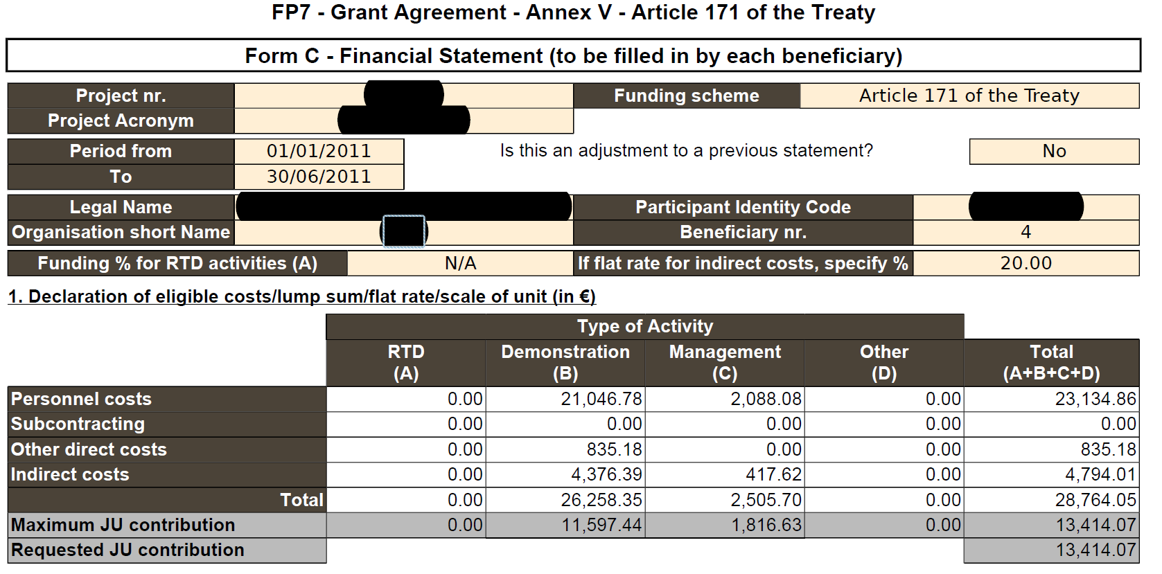
Costs not Foreseen in GA
Costs declared were not foreseen in the original GA
either not planned at all, or
not mentioned under the specific type of Activity,
or the type of Cost !

Slide 7
Costs not Foreseen in GA
Costs declared NOT foreseen in the GA – NOT planned at all :
- MNGT costs of beneficiary 2,
- or subcontractors should have been identified in the Description of Work as defined in Annex I of the FCH JU FP7 GA.
IF Not foreseen, a proper Justification should be provided to allow FCH Judge is costs needed & acceptable.

Slide 8
Depreciation
Do not charge the full cost at 100% of equipment at acquisition
Depreciate durable equipment over its useful life
Spread the cost over the duration of the project
Do not charge any residual values after project end.
projects start
Do not charge costs
after project end, though
useful life continues
Project end
Year 3
Year 1
Year 2
Acquisition cost
CHARGE

Slide 9
Depreciation Cont’d.
Can depreciation costs for equipment used for the project but bought before the start of the project be eligible?
If the equipment has not yet been fully depreciated according to the usual management and accounting practices of the beneficiary, the remaining depreciation (considering the amount of use for the project in percentage of use and time of use ) can be eligible under the project.
E.g. equipment bought in 01/ 2005, depreciation period of 48 months as per beneficiary accounting practices. If a GA is signed in Jan. 2007, & equipment is used for this FCH GA, the beneficiary can declare the depreciation incurred under the GA for the remaining 24 months in proportion of the allocation of the equipment to the project.
Basic Formula Depreciation = A ( Months/ years project use) * Cost * % project use
---------------------------------------------------------------------------
B ( years of useful life of that type of equipment)

Slide 10
VAT & Discounts
VAT may be present in direct costs, sub-contracting, ODC, IC …
VAT is usually considered as a cost by the beneficiary’s accounting
VAT, whether recoverable or not, is ineligible for FCH claims.
Please ensure that VAT is always excluded from all FCH /FP7 cost claims
VAT is often forgotten in small purchases – tickets, logistics, consumables
Discounts to be treated similarly – whenever available they shall be deducted.

Slide 11
Common Issues on Costs Eligibility
Basic Rule: All costs claimed should be based on the actual costs incurred:
Costs must be supported by proper documentation available at the beneficiary – to be kept for 5 years after end of project
Costs must be linked to the specific project –
Costs reported shall NOT be the budgeted, or estimated amounts – they should be actual costs, or at minimum shall be based on the latest information available, and later adjusted based on real costs.
Shall be incurred during the specific reporting period – if covering a longer period shall be pro-rated for the reporting one.
In a nutshell shall be eligible - ...........

Slide 12
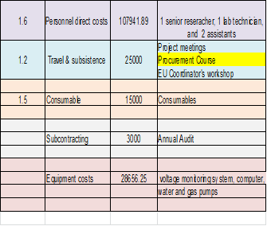
Costs NOT Related to the Specific Project
Budgeted & Reported seemingly Ok, but at reviewing the Use of Resources section we find costs not related to the project – Procurement course

Slide 13
Use of Resources
New Pop-up Screen – pls enter costs & details as per WP, unit of measure, equipment and depreciation method, consumables, travels

Slide 14
Use of Resources

Slide 15
Costs not Sufficiently Substantiated
Missing details => preclude us to decide on the eligibility of costs so clarifications requested:
Personnel – Man/months ?
Travel & Subsistence - estimates ?
Procurement Course & Coordinator’s workshop - project-related ?
Details on consumables + Estimate?
Depreciation method on Equipment?
Wrong detail – CFS or Annual audit
roject

Slide 16
Other issues identified
Different start date than the GA – costs shall be incurred during the respective reporting period as defined by the GA to be eligible.
Different reporting period – 20 months instead of 18.
Different treatment of the same costs – consultants to be treated as personnel, or sub-contracting (more in next slide….) – even become a full-rights beneficiary
Wrong reporting under previous periods – to be clarified & an adjustments Form C to be prepared & submitted.
Indirect costs reported at exactly 20% of direct costs in cases of Actual ICM – questioned and corrected as needed.

Slide 17
Consultants
- personnel or sub-contract
Personnel costs regardless if self-employed or employed by a third party, if the following cumulative criteria are fulfilled
Beneficiary has a contract with s.o. to work on tasks under the FCH project;
He/She must work under instructions & at the premises of the Beneficiary
The result of the work belongs to the Beneficiary (Article II.26 of FCH GA)
Costs of employing the consultant are not significantly different from a staffer.
Remuneration is based on working hours rather than on the delivering of specific outputs/products and should be recorded in the accounts of Beneficiary.
Travel and subsistence costs of consultant to be paid directly by beneficiary to be eligible
Subcontract if hiring consultants to perform part of the work & the conditions of Art. II.7 of FCH JU GA are fulfilled:
Sub-contracting agreement based on business conditions w/ profit included
Sub-contractors do not have any IPR or ownership rights on the deliverables
Do not usually work on the premises of the beneficiary and is not under the direct instruction /hierarchical supervision by Beneficiary
Remuneration based on the delivering of specific outputs/products rather than on working hours
Sub-contracting between beneficiaries of the GA is not allowed.

Slide 18
Issues in CFS (Form D)
Wrong Format – Form E (on methodology) instead of Form D ---- Pls NOTE the revised format since June 2012
Prevailing error - Incomplete CFS (do not include the 3 required parts)- the counter-signed ToR, the Independent Report on factual Findings, the table of procedures –.
Not counter - signed by Beneficiary and Auditor
Difference in wording / format / language.
Audit Procedures for Indirect costs NOT clearly specified
Discrepancies between costs declared by beneficiary & certified by Auditor, receipts declared and certified, interest reported & declared –
Exceptions reported not further investigated re: prior periods/ audits
- VAT and taxes identifies but not quantified
- costs not substantiated ( personnel without timesheets – but not quantified)

