Slide 1

Optimisation of the manufacturing value chain
Alicia Arce, Head of Control Systems Lab
Fundación Ayesa
PEMFC stack and MEA manufacturing workshop, 11 October 2018, Brussels

Slide 2
of the manufacturing value chain
Outline
INN-BALANCE overview
Manufacturing roadmap
Manufacturing optimization framework
Use cases
Manufacturing studies
Conclusions
PEMFC stack and MEA manufacturing workshop, 11 October 2018, Brussels

Slide 3
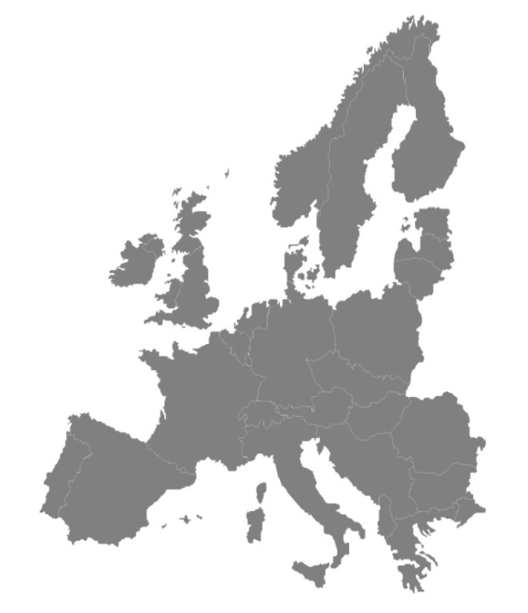









of the manufacturing value chain
INN-BALANCE overview
Consortium and key data
Industrialization-ready Balance of Plant (BoP) components for fuel cells in hydrogen vehicle
Jan. 2017-Dec. 2019
Total Budget: 6.15M Euros
FCH JU 2 project pillar: transport
Coordination: Fundacion Ayesa, Spain
Fundación Ayesa is in charge of the manufacturing-oriented design optimization, the low-cost sensorization based on state observers and fault-tolerant strategies.
www.innbalance-fch-project.eu
PEMFC stack and MEA manufacturing workshop, 11 October 2018, Brussels

Slide 4
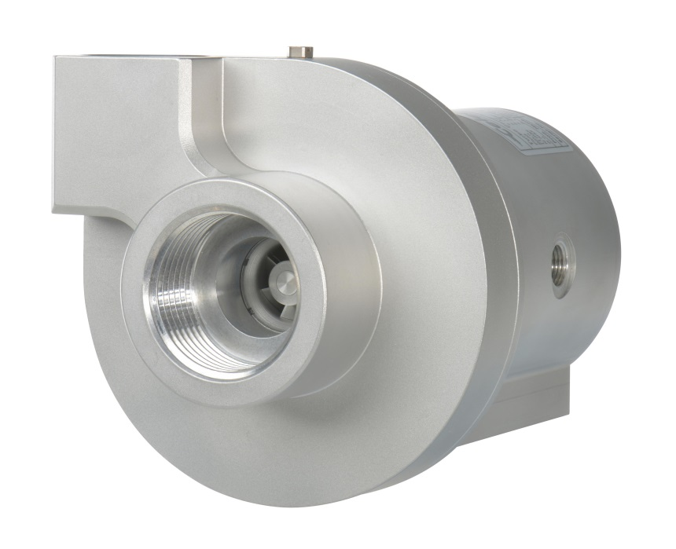
of the manufacturing value chain
INN-BALANCE overview
Context
Challenges for automotive fuel cells systems mass production and commercialization:
Technical reliability (e.g. freeze start) and performance.
High cost due to low production volume.
BoP design not suitable for automated manufacturing.
Supply chain still not in place for some components.
Objectives
New generation of low-cost fuel cell.
Balance of Plant components for automotive applications.
Develop highly efficient and reliable fuel cell BoP components.
Improve and tailor development tools for design, modelling and testing BoP.
Achieve high technology readiness levels (TRL7).
Reduce costs of current market products in fuel cell systems.
PEMFC stack and MEA manufacturing workshop, 11 October 2018, Brussels

Slide 5
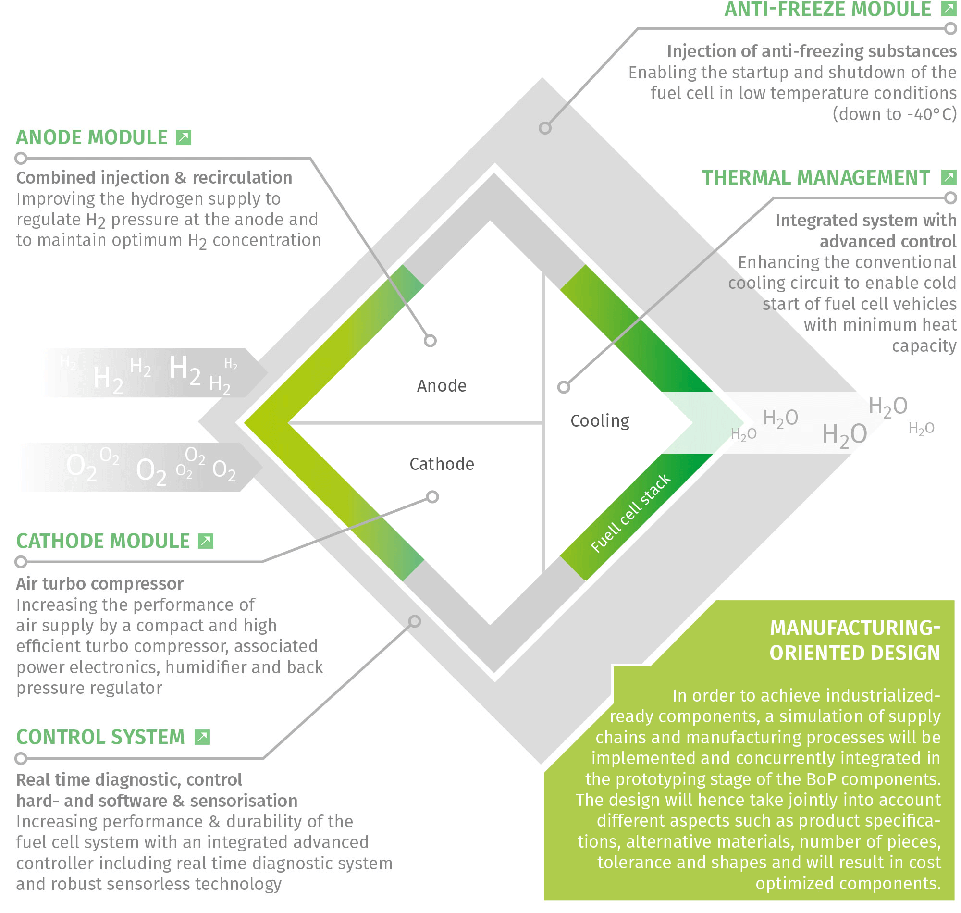
of the manufacturing value chain
INN-BALANCE overview
Activities
BoP developments
New air compressor
Combined hydrogen injection and recirculation
Advanced control and diagnosis devices
New concept for thermal management
Cost optimization and manufacturing process
Integration into a vehicle powertrain to test drivability, durability and performance
PEMFC stack and MEA manufacturing workshop, 11 October 2018, Brussels

Slide 6
of the manufacturing value chain
INN-BALANCE overview
Organization
WP1 Architecture and system level optimisation (Powercell)
WP2 Diagnosis, control and sensorization (AVL)
WP3 Turbo compressor and cathode module (Celeroton)
WP4 Anode module (AVL)
WP5 Thermal management module (DLR)
WP6 Manufacturing and cost optimization for market implementation (Fundación Ayesa)
WP7 System integration, testing and evaluation (Volvo Cars)
WP8 Exploitation, Dissemination and IPR Management of Results (Steinbeis 2i)
WP9 Communication (Steinbeis 2i)
WP10 Management and quality (Fundación Ayesa)
PEMFC stack and MEA manufacturing workshop, 11 October 2018, Brussels

Slide 7
of the manufacturing value chain
INN-BALANCE overview
Expected impacts
Manufacturing and cost optimization for market implementation
Supply chain analysis and modelling
Manufacturing process analysis and modelling
Product specifications and quality analysis
Manufacturing-oriented design optimisation framework
Cost-effectiveness study of improved manufacturing and benchmarking
High-performance fuel cell BoP components with lower production cost and long life-cycles
Increased reliability, durability and competitiveness of fuel cell systems
Standardized platform of BoP component and requirements for European equipment manufacturers
Secure and competitive supply chain
Boosting automotive fuel cells commercialization in Europe
PEMFC stack and MEA manufacturing workshop, 11 October 2018, Brussels
7

Slide 8
Manufacturing roadmap
Manufacturing approach
BoP design lifecycle
Fuel cell architecture
BoP design
BoP prototypes
BoP redesign
BoP ready for manufacturing
Manufacturing modelling and platform
Platform
population
Definition
of case studies
Analysis of results
Platform
population
Manufacturing optimization
PEMFC stack and MEA manufacturing workshop, 11 October 2018, Brussels
8

Slide 9















of the manufacturing value chain
Manufacturing optimization framework
Implemented use cases
BOM
&
Benchmarking
Supplier & manufacturing optimization
Performance simulation and impact
Equipment cost & performance impact analysis
Global optimization
Databases
Platform
Suppliers Database
Preprocessing
Data input
Database communication
Optimization
Manufacturing
Database
Supply chain model
Manufacturing model
Performance model
Stock management
Cost reduction / volume
Postprocessing
Material Database
Data output
Database communication
Data analytics
Stock Database
Connection with
other software
CAD
Risk analysis
PEMFC stack and MEA manufacturing workshop, 11 October 2018, Brussels

Slide 10
of the manufacturing value chain
Manufacturing optimization framework
Components main features
Component | Description | Main features
 | Suppliers, manufacturing, material and stock databases: Stores important data needed to feed the optimisation framework | Structured data Extensible and modifiable Easy to access
 | CAD connection: Linkage to CAD software to obtain data from different parts, equipment, 3D models… | Extraction of direct design data Whole view of the process Assemblies and parts information Improvement of design process
 | Risk Analysis connection: Linkage to Risk analysis software to introduce risk management related to supply chains. | Risk data about suppliers to include in the optimization Evaluation of risks
 | Data input: Manages the inputs introduced by the user, asking variables and avoiding entering incorrect data | User-friendly Automatic error avoidance Storage of needed data
 | Database communication: Manages the protocols to communicate the databases with the optimization framework | Easy and modifiable Fast communication
PEMFC stack and MEA manufacturing workshop, 11 October 2018, Brussels

Slide 11
of the manufacturing value chain
Manufacturing optimization framework
Components main features
Component | Description | Main features
 | Supply chain model: Models the restrictions associated with the supply chains | Cost of transport Capacity of transport Production volume Discount according to volume Multiple suppliers
 | Manufacturing model: Implements the restrictions associated with the manufacturing processes and materials | Material costs. Use of machines. Number of machines. Estimation of manufacturing time. Incompatibilities between materials and manufacturing processes.
 | Performance model: Model of the performance of the system, with different equipment and options modelled | Dynamic simulation of the system Equilibrium speed / complexity Possibility to choose different KPIs
 | Stock management: Models the ordered materials and equipment stocks and the final goods stock | Estimation of stock cost and quantities Easy to add new storage facilities Easy to change stock unit costs
 | Cost reduction/ volume: Estimates the costs depending on the ordered volume | Estimation of cost reduction Comparison between different hypothesis
PEMFC stack and MEA manufacturing workshop, 11 October 2018, Brussels

Slide 12
of the manufacturing value chain
Manufacturing optimization framework
Components main features
Component | Description | Main features
 | Data output: Presents the results to the user | Visual Schematic Exportable to other software
 | Data analytics: Analyses the output data to obtain conclusions and extra results for the user | User-friendly Modifiable options Visual
PEMFC stack and MEA manufacturing workshop, 11 October 2018, Brussels

Slide 13

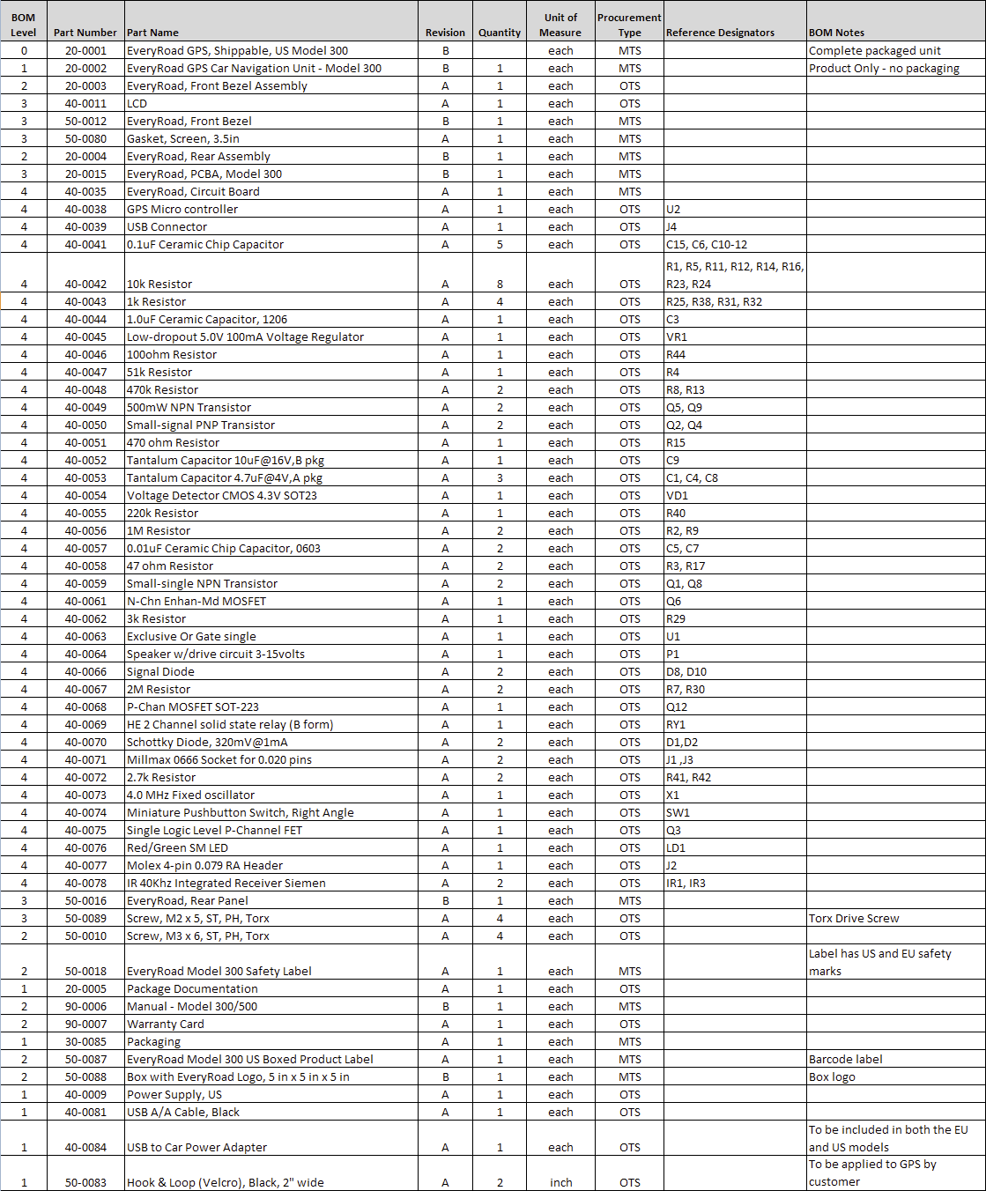
of the manufacturing value chain
Use cases
BOM and benchmarking
Concept:
The main objective of the BOM & benchmarking use case is to calculate the cost of a system composed of different parts (equipment), allowing the user to do it with several systems, comparing costs and features between them. The user introduce the different components from a portfolio of suppliers and the platform calculates the costs and compare with other introduced options.
System 1
*********************************
Fixed cost for part 1: 100000
Fixed cost for part 2: 45000
Fixed cost for part 3: 20000
Fixed cost for part 4: 78000
Fixed cost for part 5: 123000
Cost of assembling all the parts: 10.4167
Total cost of the system: 366010.4167
System 2
*********************************
Fixed cost for part 1: 140000
Fixed cost for part 2: 30000
Fixed cost for part 3: 25000
Fixed cost for part 4: 57000
Cost of assembling all the parts: 10.4167
Total cost of the system: 252010.4167
Main features:
Provide a user friendly interface to select components from data bases.
Gather information from the data bases regarding the selected components.
Calculate the whole costs according to the different parameters and with the models of the supply chain and manufacturing costs.
Present an itemized BOM and total costs.
Compare the costs with other selected options.
Examples:
Quantify the impact on the fuel cell system costs of different humidifiers of different providers.
Quantify the impact on the fuel cell system costs of different sensors from different providers.
PEMFC stack and MEA manufacturing workshop, 11 October 2018, Brussels

Slide 14

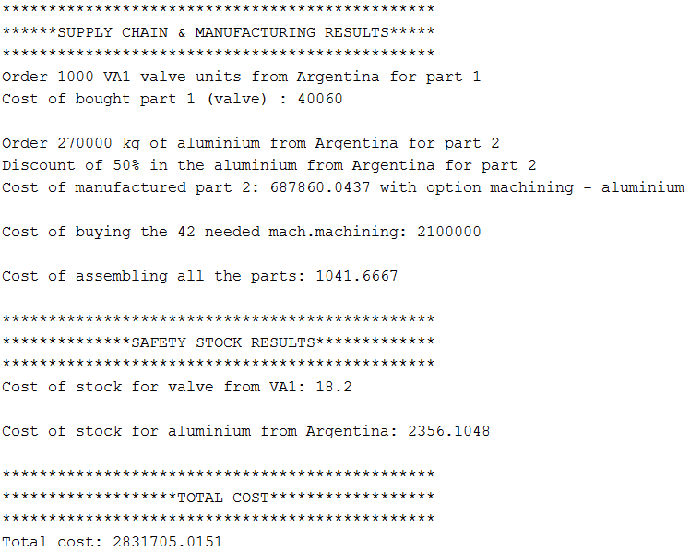

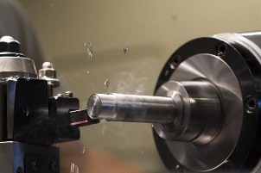

of the manufacturing value chain
Use cases
Supplier and manufacturing optimization
Concept:
The main objective of the Supplier and manufacturing optimization use case is to calculate the best option, which minimizes the system cost, starting from user introduced requirements for the system and from databases with different suppliers, manufacturing processes and materials. The user includes equipment and specs and the platform calculates the best option amongst all the providers.
Main features:
Provide a user friendly interface to introduce components and specs with quality tolerance.
Search in data bases components and providers to cover specs.
Calculate the supply chain and manufacturing costs of all the options.
Provide the best option that minimize costs.
Provide an itemized BOM with cost per part.
Examples:
Selection of humidifiers with certain specs considering the optimal cost.
Selection of valves with certain specs considering the optimal cost.
Selection of sensors with certain specs considering the optimal cost.
PEMFC stack and MEA manufacturing workshop, 11 October 2018, Brussels

Slide 15



of the manufacturing value chain
Use cases
Performance analysis and impact
Concept:
The main objective of the Performance analysis and impact use case is to calculate the impact on the performance of the system of different components from a provider portfolio. The user selects the components of the fuel cell system from provider portfolio and the platform run performance simulations to calculate the impact on performance.
Main features:
Provide a user-friendly interface to select components from provider porfolio.
Customize the fuel cell system model with the data of each component.
Run performance simulations.
Calculate and analyze the KPIs.
Calculate the whole costs according to the different parameters and with the models of the supply chain and manufacturing costs.
Compare performance and costs of different options.
Examples:
Quantify the impact on the fuel cell system performance of a humidifer with certain specs.
Quantify the impact on the fuel cell system performance of a sensor with certain specs.
Quantify the impact on the fuel cell system performance of a valve with certain specs.
PEMFC stack and MEA manufacturing workshop, 11 October 2018, Brussels

Slide 16

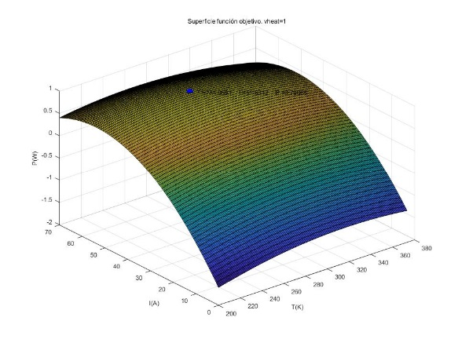
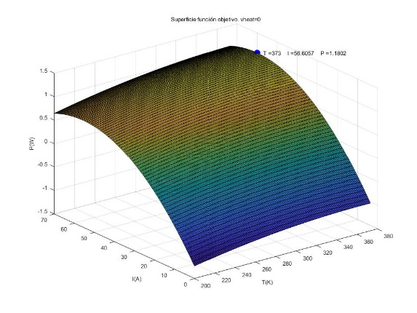
of the manufacturing value chain
Use cases
Equipment cost & performance impact analysis
Concept:
The main objective of the Equipment cost & performance impact analysis use case is to calculate the impact of an equipment or part in the total cost and in the performance of the system. The user introduces the components of the fuel cell system from the portfolio and the platform run simulations to calculate the impact on the cost and performance.
Main features:
Provide a user-friendly interface to select components from provider porfolio.
Customize the fuel cell system model with the data of each component.
Run performance simulations.
Calculate and analyze the KPIs.
Compare performance of different options.
Examples:
Quantify the impact on the cost and performance of a humidifier from the provider portfolio.
Quantify the impact on the fuel cell cost and performance of a provider sensor.
Quantify the impact on the fuel cell cost and performance of a certain provider valve.
PEMFC stack and MEA manufacturing workshop, 11 October 2018, Brussels

Slide 17


of the manufacturing value chain
Use cases
Global optimization
Concept:
The main objective of the Global optimization use case is to calculate the best option considering the supply chains, the manufacturing and the performance for the system, i.e. to find a trade-off solution, starting from user introduced requirements for the system, from databases with different suppliers, manufacturing processes and materials and from a model of the system performance.
Main features:
Provide a user friendly interface to introduce components and specs with quality tolerance.
Search in data bases components and providers to cover specs.
Calculate the supply chain and manufacturing costs of all the options.
Customize the fuel cell system model with the data of each component.
Provide the best option that minimize costs and maximize performance.
Provide an itemized BOM with cost per part.
Example:
Selection of humidifiers with certain specs considering the optimal cost and performance
Selection of valves with certain specs considering the optimal cost and performance.
Selection of sensors with certain specs considering the optimal cost and performance.
PEMFC stack and MEA manufacturing workshop, 11 October 2018, Brussels

Slide 18
of the manufacturing value chain
Manufacturing studies
Cathode module
Scenario - humidification:
4 providers
Different specifications
Different packaging and costs
4 different assemblies
Active/passive control
Different valves with time responses, energy consumption and costs.
Sensors vs observers
Manufacturing platform:
Cost benchmarking
Performance impact on durability, hybridization and efficiency
Optimum options
Analysis of extended number of automotive providers.
PEMFC stack and MEA manufacturing workshop, 11 October 2018, Brussels

Slide 19
of the manufacturing value chain
Conclusions
Systematic approach for optimizing the manufacturing value chain: emulates the experience of human design process with the capacity to compute more complex and multiple options.
Reduction the design time:
this implies the reduction of number of iteration and man power.
Reduction of number of prototypes:
this implies the reduction of costs to built different prototypes to achieve the manufacturable product.
Integration of information of different design units on an holistic approach:
multidisciplinary design optimization
PEMFC stack and MEA manufacturing workshop, 11 October 2018, Brussels

