Slide 1

Communication campaign
Financial Reporting:
Formalities & General Aspects,
Common Mistakes & E-reporting Basics
Nora Ovcharova
FCH JU Financial Officer

Slide 2
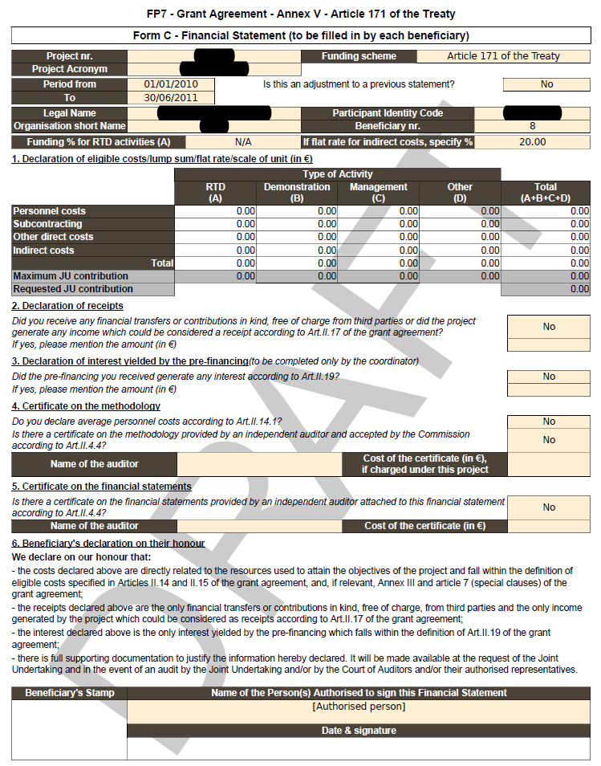
The FORCE Form C
The tool used to report/declare costs incurred and to claim the requested FCH JU contribution
1 per participant & per reporting period
Filled in by each participant & submitted electronically via the Participant Portal/Force and as signed paper to the coordinator
Pre-populated with entities’ reimbursement rates, PIC, ICM per entity & linked to Use of Resources (UoR)Section
Submitted both electronically (& physically* for Calls 2008-2011, signed originals if paper submission versus e-submission) to the FCH JU by the Coordinator

Slide 3
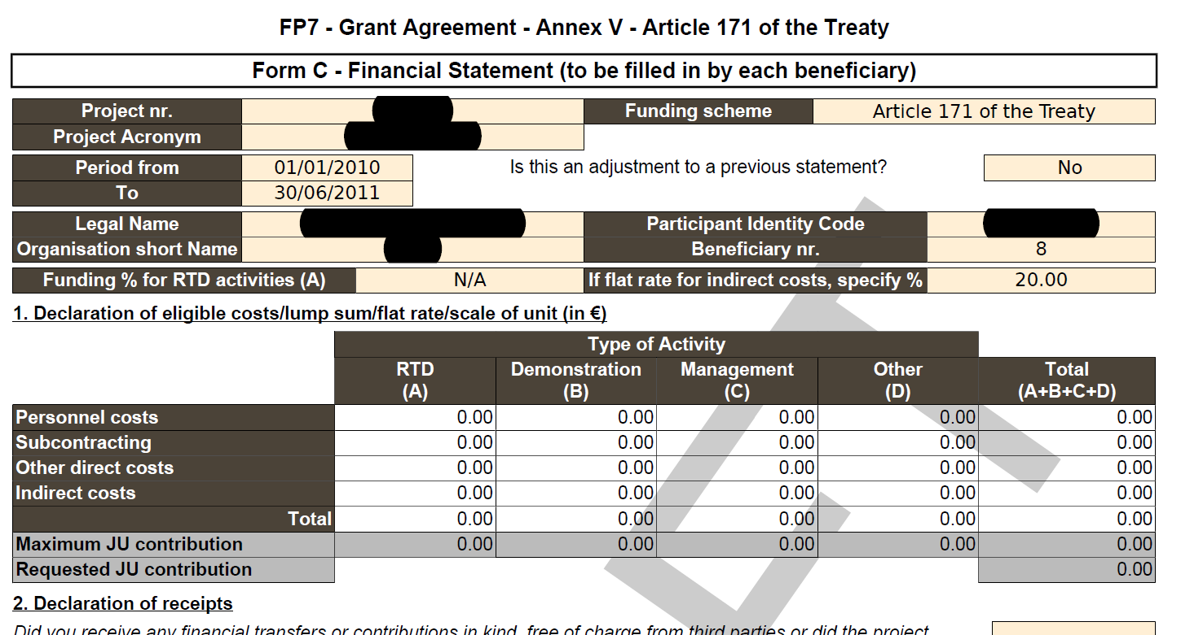

The Form C
Pre-populated fields
Data concerning project, participant No, PIC & reporting period comes automatically.
- Normal or Adjustment Form C comes as DROP - DOWN menu
Fields to be completed
- Upon clicking on a {Direct Cost cell}, the USE OF RESOURCES dialog box appears asking for details about the costs incurred (asking for WP, cost type and units, amount & explanation on the cost.)
The REQUESTED FCH Contribution
Comes automatically as the MAX allowable contribution
SO please take care to MODIFY as needed !! 3
Notes:
Explain the differences between «Maximum JU contribution» (calculated automatically according to the costs declared and reimbursement rates applicable) and «Requested JU contribution»
Highlight that if the requested contribution is not filled in we assume that the project has been carried out without needing FCH JU financial support.

Slide 4
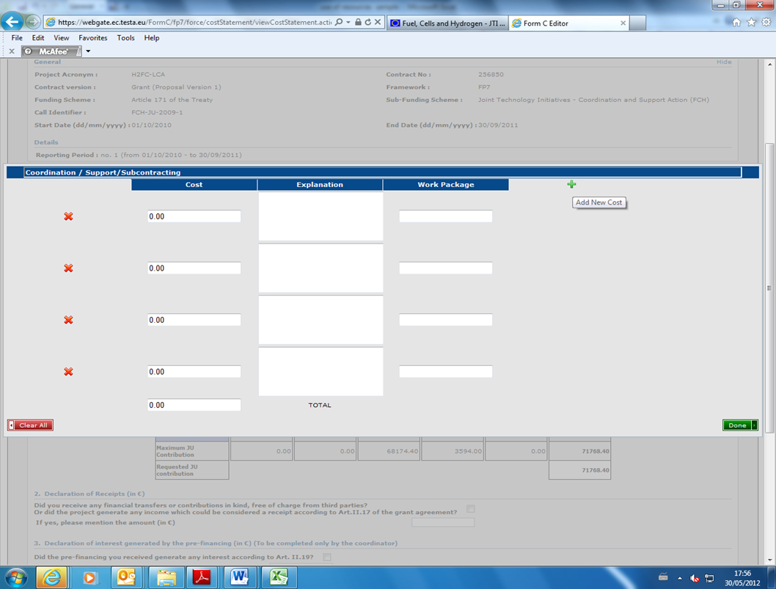
Use of Resources
Pop-up Screen – pls enter costs & details per WP, unit of measure, equipment and depreciation method, consumables details of item above 500 EU, travel details.
Detailed cost breakdown - details help FCH decide on eligibility & acceptability of costs, save clarification delays, & facilitate payment.

Slide 5
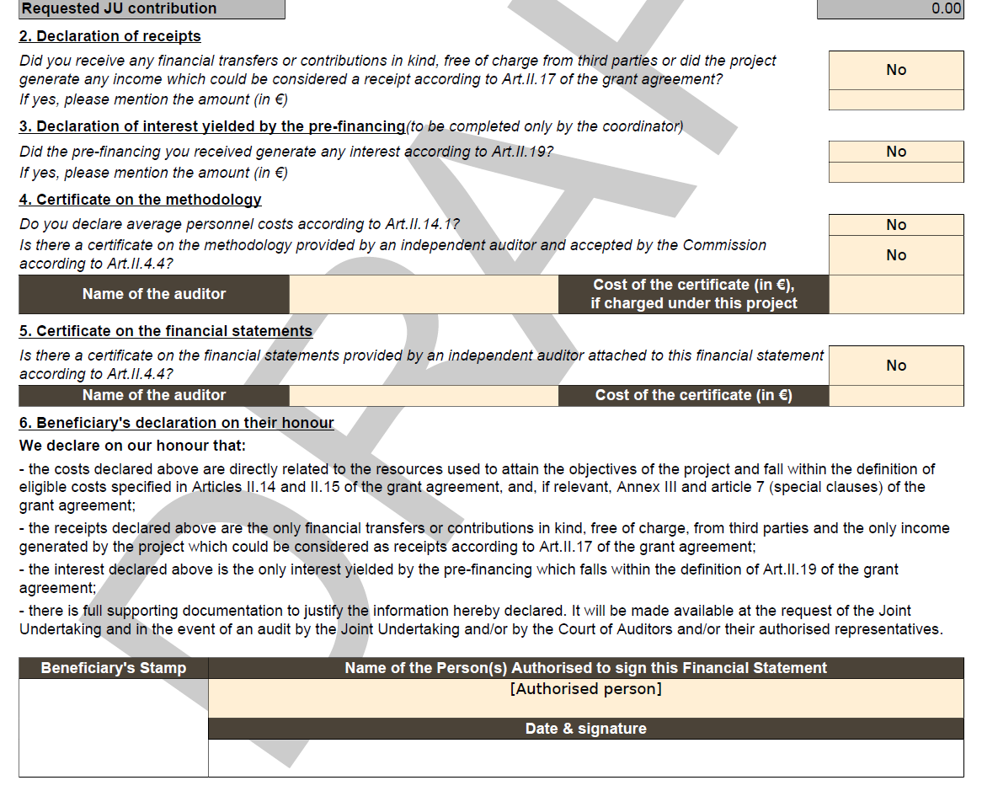
Form C Formalities
  Do not forget to declare the respective receipts & interest.!
  Do not forget to specify if indeed Average personnel costs used – based on :
  CoM (Certificate on methodology (Form E) or CoMAV (Certificate on Methodology for Average personnel costs), or
  by meeting the respective 4 cumulative criteria as per Art.II.14.1.
  Ensure that the Form C is signed by the Authorised Representative (AR) / E-sign, or enclose a delegation letter if signed by another person.
  Date and stamp the Form C.
  Justify missing stamp - If no stamp used in normal business operations
  5

Slide 6
Common Issues of Costs eligibility
Rule: Costs claimed should be based on Actual costs incurred:
Supported by proper documentation - auditable / to be kept 5 years after end of project
Used for the sole purpose of achieving the objectives of the specific project ONLY –
NOT budgeted or estimated rounded amounts – to be actual costs, or -at min. based on the latest information available (CPE), and later adjusted based on real costs.
Average personnel costs – based on
  1) CoM (Certificate on Methodology) or Co MAV (CoM for Average Pers. Costs), or
  2) compliance with Art. II.14 criteria, & adjusted next period…
Incurred during the reporting period – or pro-rated for the reporting period.
VAT shall be excluded from all costs, discounts to be figured in.
Depreciation rules to be followed as per company/ national/ international rules.
In accordance with usual accounting and management principles of the beneficiary.
Incurred by and Recorded in the accounts of the specific beneficiary
Reckless and excessive expenditures to be avoided in all costs/ groups of costs.
In a nutshell shall be eligible - ...........

Slide 7
USE of RESOURCES (UoR)
DETAILS REQUIRED
DETAILED explanation per COST TYPE strongly recommended to help FCH analysis, speed up processing & payment, avoid clarification requests/ delays.
Personnel costs:
Employee category, Person/Month, Hours spent in the project / cost claim / per WP and employee, an example: WP2 / Engineer-1 / 2,3 PM / 322 hours / 6765.40 EUR
Travel costs:
Purpose / destination / number of persons travelling / dates / cost claim / per WP and travel,
example: WP1 / Kick-off meeting / London / from 13.05.2013 to 14.05.2013 / 684.00 EUR
Consumables:
They should be itemised and described – to ensure consumables and no equipment hidden. Descriptions like “consumables – 5800.00 Euro, or “Different consumables” should be avoided
Durable Equipment
Unit & Description / Price excl. VAT / Purchase date / Useful life/ % Use - Depreciation as per FCH rules Example: 1 PC / 800 EUR / 12.9.2012 / 3 years / 100% / 350 EUR divided for the 2 or 3 reporting periods
7

Slide 8
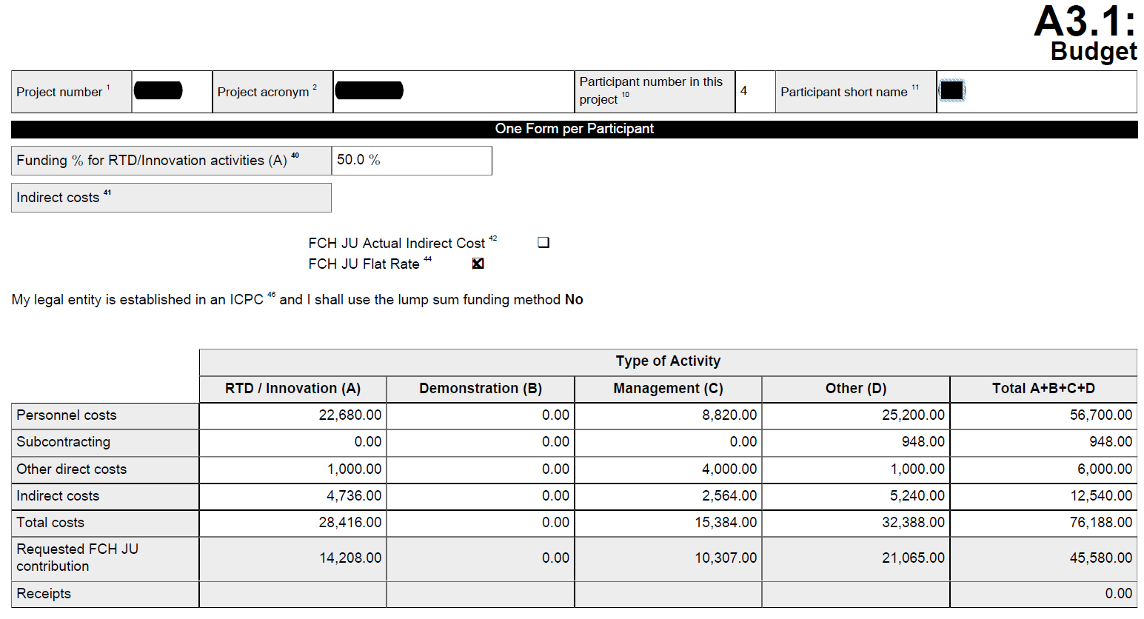
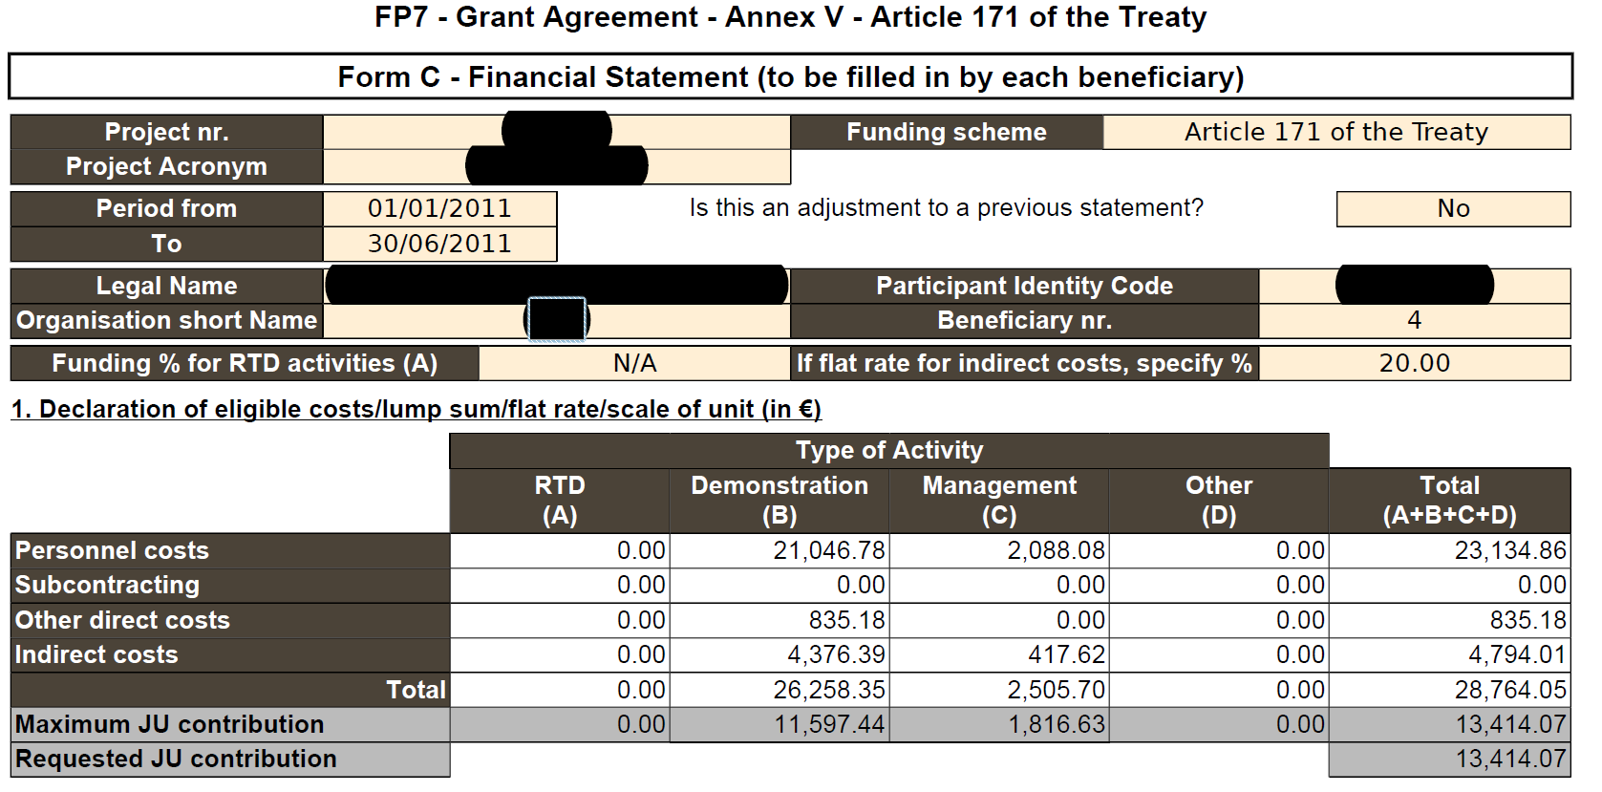
Costs NOT Foreseen in GA
Costs declared NOT planned :
either not planned at all, or
not mentioned under the specific type of Activity,
or type of Cost not planned – e.g. sub-contracting!
Slide 8
Notes:
Explain that FORCE doesn’t validate whether or not the costs have been foreseen in the original budget, but that we’ll check and we’ll ask additional explanations or reject directly the costs. So, in order to avoid delays and exchange of letters/e-mails, it’d be good to check it beforehand

Slide 9
Costs NOT Foreseen in GA
Costs declared NOT foreseen in the GA – e.g NOT planned at all
- MNGT costs of # 2,
- or subcontractors should have been identified in the DoW / Annex I of FCH JU GA.
If not foreseen, a solid proper Justification should be provided to allow FCH Judge IF indeed costs needed & eligible/acceptable.
Minor tasks sub-contracting OK – to be clarified properly.
9
Notes:
After having talked in the previous slide of the necessity of having the costs previously foreseen in the Budget we talk here about the special case of subcontracting that, in addition to be present in the budget, must be perfectly identified in the DoW.

Slide 10
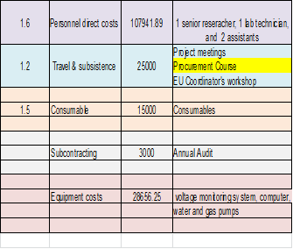
Costs NOT Related to the Specific Project
Budgeted & Reported seemingly OK, but at reviewing the UoR we find costs not related to the project – Procurement course

Slide 11
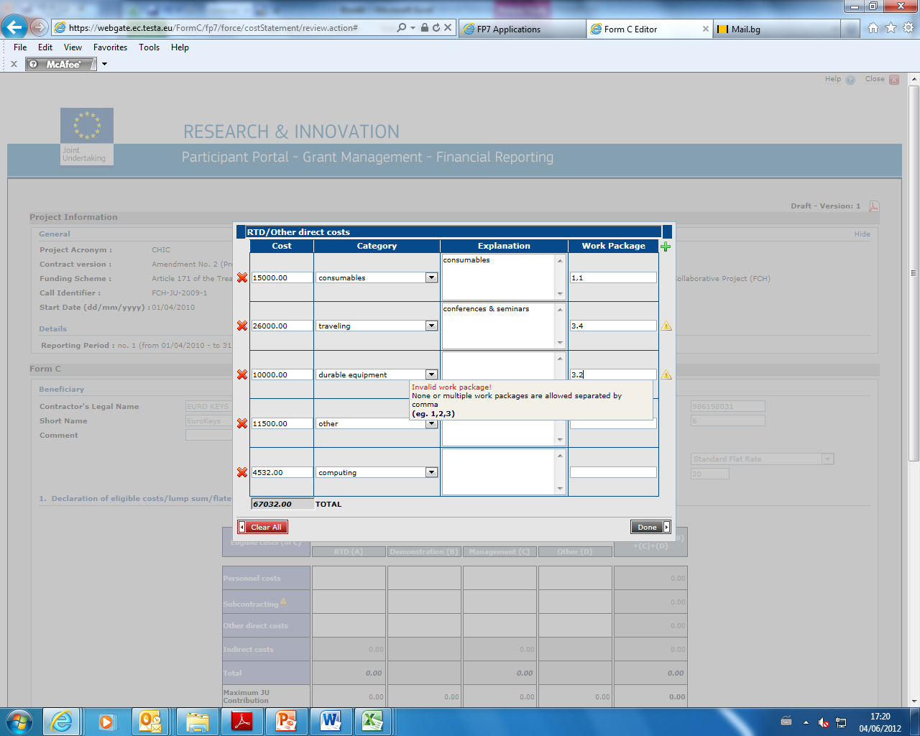
Use of Resources
New Pop-up Screen – pls enter costs & details as per WP, unit of measure, equipment and depreciation method, consumables, travels

Slide 12
Costs NOT Sufficiently Substantiated
Missing Details
We cannot decide on the eligibility costs so clarifications requested:
Personnel – Man/months per WP?
Travel & Subsistence - estimates,
or actual costs incurred & accounted for?
Procurement Course & Coordinator’s workshop - are these project-related ?
Consumables Details + Actuals/Estimate?
Depreciation method on Equipment?
VAT/ Discounts on purchases deducted?
Wrong detail – CFS, or Annual audit
roject

Slide 13
VAT, Other Taxes & Discounts
VAT & taxes may be present in direct costs, sub-contracting, ODC, IC …
VAT is usually considered as a cost by the beneficiary’s accounting
VAT, whether recoverable or not, is ineligible for FCH claims.
Please ensure that VAT is always excluded from all FCH /FP7 cost claims
VAT is often forgotten in small purchases – tickets, logistics, consumables
Discounts to be treated similarly – when granted, they shall be deducted.

Slide 14
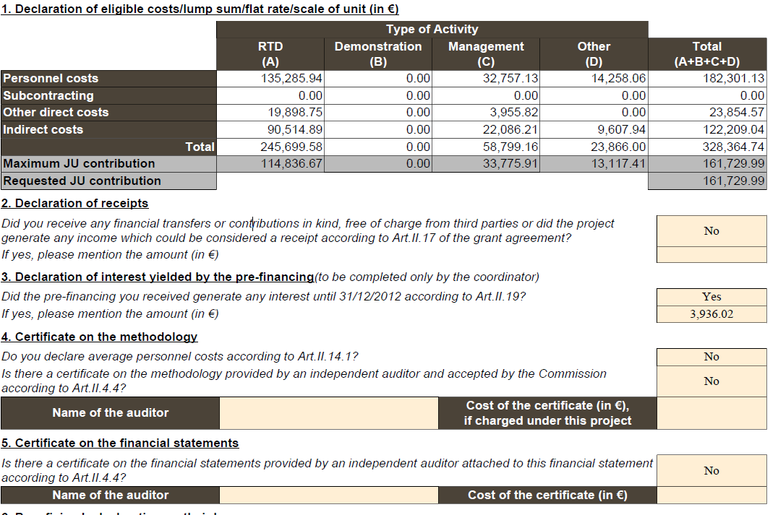
Reporting example

Slide 15
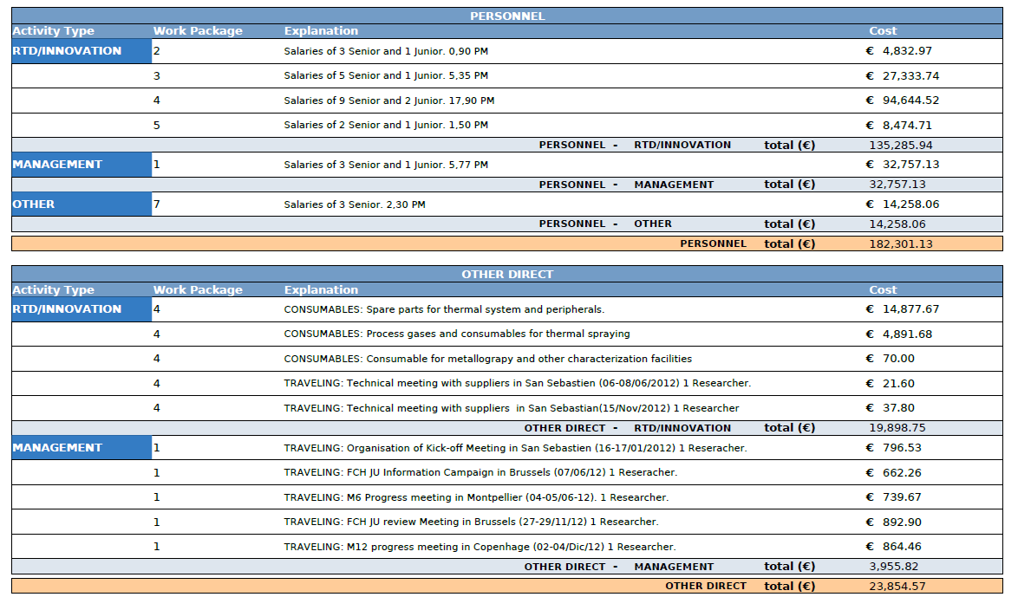
USE of Resources

Slide 16
Errors observed - Clarifications
Personnel, ODC & indirect costs seem the most common Clarifications topics
Different from the official one start date – costs shall be incurred during Reporting period (s) as defined by GA to be eligible
Different reporting period – 20 months instead of 18 – please pro-rate !
Different treatment of the same costs – consultants to be treated as personnel, or sub-contracting, or eventually as a TP / beneficiary/SME?
Wrong reporting under previous periods – clarified & adjustments done.
IC reported at 20% of DC in case of Actual ICM – Hardly possible to be actual !
Travel & subsistence reported as Direct costs – not directly project related - IC pool

Slide 17
Interest and Receipts
Bank Interest shall be reported by the Coordinator only – for funds not distributed to partners ( not for the COO’s own share) as the interest on own funds generally belongs to the beneficiaries.
Interest and receipts reported per period BUT revisited at final payment to make sure non-profit rule observed – i.e the FCH Contribution + interest received (treated as receipt for FCH) + receipts shall not exceed 100% total costs – FCH + receipts + Interest < than 100% total costs accepted.
Bank charges for Bank & Mother Company Guarantee for the FCH project + charges for special trust accounts are eligible costs to be reported.
CFS auditors’ fees are eligible costs – we encourage you to report these under MNGT sub-contracting

Slide 20
Preparing for E-Reporting
In the beginning of the project
  Nomination of Financial Statement Authorised Signatory (FSIGN): ex AR for paper submissions, i.e. the person(s) authorised to sign Forms C electronically
  First step: Identification / Nomination of a LEAR
    FSIGNs nominated by the Legal Entity Appointed Representative (LEAR),
    online directly in the identity and access management (IAM) of the Participant Portal.
    => The nomination of a LEAR for each participating organisation becomes mandatory.
  Second step: LEAR nominates the FSIGNs
    LEARs can register as many FSIGNs as needed for their organisation
    Nominations are made in the role management screen under "My organisations".
  Third step: Participant Contact chooses the FSIGN for the project
    One of the participant/coordinator contacts chooses one or more FSIGNs for the project from the list nominated by the LEAR.
    This is done in the role management screen of the project.

Slide 21
E-reporting
2. When Report Due
  Form C
    financial data introduced in the financial reporting module,
    Form C is identified as "ready for signature" (instead of submitted directly to the coordinator)
    Notification to FSIGN who signs it electronically and transmits it to the coordinator.
    If no FSIGN yet assigned to the project, the system alerts & provides instructions on steps to take.
  Certificates on financial statements (CFS),
    scanned & uploaded with the Form C before the form is identified as "ready for signature".
    The original of the CFS (signed by the certifying auditor) must be kept in the files of the beneficiary and available in case of audit (no longer sent in paper to the FCH JU).
  Third parties (Special clause 11)
    A separate Form C
    to be completed in the financial reporting module and transmitted by the beneficiary to the coordinator (without electronic signature).
    After the coordinator transmitted the whole package to the FCH JU, the Form C of the third party must be printed and hand-signed by an authorised representative of the third party.
    must be kept in the files of the beneficiary (no sending to the FCH JU).

Slide 22
Errors of CFSs (Form D)
AIM: To provide Assurance on Eligibility and Validity of Total Costs claimed - when reaching cumulative 1) FCH interim contribution ≥ 325K Euro, 2) final uncovered claims ≥ 50K
Errors : Wrong Format – Form E (on methodology) instead of Form D, or EU format
Prevailing error - Incomplete CFS (package does not include all 3 required parts) - 1) Counter-signed by you and auditor ToR, 2) Independent Report on Factual Findings , 3) Table of Procedures with results and explanations where N/A, + copies of validated FORM Cs annotated by CFS auditor– …rejected for correction and resubmission.
ToR not signed – or not co-signed by both Beneficiary and Auditor
Difference in wording / format / language. NB Standard ENG CFS is mandatory.
Table of procedures – results of procedures not indicated, N/A not explained, not specified b/n the options for ICM validation
Discrepancies between costs declared by beneficiary & certified by the Auditor, interest & receipts declared and certified, RoE comment, interest reported & declared – reject ?
Exceptions reported not further investigated and quantified, prior periods/ audits
Ineligible VAT & other Taxes identified – to be rejected.
Auditors reclassify FCH accepted costs without justification – e.g. sub-contracted minor tasks!

