Slide 1

Communication Campaign
23 June 2014
Elisabeth Robino
Head of Finance & Administration

Slide 2
Agenda
Time frame | Content | Speaker
9.00 – 9.30 | Registration of the participants
9.30 – 9.40 | Introduction | Elisabeth Robino
9.40 – 10.00 | FCH JU control system | Elena Climent-Vañó
10.00 – 10.45 | Formalities and general aspects in the process of costs reporting | Nora Ovcharova
10.45 – 11.00 | Coffee Break
11.00 – 12.15 | Personnel costs; subcontracting, other direct costs & indirect costs | Antonio Requena Fernandez/ Thanos Batsilas
12.15 – 13.30 | Lunch break
13.30 – 14.30 | Other aspects of interest for all projects (and of particular relevance to demonstration projects): Third parties; type of links between legal entities and a FCH JU project; purchase of equipment; receipts | Nicolas Brahy/ Elisabeth Robino
14.30 – 15.15 | Lessons learned from the experience of external audit firms | Julian Rummins PKF Littlejohn LLP
15.15 – 15.45 | Coffee break
15.45 – 16.45 | Questions and Answers

Slide 3
List of contents
Introduction
Cost reporting chain
Consequences of errors
Where to find information

Slide 4
1. Introduction
FCH JU financial provisions different from FP7
Commission’s communication campaign regarding FP7
FCH JU Communication Campaign
Different beneficiaries
FCH JU experience from first audits

Slide 5



2. Cost reporting chain
Certifying Auditors
(ex – ante)
Coordinators/ Beneficiaries
FCH JU
(AO)
External audit firms ( local/ coordinators)
(ex-post)

Slide 6

3.Consequences of errors
Consequences of errors
Beneficiaries:
Non-optimal use of funding available
Delayed payments
Recoveries
Liquidated damages
Extrapolation
FCH JU
Scrutiny of the Budgetary Authority and ECA
Increased error rate
Increased ex post audit efforts
Corrective measures

Slide 7
4. Communication campaign
AIM
Improve reliability of ex ante certificates
Improve the quality of cost reporting
Contribute to error free cost claims

Slide 8
5. Additional information
Guides & Documents
Guide to Financial Issues for FCH JU beneficiaries (published October 2013)
FP7 Guidance notes for beneficiaries and auditors on certificates issued by external auditors (version July 2012)
FAQ on certificates issued by external auditors (published July 2012)
Grant Agreement with updated Forms D and E

Slide 9
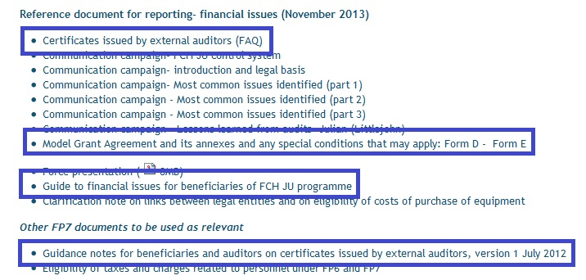
5. Additional information
http://www.fch-ju.eu/content/how-participate-fch-ju-projects

Slide 10
5. Additional information
Generic FCH JU e-mail address:
fch-projects@fch.europa.eu
For questions re CoM and CoMAv:
FP7 helpdesk web service at
http://ec.europa.eu/research/index.cfm?pg=enquiries

