Slide 1

FITUP
(Grant Agreement 256766 )
Fuel cell field test demonstration of economic and environmental viability for portable generators, backup and UPS power system applications
Ilaria Rosso - FITUP project Coordinator
Electro Power Systems SpA
http://www.fch-ju.eu/

Slide 2












Project & Partnership description
Starting Date: 01/11/2010
Duration: 36 months + 6 month extension
Budget: € 5.289.900
Funding: € 2.475.825
Partners: 11 consortium partners +
1 additional final user
Countries: Italy, Switzerland, Turkey, Germany, Netherlands
UPS-Producers
End Users
R&D Centres
Certification
Notes:
2
22

Slide 3
Scope of the project
FITUP aims to demonstrate the technical viability and economic maturity of backup power systems based on fuel cell technology
13 market ready systems from 2 suppliers are installed and being tested at selected real application sites across Europe for field trials.
6 systems are being testing at R&D centres for benchmarking.
Technology is under demonstration at various ambient conditions in real-life telecommunication applications while the data are collected and analysed.
Notes:
33

Slide 4
Technical Targets
Technical Targets:
      Reliability of greater than 95%
        Durability of more than 1500 hours
        More than 1000 cycles
Uniform certification procedures for installation and testing of fuel cell backup power systems in selected countries will be developed.
Lessons learnt in regards to installation and operation will be shared to avoid obstacles for upcoming projects and activities.
Notes:
44

Slide 5
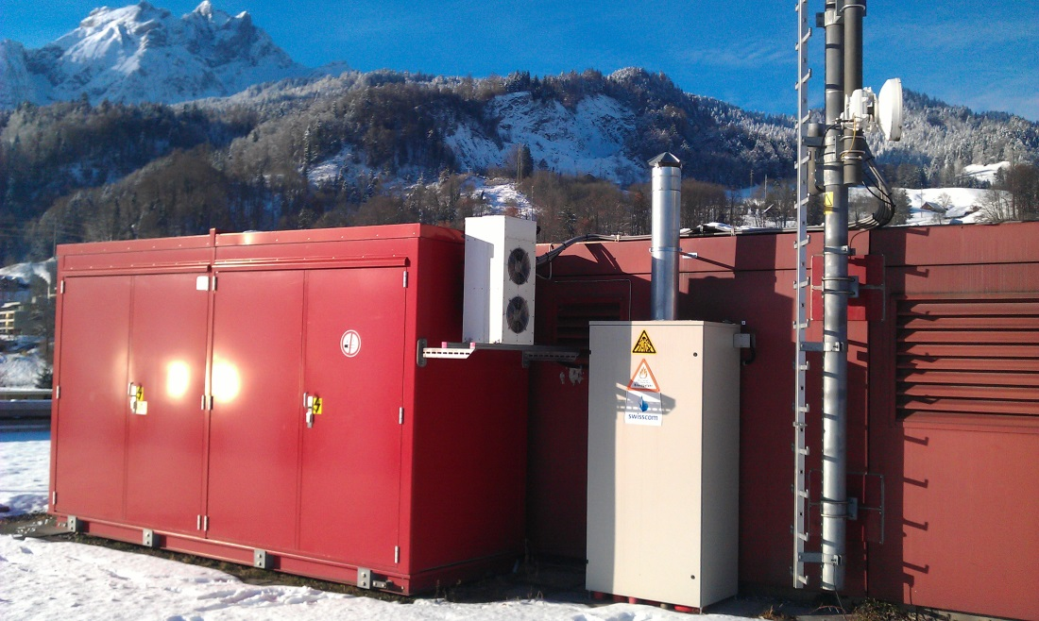
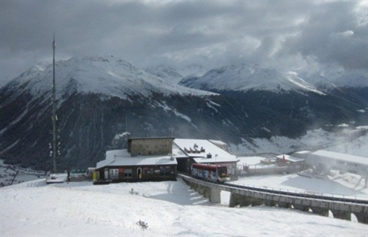
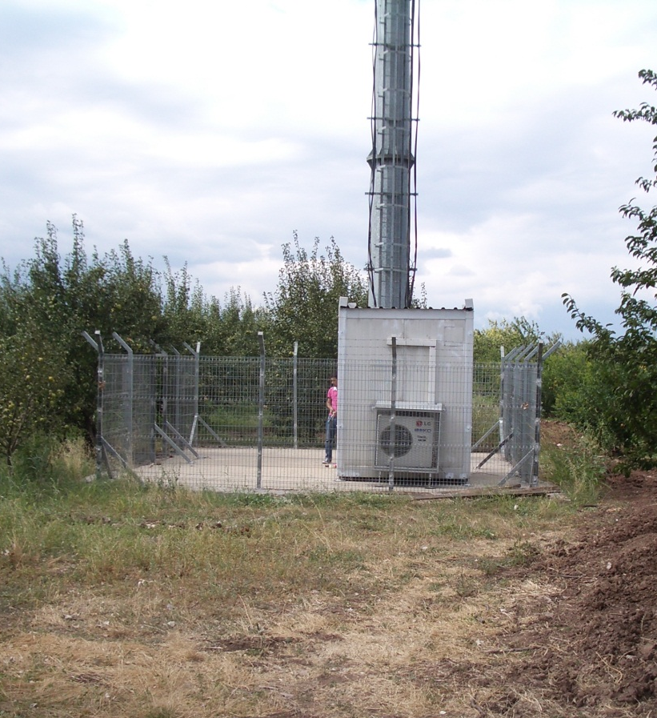
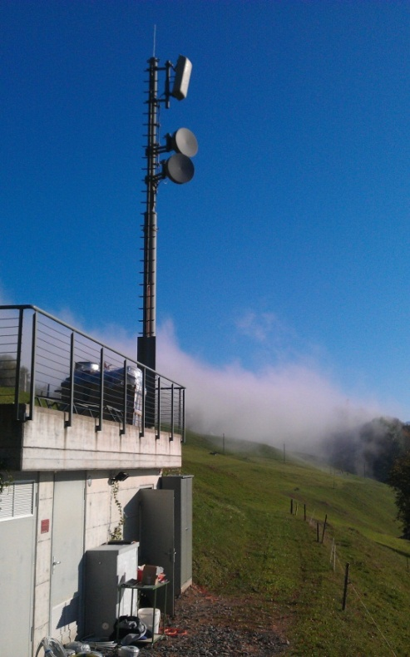
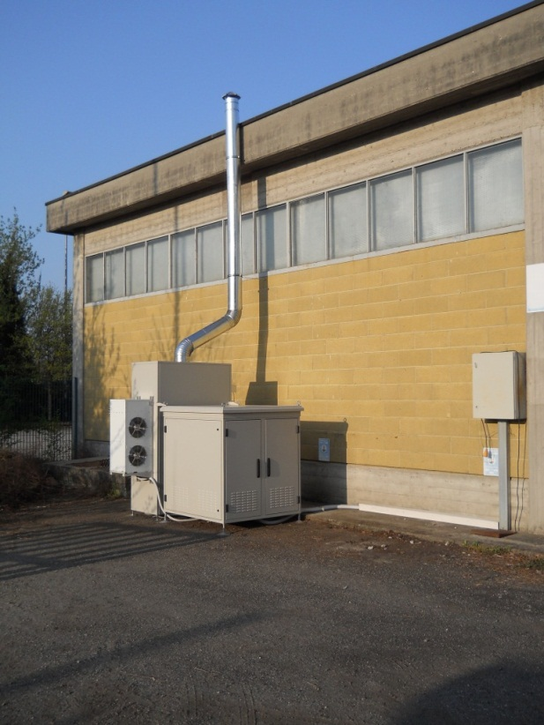
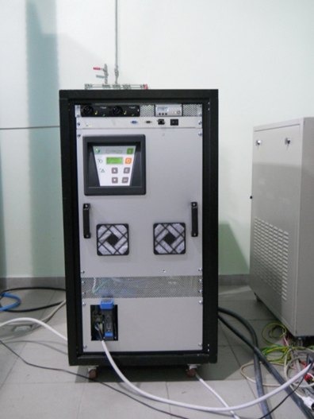
1. Project achievements
Site in Switzerland – Swisscom
Site in Switzerland – Davos – Swisscom
(2200 m, cable railway)
Benchmarking -JRC
Sites in Italy - WIND
Site in Switzerland – Polycom
Sites in Turkey - Bursa
– Turkcell
Notes:
55

Slide 6
1. Project achievements
Test strategy
Split up into benchmark testing within labs and field testing at actual customer sites.
Three different test classes representing different outage times within grid:
  short term grid failures (A type) – 15 min. operation
  medium and long term grid failures (B type) – 240 min. operation
  catastrophic grid failures (C type) – 4320 min. operation
Within the labs the test are performed with different power levels (50%; 75% and 100%).
Different off periods between cycles (1 min. vs. 60 min.).
Testing under real life climate operating conditions on field and simulated within climate chamber.
Notes:
66

Slide 7
1. Project achievements
Test Progress
 | Location | End-user | Cycles done | Cycles targeted | % Progress | Hours done | Hours targeted | % Progress | reliability%
1 | Lucerne, Horw | Swisscom | 484 | 438 | 111% | 140,50 | 114,5 | 123% | 98,14%
2 | Lucerne | Swisscom | 377 | 438 | 86% | 77,5 | 114,5 | 68% | 99,73%
3 | Zizers | Swisscom | 323 | 438 | 74% | 82,5 | 114,5 | 72% | 97,52%
4 | Davos | Swisscom | 385 | 438 | 88% | 88,8 | 114,5 | 78% | 100,00%
5 | Chur | Swisscom | 410 | 438 | 94% | 96,3 | 114,5 | 84% | 100,00%
6 | Ennetbürgen | BKPNW | 472 | 438 | 108% | 113,7 | 114,5 | 99% | 100,00%
7 | Dallenwil | BKPNW | 467 | 432 | 108% | 109,9 | 154,5 | 71% | 99,36%
8 | Alpnach | BKPNW | 442 | 432 | 102% | 154,6 | 154,5 | 100% | 100,00%
9 | Settimo Milanese | WIND | 167 | 572 | 29% | 87 | 338 | 26% | tbc
10 | Milano | WIND | 223 | 572 | 39% | 97 | 338 | 29% | tbc
11 | Pavia | WIND | 47 | 572 | 8% | 19 | 338 | 6% | tbc
12 | Bursa | Turkcell | 118 | 572 | 21% | 89,5 | 338 | 26% | 97,46%
13 | Bursa | Turkcell | 175 | 572 | 31% | 86,9 | 338 | 26% | 100,00%
14 | Turin (Benchmark) | EP | 248 | 1001 | 25% | 172 | 1509 | 11% | 100,00%
15 | Istanbul -> D | Future-E | 552 | 1001 | 55% | 760 | 1509 | 50% | 100,00%
16 | Petten | JRC | 34 | 1001 | 3% | 37,75 | 1509 | 3% | tbc
17 | Petten | JRC | 0 | TBD |  |  | TBD
18 | Petten | JRC | 1087 | 1001 | 109% | 1543 | 1509 | 102% | 99,72%
19 | Petten | JRC | 0 | TBD |  |  | TBD
Notes:
77

Slide 8
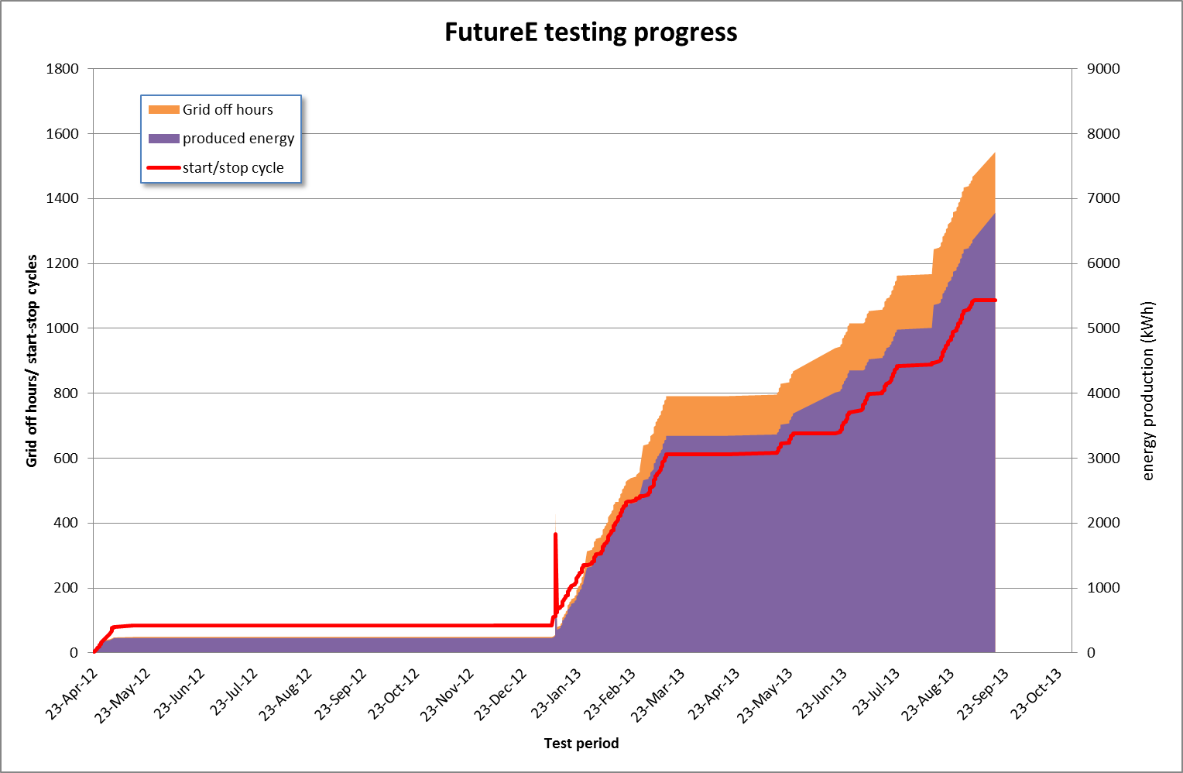
1. Project achievements
Notes:
88

Slide 9
1. Project achievements
Expected output AIP Topic: 4.2 Call: 2009 |  | Objectives Project | Current status
Number of FC back-up systems | 5-10 | 19 | 19
Reliability | 100% | >95% | 99,4% so far
Response time of less than | 5 ms | < 5 ms | Satisfied so far
Lifetimes greater than | 5 years | >1500 h | 1500 operating hours are demonstrated
Number of start-stop cycles | 1000 | 1000 | 1000 start-stop cycles are demonstrated
Target system cost | 5 k€/kW | 5 k€/kW | 5,5 k€/kW (including hydrogen generators)
Notes:
99

Slide 10
2. Relationship to earlier and
other current projects
  FCTESQA
    Fuel Cell Systems Testing, Safety & Quality Assurance (FCTESQA) led by JRC is a Specific Targeted Research project co-financed within FP6.
    Test protocol developed in FITUP will be shared and a common standardization procedure will be sought.
  FC-HyGuide
    Life Cycle Assessment Guidance for Fuel Cells and H2-Technologies is a project funded by FCH-JU.
    Outputs of FC-HyGuide are being used to carry out LCA in FITUP project.
  FC Powered RBS
    There will be a collaboration shought between the two projects for disseminating common objectives (e.g. non technical barriers, certification etc.)
Notes:
1010

Slide 11
3. Cross-cutting issues
  Test architecture and test protocols developed in this project will be standardized.
  Certification procedures will be developed and/or amended for installation of fuel cell UPS systems. TUV Sud will supervise these activities.
Potentially interested industries will be aware of the technology by disseminating project results in conferences, fairs and trade shows.
  LUASA presented a technical paper at EFCF 2013 in Lucerne, July 2013
  EPS/FutureE/LUASA presented the project In Tutorial Fuel cells at INTELEC 2013, in Hamburg, October 2013.
  Bilgi presented the project as success story in Horizon 2020 information days in Istanbul, October 2013
A workshop is planned in Istanbul in March 2014 for dissemination of the project results to the parties from related industry and academia.
Public awareness at large will be maintained with newsletters, internet and published material (3 press releases done). Project website is up and updated.
At the end of the project a report on technical results and on non-technical barriers will be published.
Notes:
1111

Slide 12
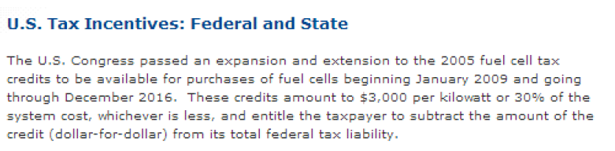
4. Exploitation /Recommendation towards the Programme
  Technical viability and reliability of back-up fuel cell system is proven
  Follow up of the project:
  Help market adoption of fuel cell systems as a back-up solution
    FCH-JU projects are not so attractive for back-up final users: (too much burocracy, administrative tasks)
    Public incentives/ tax rebate for mass adoption of fuel cell back-up systems
up to now only US, not EU, FC UPS /back-up systems manufacturers sold thousands of systems!
Notes:
1212

Slide 13
Thank you for your attention!
For more information: http://fitup.engr.bilgi.edu.tr
Ilaria Rosso
Project Coordinator FITUP
Ilaria.rosso@electropowersystems.com
Notes:
1313

