Slide 1

HYPER
(303447)
Juliet Kauffmann
Orion Innovations
www.hyperportablepower.com

Slide 2







General overview
  Integrated hydrogen power packs for portable and other autonomous applications
  3 years: September 2012 - August 2015.
  Total budget: €3,916,509; FCH JU contribution: €2,221,798.
Orion Innovations | Product commercialisation | SME | UK
PaxiTech | Fuel cell development | SME | France
Uni. Glasgow | Advanced H₂ storage materials | Research | UK
EADS IW | Demo. specific applications | Industry | Germany
Institute of Energy | Thermal modelling | Research | Poland
McPhy Energy | Solid state H₂ storage tank | SME | France
JRC | Reference laboratory | Research | Belgium

Slide 3
Core MAIP/AIP targets
    MAIP and AIP (2011): Early Markets
    To show the technology readiness of specific applications; to address cost competitiveness, lifetime, reliability and sustainability requirements.
To develop a range of fuel cell based products capable of entering the market in the near term.
AIP 2011 Topic 4.4 Research, development and demonstration of new portable Fuel Cell systems
To develop application specific prototypes ready to be used by specified end users, and demonstrating performance and operational improvements.
To incorporate design for manufacture that reduces costs.
To provide recommendations for an effective RCS framework.

Slide 4
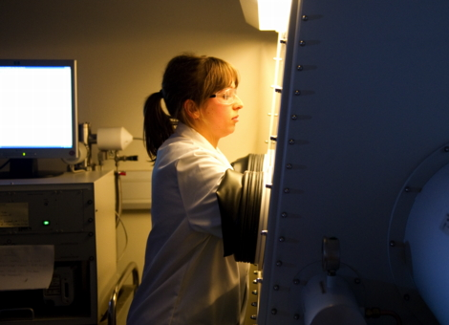
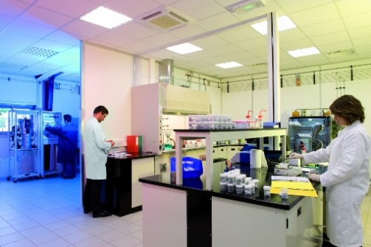
HYPER project core concept
To develop a flexible and fully-integrated fuel cell and storage system for portable power applications:
LT PEM 50 W_{e} Fuel cell stacks
Max power
500 We
Inter-changeable H2 Storage
Solid-State/ Gaseous
Integrated system: fuel cell and storage system combined and readily customised for multiple applications

Slide 5
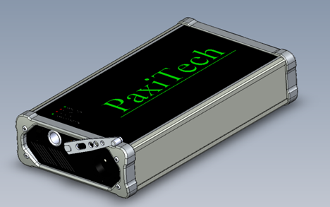
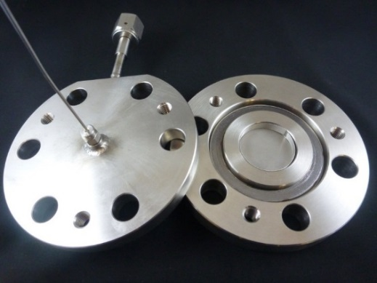
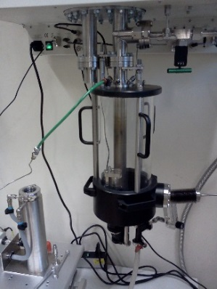
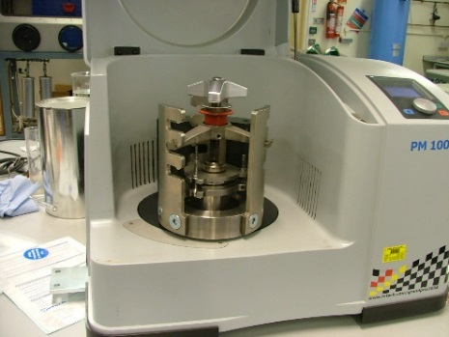
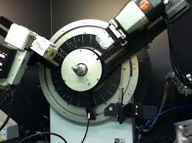
Primary research objectives
HYPER system output (W_{e}) | 100 | 500
Weight (kg) | 6.5 | 10
Volume (l) | 6 | 10
Runtime (hrs) | 25 | 5
FC efficiency | 50% | 50%
Call specified targets:
        Volume and weight: <35 kg/kW and 50 l/kW
        System efficiency >30%
        Lifetime: 1000h, 100 start stop cycles
        Operating temp: -20°C to 60°C;
        System cost: <€5000/kW

Slide 6
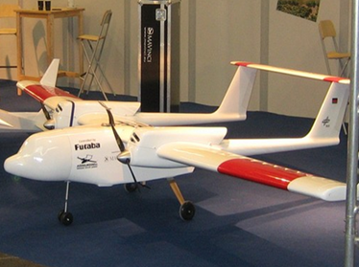

Demonstration and commercial objectives
    Demonstration:
Field demonstration of two application specific prototypes, using both solid-state and gaseous storage with end users:
        100 We portable power pack/field battery charger – OEM tbd/EADS IW.
        500 We range extender for a UAV – EADS IW.
        Commercialisation
        A system based on operational and performance targets that have been informed by end user requirements.
        Embedding cost improvement and design for manufacture within the development pathway to meet key cost targets (<€5000/kW).
        Commercialisation plan that addresses the barriers to market uptake, and identifies early routes to market.

Slide 7
Project timing
We are just over a third of the way through the project
 | Q1 | Q2 | Q3 | Q4 | Q5 | Q6 | Q7 | Q8 | Q9 | Q10 | Q11 | Q12
WP1: Systems Engineering
WP2: Develop 50 W_{e} FC module
WP3: Develop solid state H₂ storage
WP4: Testing H2 storage materials
WP5: Develop gaseous H₂ storage
WP6: Prototype 100 W_{e} system
WP7: Prototype 500 W_{e} system
WP8: Field testing
WP9: Commercialisation strategy
WP10: Dissemination

Slide 8
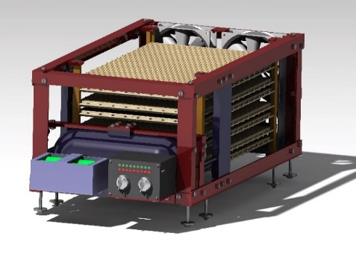
Project achievements to date
    WP 1: Systems Engineering
        Initial systems engineering review complete: with a focus on defining sub-systems and interfaces, that will meet customer requirements.
        System specification to be fixed by January 2014.
        WP2: Fuel cell development
        Fuel cell optimization complete: with >2000 hrs testing on PEM, GDL and catalyst concentration. Target power densities have been achieved at this level (>100 mW/cm²).
        PoP 50 W_{e} module nearing completion.
        WPs 3 and 4: Solid state H₂ Storage materials
        Synthesis and testing has been carried out on three solid-state hydrogen storage materials (MgH₂ + catalysts; LiOH + LiH; and Li-N-H).
        MgH₂ + catalysts as a fully reversible option and LiOH + LiH as a ‘one-shot’ option are now being modelled, and will be tested in a benchtop tank system.
        (PEM: proton exchange membrane; GDL: gas diffusion layer; PoP: proof of performance)

Slide 9
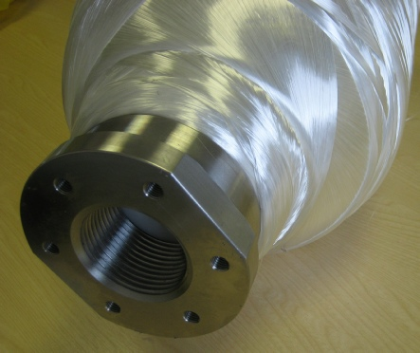
Project achievements to date cont’d
    WP 5: Gaseous storage
        Gas cylinder options analysed and sourcing of both 700 bar and 300 bar cylinders and suitable valves and regulators is underway.
        WP 9: Commercialisation
        Draft commercialisation strategy complete. Linde acting in advisory role.
        Focus for next 6 months
        PoP of scaled up FC and storage modules, ready for system integration.
        Refinement of commercialisation strategy, including life cycle analysis.
        Consideration of safety, regulations, codes and standards to ensure that requirements for both gaseous and solid state H₂ storage are addressed.
        Further engagement of end users in preparation for field testing.

Slide 10
Issues raised to date
Issue | Mitigation
Delay in starting materials research (recruitment of post-doc) would impact on subsequent work. | Doubling of resources has accelerated materials research.
Solid state storage materials: one or both remaining materials will not prove viable once tested at benchtop scale. | Further materials options are to be explored - including hybrid material systems which can be modelled at the tank level, based on inputs from benchtop testing. Deadline for decision on preferred material systems for development at end of November (on track).

Slide 11
Issues raised to date cont’d
Issue | Mitigation
Gaseous storage – 700 bar cylinders available in 2 l volumes only; homologation very expensive with long lead time. | Demonstration of both 300 bar 4 l and 700 bar 2 l cylinders to prove technical feasibility and flexibility.
System integration requirements have a negative impact on some target specifications – need to optimise ‘trade offs’. | System optimisation through testing and modelling.
Overall – mitigation and project planning focused on building in flexibility to accommodate different scenarios

Slide 12
Collaboration and dissemination
    Solid state storage Joint Workshop
        One day workshop held in October 2013 with three other projects that are focussing on solid state storage materials (SSH2S, EDEN and BOR4STORE):
          Presentations
          Poster session
          Break out discussion groups (materials, tank design, system integration and markets)
          The workshop attended by more than 60 individuals from the four projects.
          Additional conferences and posters
        Two oral presentations and three poster presentations at industry conferences.

Slide 13
Summary of project expectations
 | Call objectives | Project objectives | Status
Volume and weight | <35 kg/kW and 50 l/kW | 20 kg/kW and 20 l/kW for 500 We system | On track
Final system cost | <5,000 €/kW | <5,000 €/kW | Cost at volume tbd
System efficiency | >30% | 50% | Potential for 50%
Lifetime | 1000h, 100 start stop cycles | 1000h, 100 start stop cycles | On track
Operating temp | -20 °C to 60 °C | -20 °C to 60 °C | On track
To develop application specific prototypes ready to be used by specified end users: basic project design.
To incorporate design for manufacture that reduces costs: ongoing.
To provide recommendations for an effective RCS framework: WP 5.

Slide 14
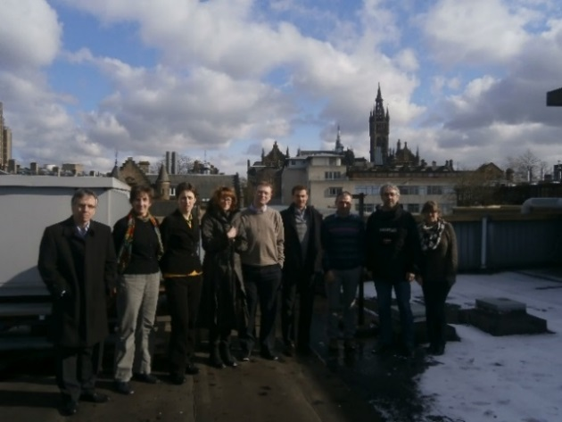
Self-assessment summary
        After 14 months, key tasks to date are completed or close to completion.
        Key milestones for next 6-12 months are scale up and PoP of both storage and fuel cell modules and subsequent system integration into 100 W_{e} prototype.
        The Consortium is working well together, with good collaboration in addressing technical challenges.
        Project currently on track to deliver against targets, with final system specification to be fixed in January 2014.
        Project risks have been identified, with mitigation steps defined.
        Project costs are in line with plan.
        THANK YOU

