Slide 1

SSH2S
(256653)
Fuel Cell Coupled Solid State Hydrogen Storage Tank
Marcello Baricco
SSH2S Coordinator
Università di Torino
marcello.baricco@unito.it

Slide 2
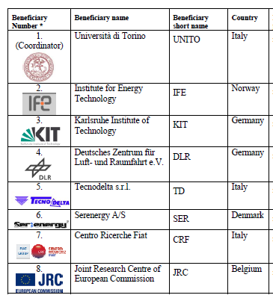
SSH2S in figure
Beginning:
Feb. 1st, 2011
End:
Sept. 30th, 2014
Duration:
42 months
Budget:
3.5 M€ Total
1.6 M€ JU contribution
Partners:
4 research + JRC
3 industries

Slide 3
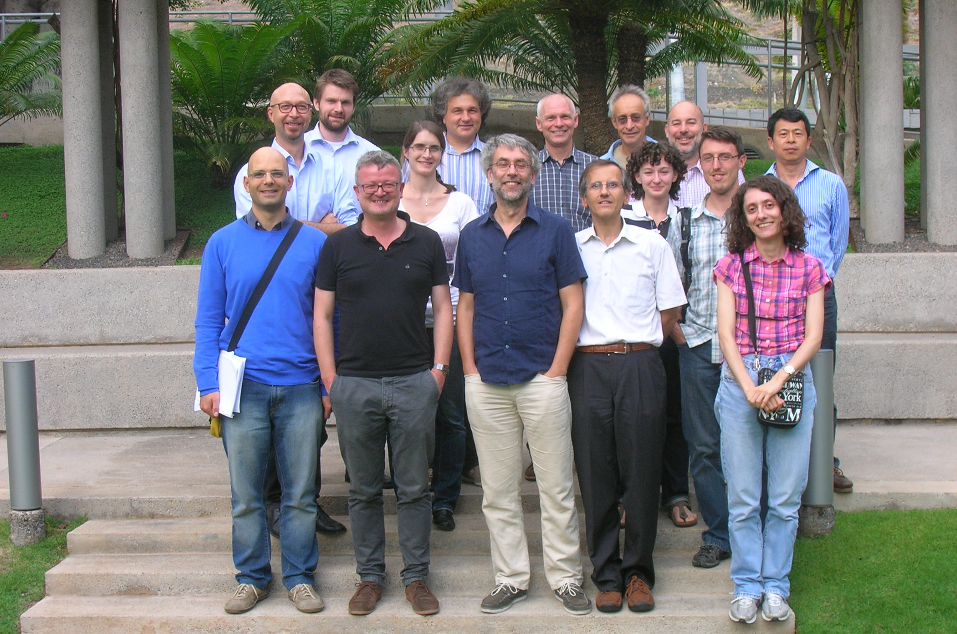
SSH2S in picture

Slide 4
SSH2S goals
Integration between hydrogen storage system and HT-PEM fuel cell
Development of new materials with high gravimetric and volumetric energy density
Technically relevant loading temperature and pressure
Loading time and stability of performances after several cycles
New tank for supply of hydrogen flow.
Low cost
Volumetric and gravimetric energy density of hydrogen storage systems
Notes:
4

Slide 5
SSH2S challenges
Design, synthesis and physico-chemical characterization, of existing and novel materials for solid state hydrogen storage.
New two-materials concept for the tank, combining hydrogen sorption properties of complex hydrides and metal hydrides.
Development of a prototype tank.
Integration of materials/tank systems with HT-PEM Fuel Cell (1 kWel).
Application of the integrated system as APU for a LTV.
Lab-scale tank
Notes:
5

Slide 6
SSH2S Combo concept
Concept of reactor based on «double material»
Notes:
6

Slide 7

SSH2S expected results
An up-scaled production of a material with capacities of up to 4.5 H₂ wt%, fully reversible at 180°C.
High stability on cycling.
New concepts on the coupling of solid state hydrogen tank with HT-PEM fuel cells.
Development of a prototype 1 kW integrated system
Possible application to a 5 kW APU.
Business opportunities for MSE.
Selected Full Electric Vehicle for APU
Notes:
7

Slide 8
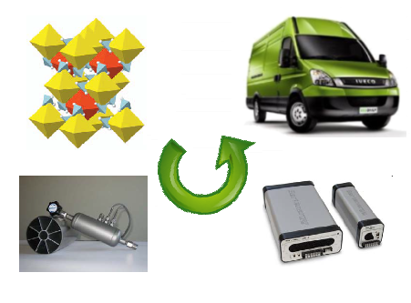
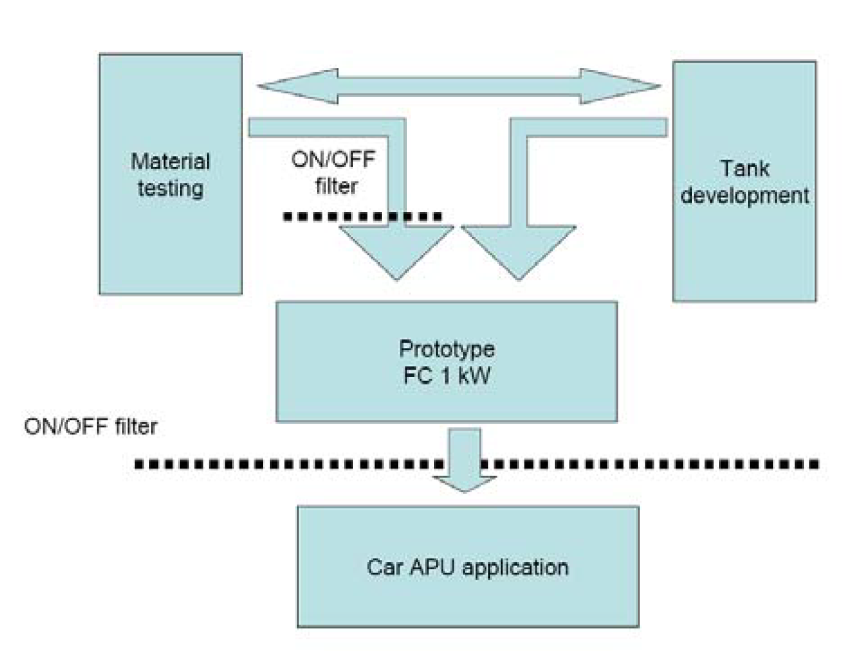
SSH2S scheme
INNOVATION
From new materials to
integrated APU system.
Notes:
8

Slide 9
SSH2S workplan
WP | Title | Type | Leader
1 | Material Design and Synthesis | RTD | KIT
2 | Materials Characterisation | RTD | IFE
3 | Lab-scale Tank Development | RTD | DLR
4 | Fabrication and Testing of Prototype Tank | RTD | TD
5 | Tank-FC integration (1 kW_{el}) | RTD | SER
6 | Final User Test | DEM | CRF
7 | Management | MGT | UNITO
Notes:
9

Slide 10
SSH2S WP1-2 results
The role of additives on the Li-Mg amide systems have been explored.
2 LiNH₂ + 1.1 MgH₂ + 0.1 LiBH₄ + 3wt% ZrCoH₃ has been selected and prepared in up-scaling conditions.
A batch of 3 kg of complex hydride has been made available.
A maximum 4.5 wt% gravimetric density has been obtained, with good cyclability.
Li-Mg amide systems have been shown to be suitable for the development of the hydrogen tank.
Vibrational ball mill for large scale preparation
Notes:
10

Slide 11
SSH2S WP3 results
Experiments and calculations on double materials concept have demonstrated a significant synergic effect.
Extended equations for thermo-fuid-dynamic modelling have been set up.
Two different lab scale tanks have been designed and put in operation to test different combination of mixed materials.
Testing setup with integrated tank (600 g)
Notes:
11

Slide 12
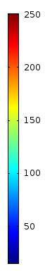


SSH2S Combo simulation
temperature
T_{i} (t=0) = 20 °C; T_{oil} (t=0) = 130 °C; t = 0…1800 s
Pure Amide
powder bed is heated from outside
Combi-Tank
reaction is initiated at the center
Notes:
12

Slide 13
SSH2S WP4 results
A prototype tank have been developed.
On basis of thermo-fuid-dynamic simulations, a detailed drawing of the hydrogen tank has been prepared.
A glove-box has been set-up and it is ready for the fabrication of the tank. Preliminary welding tests have been performed.
A complete report on safety for the hydrogen tank has been produced.
Prototype tank (3 Kg)
Notes:
13

Slide 14
SSH2S Combo results
Single tube
4 h with 1 kW_{el} possible
1 kW_{el} tank
Notes:
14

Slide 15
SSH2S WP5 results
Integrated system has been considered.
Requirements have been defined, as a starting point for further developments.
BoP for the integrated 1 kW system has been defined.
Preliminary tests on fuel cell stack and components have been performed.
Circuit diagram
Notes:
15

Slide 16
SSH2S WP6 plans
The APU will be installed inside the vehicle
Safety issues are under investigation (e.g. hydrogen sensor).
LCA analysis is planned.
Techno-economical evaluation is planned.
Load area of LTV
Notes:
16

Slide 17
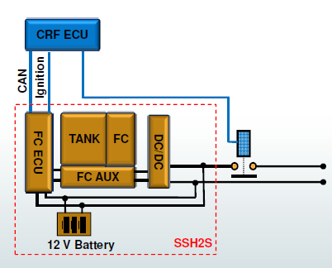
SSH2S vs MAIP/AIP
AA 2: Hydrogen Production, Storage & Distribution
MAIP/AIP targets | Project goal | Project status | Gaps bottlenecks in RTD
Long-term and break-through oriented research on improved solid state hydrogen storage options for increased efficiency and storage capability, i.e. 2nd generation hydrogen storage technology. | Integrated system to be demonstrated in a prototype APU system (1 kW) and possibily in (5 kW) | Architecture under development. Good material properties | Intrinsic properties of materials not yet optimized
Architecture for Daily Electric
Notes:
17

Slide 18
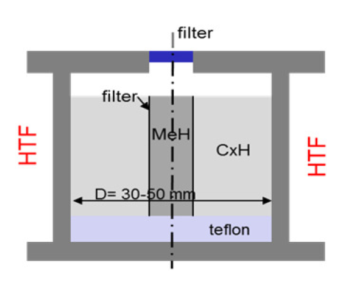
SSH2S vs MAIP/AIP
AA 2: Hydrogen Production, Storage & Distribution
MAIP/AIP targets | Project goal | Project status | Gaps bottlenecks in RTD
Storage materials with capacities ≥ 6 wt.%, ≥ 60 kg H₂/m³ reversibly releasing hydrogen at operating temperatures compatible e.g. with PEM FC, HT PEM FC or SOFC / MCFC | Approx. 5 wt% H₂ (amides) 7-11 wt% wt% H₂ (mixed borohydrides) Double materials concept | Storage materials with capacities up to 4.5 wt% H₂ Reversibility at 180 °C Single reaction step Stability on cycling Stop for mixed borohydrides | Lack of reversibility in new developed materials
Double Materials concept
Notes:
18

Slide 19

SSH2S vs MAIP/AIP
AA 2: Hydrogen Production, Storage & Distribution
MAIP/AIP targets | Project goal | Project status | Gaps bottlenecks in RTD
Improved system density for H₂ storage (2015: 9 %wt of H₂) | 4 wt% of H₂ 40 kg H₂/m³ Close to room temperature and pressure | Not yet available Gravimetric density likely lower than goal Volumetric density likely OK | High gravimetric density material with suitable properties not yet available
Cost effective production routes of the materials | < 1250 €/kg H2 | Not yet available, but higher than goal | Low production for limited market
HT-PEM for integrated system
Notes:
19

Slide 20
SSH2S dissemination
Workshop of FCH-JU projects on hydrogen storage - BOR4STORE, EDEN, HYPER, SSH2S - Oct. 2nd, 2013 in Tenerife (Spain).
Main topics discussed are the following:
  Materials for solid-state hydrogen storage
  Hydrogen tanks based on solid-state materials
  Integration of solid-state hydrogen tanks with fuel cells
  Final use and applications
Workshop of FCH projects related to APU in Torino (Italy) as a final event of the project (i.e. June 2014). DESTA and FCGEN agreed to join the meeting.
Publications and conferences.
Notes:
20

Slide 21

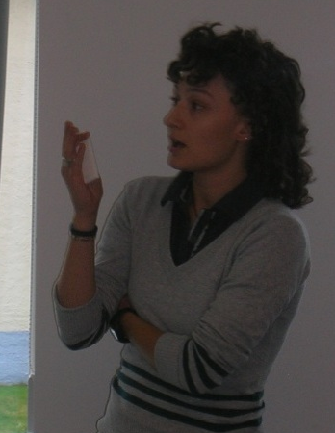
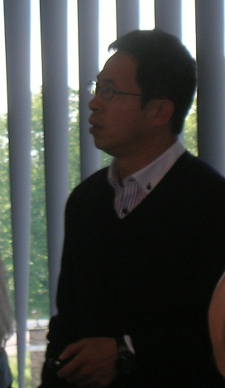
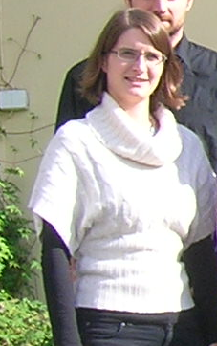
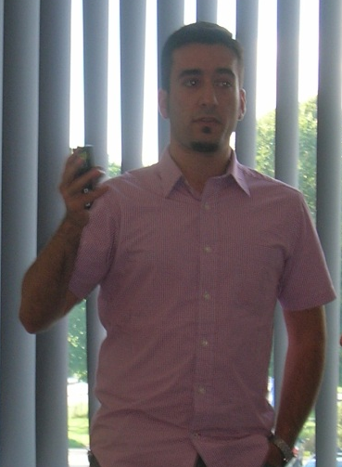
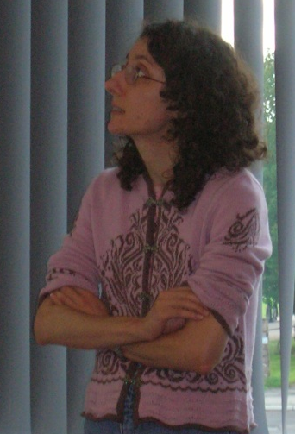
SSH2S cross cutting issues
Training: 3 PhD student and 5 PostDocs involved in the projec
Website www.ssh2s.eu
Post-project activities to be defined
Connections with national and international hydrogen projects and organizations
Notes:
21

Slide 22
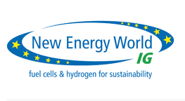





acknowledgments
Thank you for your attention
Notes:
22

