Slide 1

Program Review Days 2013
Introduction to portfolio of cross-cutting projects
Guillaume Leduc, Project Manager
http://www.fch-ju.eu/

Slide 2
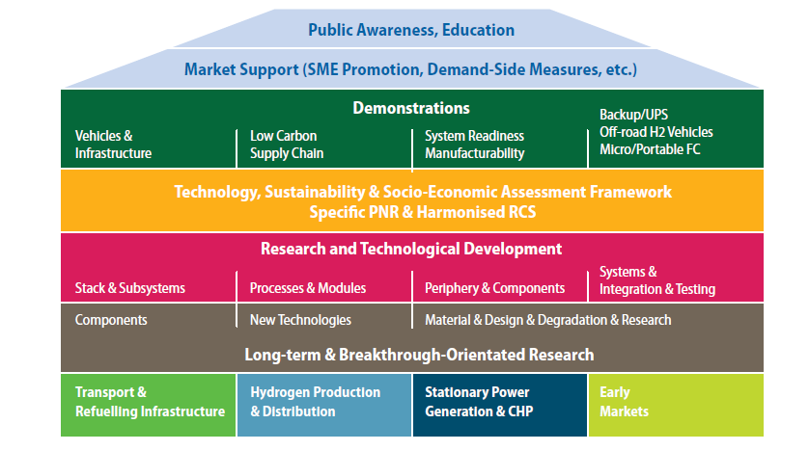
Multi-Annual Implementation Plan
2008 - 2013

Slide 3
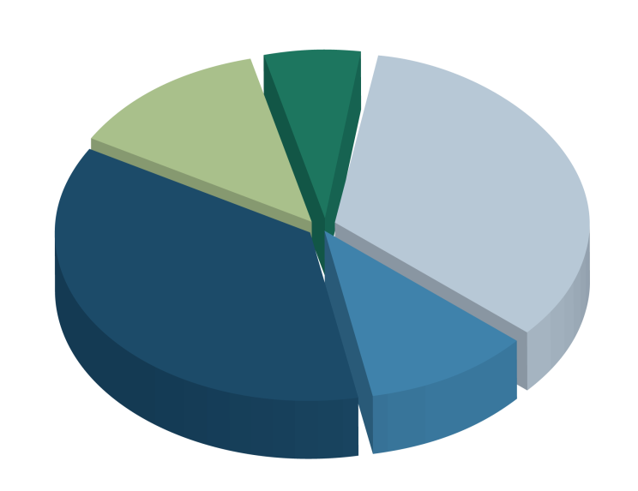
MAIP objectives
Planned budget
Cross-Cutting
Activities (6-8%)
+ PNR and benchmarking projects from other application areas
11 projects
Early Markets
(12-14%)
RCS & PNR
Harmonised standards
Transportation & Refuelling infrastructure
(32-36%)
5 projects
Education & Training
4 projects
Stationary Power Generation & CHP (34-37%)
Hydrogen Production & Distribution (10-12%)
Socio-economic & Benchmarking
3 projects
1 project
2 projects
Safety issues
TMA
LCA

Slide 4
Overview of projects portfolio (1)
Number of projects
Up to call 2013: 26 projects funded on cross-cutting activities
→ 9 projects finished, 12 projects running, 5 under negotiation (call 2013)
11
8 running projects + 3 under negotiation
5
3 projects finished + 1 running project + 1 under negotiation
3
3 running projects
4
3 projects finished + 1 under negotiation
1
1 project finished
2
2 projects finished

Slide 5
Overview of projects portfolio (2)
FCH JU funding
€ 29 million FCH JU contribution up to call 2013
→ 6.8% of the total FCH JU budget
€ 54 million total costs

Slide 6
Overview of projects portfolio (3)
FCH JU budget per type of activity
Benchmarking (1)
Social acceptance (1)
Roadmaps (2)
TEMONAS
FC-HyGuide
Nb of projects (right scale)
Safety knowledge assessment (1)
H2 sensors (1)
CFD evaluation protocol (1)
Material testing
ca. € 29 million
(total of 26 projects)
Stack
testing
H2 quality and measurement
(11 projects)
Vocational training (2)
Post-graduate, scientists (1)
Public safety officials (1)
First responders (1)
Fast-filling
Indoor use

Slide 7
Key achievements
  → A guidance document was developed (project FC-HyGuide) on how to perform LCA of FCH technologies. Document available on the FCH JU website.
  For more info: http://www.fc-hyguide.eu/
  → Preparation of large demo projects on H2 vehicles (Nexthylights), benchmarking data for stationary power generation(FC-Eurogrid)
  → A specific TMA tool (TEMONAS) has been developed for the FCH JU so as to monitor and evaluate progress towards the FCH JU objectives and vis-à-vis external developments. For more info: http://www.temonas.eu/
  → Education and Training
    HyProfessionals - Vocational H2 training status in the EU, 4 pilot actions attended by 353 students (253 person/week), assessment of the human resources required to cover several FCH market needs (more info at: http://hyprofessionals.eu/)
    HyFacts - Development of a training package for regulators and public safety experts (more info at: www.hyfacts.eu/)
    TrainHy - Development on an International Curriculum on FCH technologies (more info at: http://www.hysafe.org/TrainHyProf)
On-going impacts of PNR projects on RCS (e.g. ISO TC 197, IEC TC 105) – International collaboration is crucial!

Slide 8
On-going PNR projects
Material/stack testing
HyCOMP - Enhanced Design Requirements and Testing Procedures for Composite Cylinders intended for the Safe Storage of Hydrogen (01/01/2011 - 31/12/2013; €1.4 million FCH JU funding)
StackTest - Development of PEM Fuel Cell Stack Reference Test Procedures for Industry (01/09/2012 - 31/08/2015; € 2.9 million FCH JU funding)
MATHRYCE - Material Testing and Design Recommendations for Components exposed to Hydrogen Enhanced Fatigue (01/10/2012 - 30/09/2015; € 1.3 million FCH JU funding)
FireComp - Modeling the thermo-mechanical behavior of high pressure vessel in composite materials when exposed to fire conditions (01/06/2013 - 31/05/2016; € 1.9 million FCH JU funding)
H2 measurement
HyAC - High measurement accuracy of hydrogen refueling (01/10/2013 - 30/09/2014; € 0.5 million FCH JU funding)
Fast transfers of compressed H2
HyTransfer - Pre-Normative Research for Thermodynamic Optimization of Fast Hydrogen Transfer (01/06/2013 - 30/11/2015; € 1.6 million FCH JU funding)
Safe indoor use of H2 and FC
HyIndoor - Pre Normative Research on the indoor use of fuel cells and hydrogen systems (02/01/2012 - 01/01/2015; € 1.5 million FCH JU funding)

Slide 9
Other on-going projects
First responders
HyResponse - European Hydrogen Emergency Response training programme for First Responders (01/06/2013 - 31/05/2016; €1.9 million FCH JU funding)
Safety knowledge assessment
H2Trust - Development of H2 Safety Expert Groups and due diligence tools for public awareness and trust in hydrogen technologies and applications (01/06/2013 - 30/11/2014; € 0.8 million FCH JU funding)
Assessment of best practices in use of CFD for safety analysis
SUSANA - Support to Safety Analysis of Hydrogen and Fuel Cell Technologies (01/09/2013 - 31/08/2016; € 1.2 million FCH JU funding)
Hydrogen safety sensors (first FCH JU/US DoE common project)
H2Sense - Cost-effective and reliable hydrogen sensors for facilitating the safe use of hydrogen (01/06/2013 - 31/05/2014; € 0.4 million FCH JU funding)
9

Slide 10
Thank you for your attention!
Further info:
FCH JU : http://fch-ju.eu
NEW-IG : http://www.new-ig.eu
N.ERGHY : http://www.nerghy.eu

