Slide 1

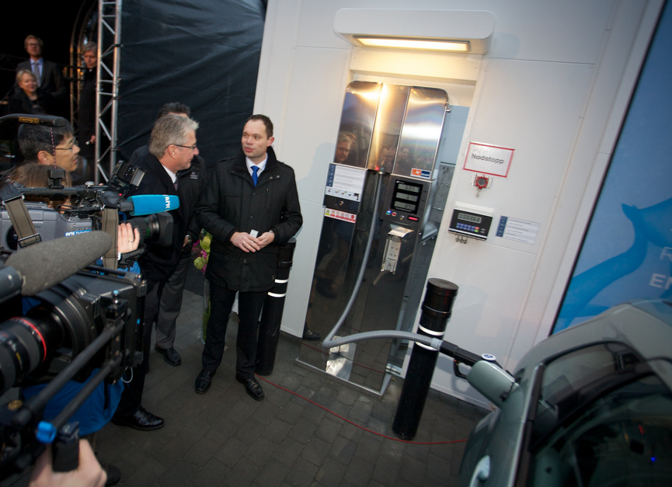
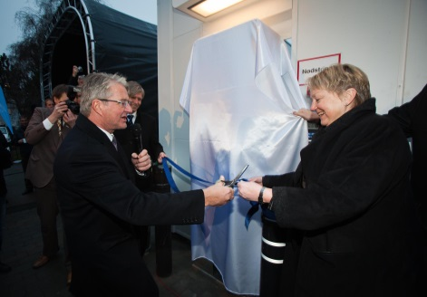
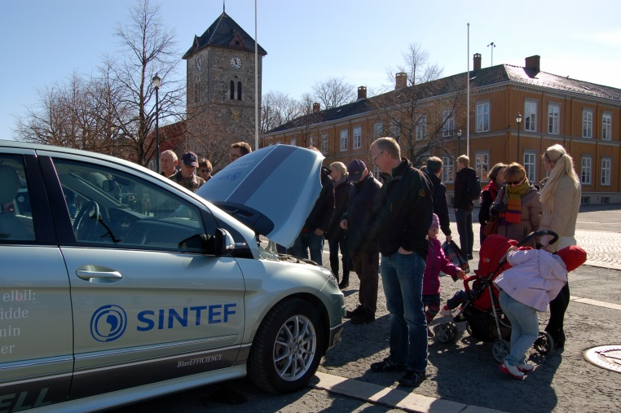
Strong European partnership - ready for take two
1.Jan 2014
2
6th Stakeholder General Assembly for the
Fuel Cells and Hydrogen Joint Undertaking
13 November 2013, Brussels
Unni Steinsmo, President and CEO, SINTEF
Notes:
Explain the photo in the context of linking R&D, demonstration and deployment
I firmly believe that fuel cells and hydrogen are among the key innovations that will help Europe, and indeed the world, achieve a low carbon, secure and competitive economy.
What will it take for Europe to ensure competitiveness, indeed – to become the winning team? In an ever more competitive global landscape, Europe certainly needs to keep its foot on the accelerator – and maybe even change gear?
Bridge: I am, on behalf of SINTEF, proud to be a part of this initiative, which mirrors our purpose and role in society (Technology for a better society).

Slide 2
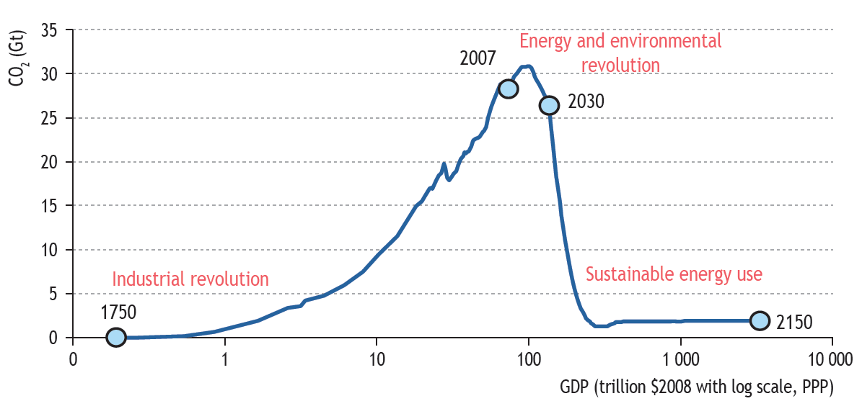
This is our time. Big challenges. Huge possibilities.
Our responsibility: To take care of the environment, To manage the resources, to create the jobs of the future and the good society.

Slide 3
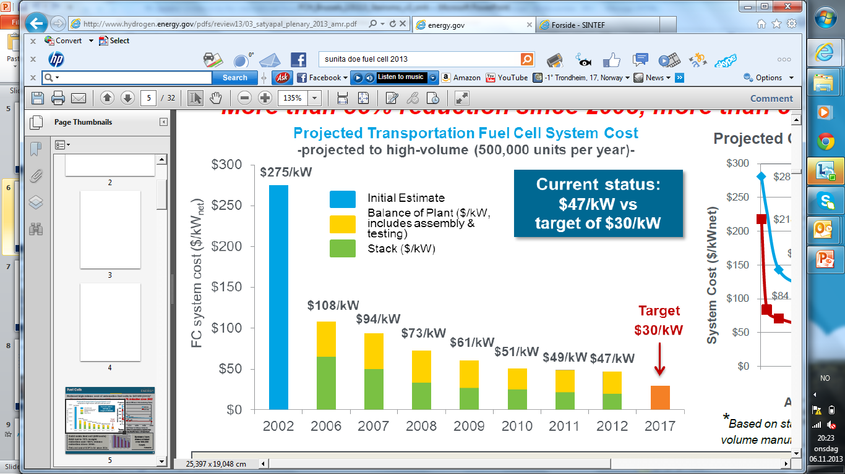

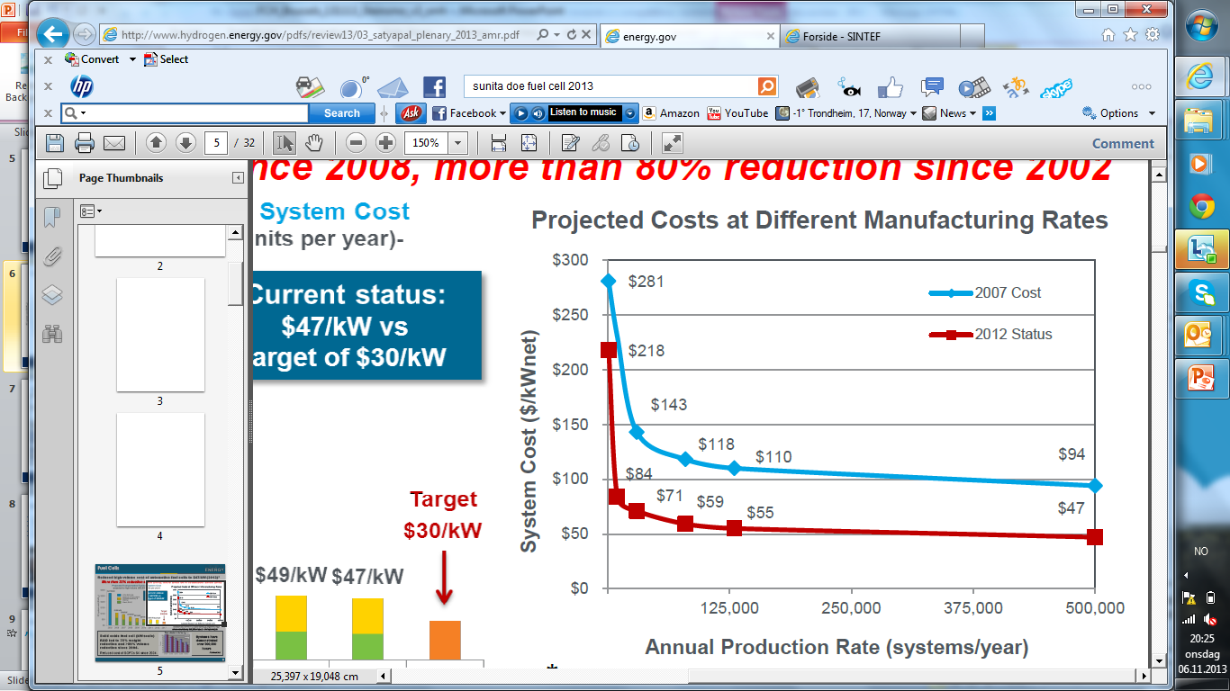
Fuel Cell Cost evolution, PEMFCs automotive applications
Notes:
Similarly, we've seen how fuel cells for automotive applications are getting ever closer to the cost target. We now need to increase volume to become competitive with internal combustion engines (at $30/kW).
Life time of fuel cells also have to be increased both for automotive and stationary applications, and here SINTEF is engaged in three FCH JU projects and acts as coordinator of one of these.

Slide 4
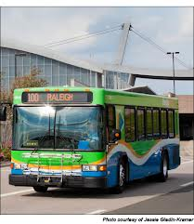
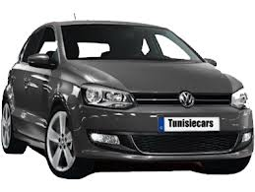
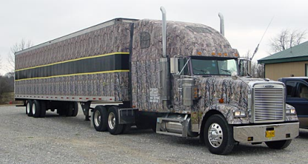
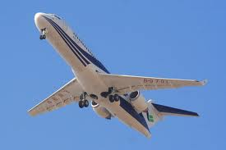
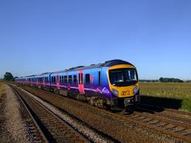
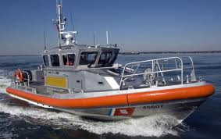
Alternative fuels for transport
 | Road |  |  |  |  |  | Air | Rail | Water
Range | Urban | Medium | Long | Short | Medium | Long |  |  | Inland | Short sea | Maritime
Natural gas |  |  |  |  | LNG | LNG |  |  | LNG | LNG | LNG
Electricity
Biofuels
Hydrogen
Source: European Commission, DG Transport
Notes:
12/11/2013
4
We've seen endless discussions on "WHO WILL BE THE WINNER", but I'm convinced that there is NO SILVER BULLET, as confirmed by EU's proposal for a Directive for Alternative Fuels.
A variety of fuels and drive trains are needed to reach our ambitious emission targets, and we believe that Hydrogen and Fuel Cells represent key technologies to reach sustainability in transportation.

Slide 5
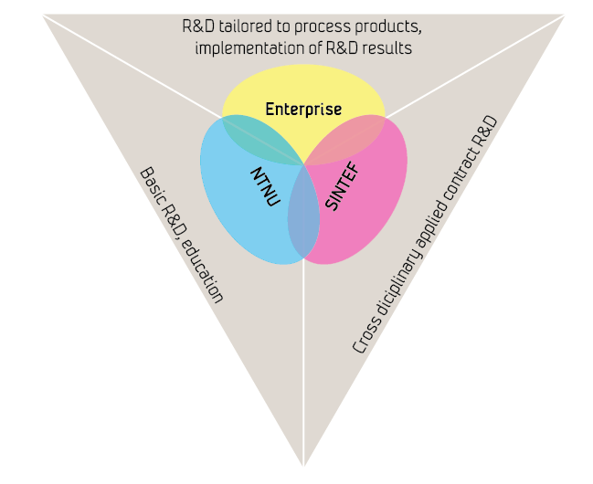
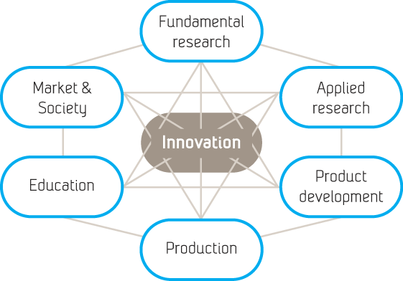
Our innovation model
”
From problem definition through
origination and refinement of ideas
to transformation into something useful
"Problems set and solved in the context of an application"
Notes:
INTEF is a link between university (explain NTNU) and industry.
This has been our innovation model for more than 60 years
"Science and technology R&D lie at the heart of innovation"
More than 90 percent of our income comes from contracts won in open competition – this ensures that all our projects by definition have needs and demand in the industry as a starting point.
Instruments like the FCH JU are therefore well aligned with SINTEF's well established business model since the 1950s
Bridge: We therefore highly support the continuation of the FCH JU in the Horizon 2020 time frame (2014-2020) and perceive this as a strong partnership well shaped to address the key challenges.

Slide 6



Strong partnership – industry in the lead
Industry grouping
Over 60 members
Research grouping
~ 60 members
Notes:
In the context of Fuel Cells Hydrogen Joint Undertaking, SINTEF represents both a
key player through our contribution in the R&D activities as well as
strategically through our representation in the Executive Board of N.ERGHY
This is a unique joint undertaking: the only one where R&D community have a seat in the Governing Board (steering committee). We believe this is one of the key strengths of this JU because it ensures that we are addressing the key challenges at hand. As such, it is a means to accelerate the development of technology base towards market deployment of a portfolio of FCH solutions across energy and transport sectors.
Bridge: Let me elaborate on the European Research Community, represented by N.ERGHY (the Research Grouping), of which SINTEF is one of around 60 members

Slide 7

Strong partnership – European research community
~60 members
20 countries
~ 2000 scientists
Geographical Member Distribution
February 2013
Notes:
With more than 2000 researchers working on hydrogen and fuel cell technologies throughout Europe, we believe that this is one of the pillars to success for the European initiative.
The FCH JU has played a leading role in actively shaping the R&D agenda, focusing on the most critical actions, within and across sectors / applications, and assigned funding based on “return on investment”.
The FCH JU has funded a broad range of research projects. Without these funds, many technology breakthroughs would not have occurred.
Bridge: One example is…

Slide 8
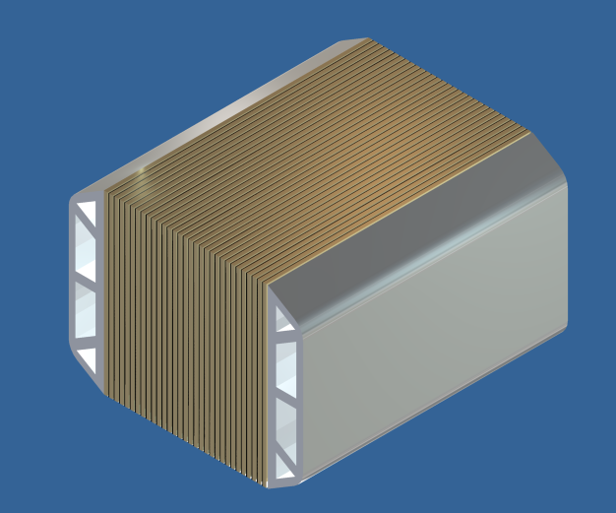
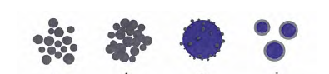
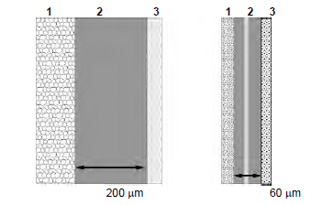
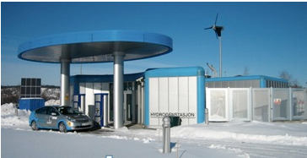
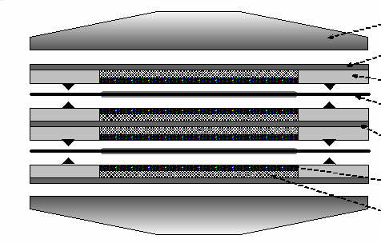
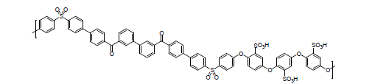






NEXPEL main objective:
Develop and demonstrate a PEM water electrolyser integrated with RES:
75% Efficiency (LHV), H₂ production cost ~ €5,000 / Nm³h⁻¹, target lifetime of 40,000 h
New catalysts
Improved MEAs
Improved DC-DC converter
Novel stack design and new construction materials
New membrane materials
Notes:
These results have come to fruition owing to the programming and financing predictability of FCH JU
This long-term outlook offers a stable environment without which some activities would be impossible
Knowledge taken into use!

Slide 9



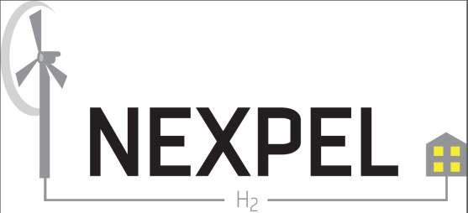



Projects under the FCH JU-program w/SINTEF involvement
PreparH2
SMARTCat
RAMSES
Scandinavia
Notes:
The NEXPEL project is now followed up by the NOVEL project, taking European based PEM water electrolyser technology one step closer to market.
NEXPEL and NOVEL are two out of more than 10 FCH JU projects that SINTEF is proud of contributing to, of which we coordinate 5.
Bridge: SINTEF has not only engaged in R&D projects, but also two demonstration projects, HyLIFT DEMO and H2movesScandinavia, how come?

Slide 10

Bridging the gap
Sustainable
market
Infrastructure
Common standards
Infrastructure
Common standards
RTD Projects
Green Car Initiative
FCH JU
Collaborative research
Market incentives
Subsidies
Fiscal advantages
EIB loans
Regulatory measures
CO2 and pollutants
Fuel quality and renewable energy Directives
Green procurement
Source: European Commission, DG Transport
Notes:
So, back to where we started:
Why does SINTEF engage in the deployment?
The answer is simple: Infrastructure is the missing link to form a market for fuel cell vehicles
Sustainability is not only about developing the right technologies.
At SINTEF, we are committed to contributing to the whole value chain, and we will continue to play a key role in the strong European effort on fuel cells and hydrogen technologies.
I can't see a better way of fulfilling SINTEF's vision "Technology for a better society".

Slide 11
Notes:
Key success criteria: Linking R&D, demonstration and deployment
Taking technology leadership – together
Shorten time to market
The ideal mix: Price, Efficiency and Life time
Thanks to this program, we have been able to develop our expertise and enhance our position at the forefront of technological development in FCH. I look forward to working with all of you over the nest few years to accelerate the development of a cutting-edge technology and, most importantly, deploying a portfolio of FCH solutions across energy and transport sectors.

