Slide 1

RESelyser
(278732)
Regine Reissner
Deutsches Zentrum fuer Luft- und Raumfahrt (DLR)

Slide 2
0. Project & Partnership description
  General Overview
  “Hydrogen from RES: pressurised alkaline electrolyser with high efficiency and wide operating range”
  Duration Nov. 2011 – Oct. 2014
  Total budget: 2.89 Mio. €, FCH-JU contribution: 1.48 Mio. €; Regional support: 594,000 DKK from ForskEl program of Energinet.dk
  Consortium:
  DLR Dt. Zentrum f. Luft- und Raumfahrt - Germany (coordinator)
  VITO Vlaamse Instelling voor Technilogisch Onderzoek N.V. – Belgium
  Hydrogenics Europe NV – Belgium
  DTU Danmark Techniske Universitet, Risoe Lab - Denmark
http://www.reselyser.eu

Slide 3
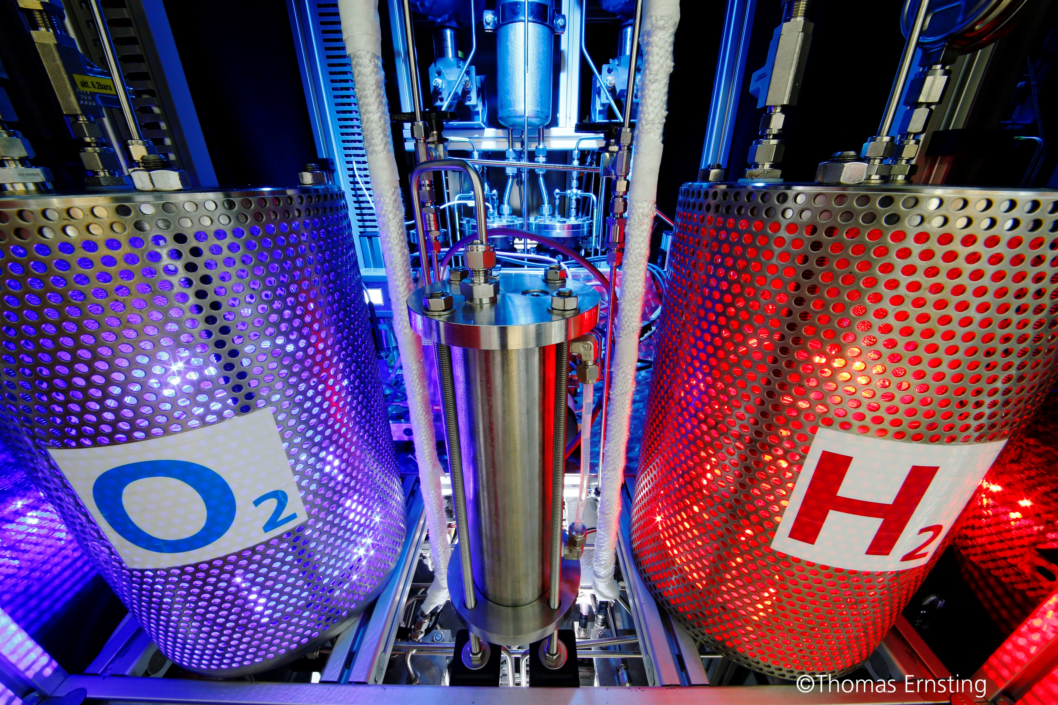

1. Project achievements in relation to the AIP/MAIP
    Project objectives and targets in relation to the AIP/MAIP
The project develops high pressure, low cost alkaline water electrolysers that can be integrated with renewable power sources using
an advanced membrane concept,
highly efficient electrodes
and a new cell concept
http://www.reselyser.eu

Slide 4
1. Project achievements in relation to the AIP/MAIP
    Project objectives and targets in relation to the AIP/MAIP
AIP 2010 efficient alkaline electrolyser RESelyser Objectives
http://www.reselyser.eu

Slide 5
1. Project achievements in relation to the AIP/MAIP
    Project objectives and targets in relation to the AIP/MAIP
AIP 2010 efficient alkaline electrolyser RESelyser Objectives
Power level single stack exceeding 5 kW
http://www.reselyser.eu

Slide 6
1. Project achievements in relation to the AIP/MAIP
    Project objectives and targets in relation to the AIP/MAIP
AIP 2010 efficient alkaline electrolyser RESelyser Objectives
Power level single stack exceeding 5 kW -> 30 kW
http://www.reselyser.eu

Slide 7
1. Project achievements in relation to the AIP/MAIP
    Project objectives and targets in relation to the AIP/MAIP
AIP 2010 efficient alkaline electrolyser RESelyser Objectives
Power level single stack exceeding 5 kW -> 30 kW
Efficiency @ 0.75 A/cm²: η>80% on HHV basis
http://www.reselyser.eu

Slide 8
1. Project achievements in relation to the AIP/MAIP
    Project objectives and targets in relation to the AIP/MAIP
AIP 2010 efficient alkaline electrolyser RESelyser Objectives
Power level single stack exceeding 5 kW -> 30 kW
Efficiency @ 0.75 A/cm²: η>80% on HHV basis demonstrated with 300 cm² electrodes, low cost materials
http://www.reselyser.eu

Slide 9
1. Project achievements in relation to the AIP/MAIP
    Project objectives and targets in relation to the AIP/MAIP
AIP 2010 efficient alkaline electrolyser RESelyser Objectives
Power level single stack exceeding 5 kW -> 30 kW
Efficiency @ 0.75 A/cm²: η>80% on HHV basis demonstrated with 300 cm² electrodes, low cost materials
Electrolyser system operating at 15 MPa with internal compression or 3MPa bar without additional compressing means
http://www.reselyser.eu

Slide 10
1. Project achievements in relation to the AIP/MAIP
    Project objectives and targets in relation to the AIP/MAIP
AIP 2010 efficient alkaline electrolyser RESelyser Objectives
Power level single stack exceeding 5 kW -> 30 kW
Efficiency @ 0.75 A/cm²: η>80% on HHV basis demonstrated with 300 cm² electrodes, low cost materials
Electrolyser system operating at 10-15MPa concept, 2.5MPa realisation
http://www.reselyser.eu

Slide 11
1. Project achievements in relation to the AIP/MAIP
    Project objectives and targets in relation to the AIP/MAIP
AIP 2010 efficient alkaline electrolyser RESelyser Objectives
Power level single stack exceeding 5 kW -> 30 kW
Efficiency @ 0.75 A/cm²: η>80% on HHV basis demonstrated with 300 cm² electrodes, low cost materials
Electrolyser system operating at 10-15MPa concept, 2.5MPa realisation
Retention of >90% of initial efficiency over at least 1000 on/off switching cycles
http://www.reselyser.eu

Slide 12
1. Project achievements in relation to the AIP/MAIP
    Project objectives and targets in relation to the AIP/MAIP
AIP 2010 efficient alkaline electrolyser RESelyser Objectives
Power level single stack exceeding 5 kW -> 30 kW
Efficiency @ 0.75 A/cm²: η>80% on HHV basis demonstrated with 300 cm² electrodes, low cost materials
Electrolyser system operating at 10-15MPa concept, 2.5MPa realisation
Retention of >90% of initial efficiency over at least 1000 on/off switching cycles demonstrated with 10 kW electrolyser
http://www.reselyser.eu

Slide 13
1. Project achievements in relation to the AIP/MAIP
    Project objectives and targets in relation to the AIP/MAIP
AIP 2010 efficient alkaline electrolyser RESelyser Objectives
Power level single stack exceeding 5 kW -> 30 kW
Efficiency @ 0.75 A/cm²: η>80% on HHV basis demonstrated with 300 cm² electrodes, low cost materials
Electrolyser system operating at 10-15MPa concept, 2.5MPa realisation
Retention of >90% of initial efficiency over at least 1000 on/off switching cycles demonstrated with 10 kW electrolyser
Modular system cost 1,000 € per Nm³/h plant capacity for the stack and 3,000 € /Nm³ for a complete system
http://www.reselyser.eu

Slide 14
1. Project achievements in relation to the AIP/MAIP
    Project objectives and targets in relation to the AIP/MAIP
AIP 2010 efficient alkaline electrolyser RESelyser Objectives
Power level single stack exceeding 5 kW -> 30 kW
Efficiency @ 0.75 A/cm²: η>80% on HHV basis demonstrated with 300 cm² electrodes, low cost materials
Electrolyser system operating at 10-15MPa concept, 2.5MPa realisation
Retention of >90% of initial efficiency over at least 1000 on/off switching cycles demonstrated with 10 kW electrolyser
Modular system cost 3,000 € per Nm³/h plant capacity for the complete system
http://www.reselyser.eu

Slide 15
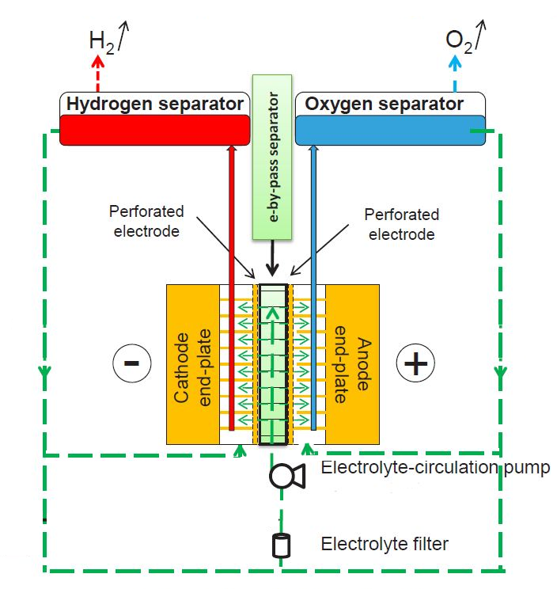
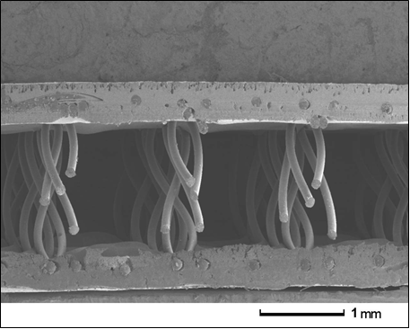
1. Project achievements in relation to the AIP/MAIP
    Project Achievements in respect to the stated objectives and targets
RES-operation-> Improvements in low current density and high pressure as well as high current density region by « e-bypass membrane »
http://www.reselyser.eu

Slide 16
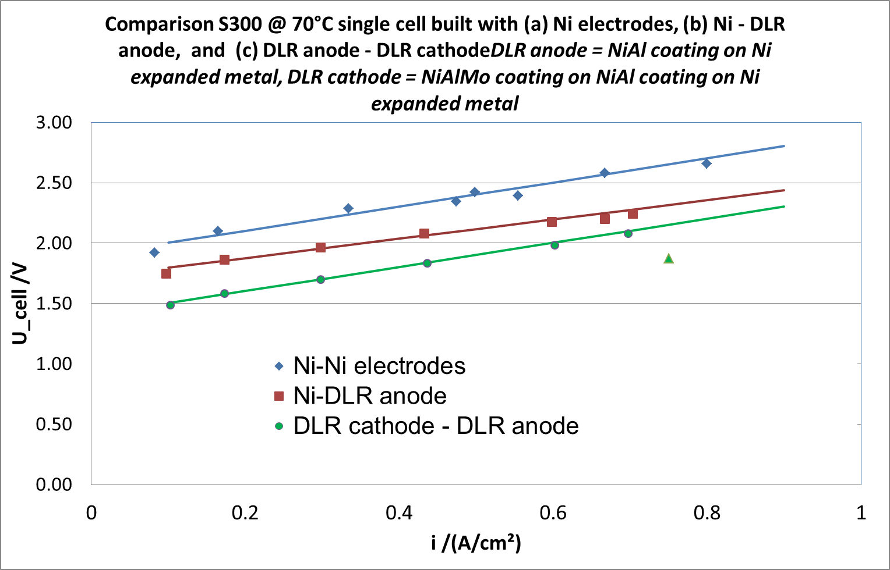
1. Project achievements in relation to the AIP/MAIP
    Project Achievements in respect to the stated objectives and targets
http://www.reselyser.eu

Slide 17
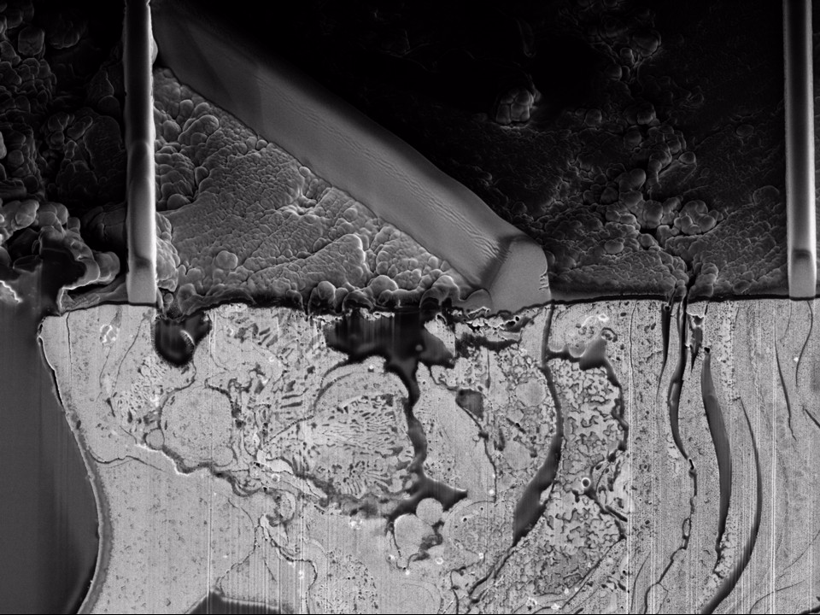
1. Project achievements in relation to the AIP/MAIP
    Project Achievements in respect to the stated objectives and targets
Porosity investigation of electrode coating by 3D SEM reconstruction
http://www.reselyser.eu

Slide 18
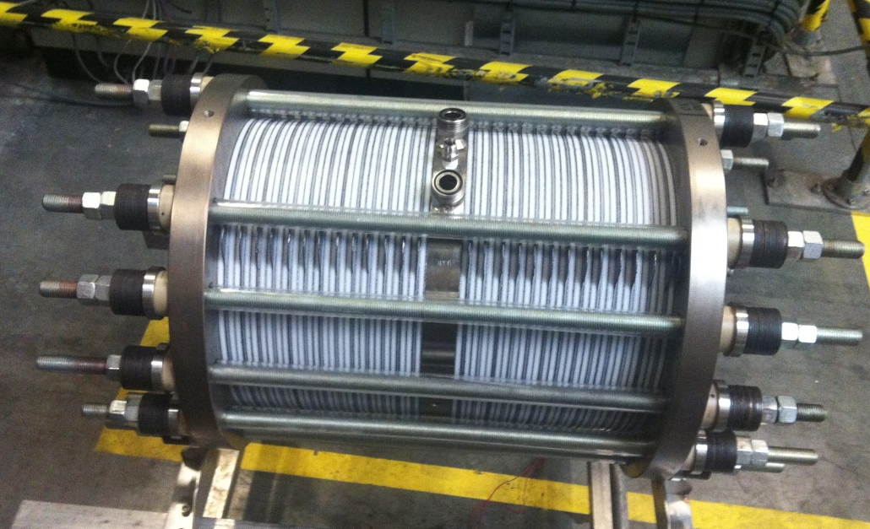
1. Project achievements in relation to the AIP/MAIP
    Project Achievements in respect to the stated objectives and targets
10 kW stack with e-bypass membrane and Plasma-spray coated electrodes
http://www.reselyser.eu

Slide 19
1. Project achievements in relation to the AIP/MAIP
    Evaluation of the progress towards the overall project objectives
Power level single stack 30 kW | 10 kW stack ready
Efficiency @0.75 A/cm²: η>80% on HHV basis demonstrated with 300 cm² electrodes, low cost materials | η=70%
Retention of >90% of initial efficiency over at least 1000 on/off switching cycles demonstrated with 10 kW electrolyser | Tests in preparation
Modular system cost 3,000 € per Nm³/h plant capacity for the complete system | System not yet defined and quantified

Slide 20
1. Project achievements in relation to the AIP/MAIP
    Bottlenecks and Risks
Some delays
  delayed materials delivery from suppliers
Delay because of sealing / mechanical construction
Extra effort for adequate degassing efficiency
http://www.reselyser.eu

Slide 21
2. Complementary information
  Complementarity with Projects from Other Programs
  DTU Energinet.dk
  DLR German national projects
  Hydrogenics Ingrid FP7 nr. 296012 (DG-Energy) / Don Quichote (FCH-JTI nr. 303411)
  VITO ElyGRID
  Dissemination Activities
  Workshop planned with ElyGRID
  Papers
  Conference and exposition presentations
http://www.reselyser.eu

Slide 22
2. Complementary information
  Exploitation and Post-Project Activities
  Added value in Hydrogenics’commercial electrolysers
  electrode materials, sealing, elevated pressure concept, control electronics,…
  Licensing of materials and concepts to other interested companies
  Recommendations towards the Programme
  Next step: to realise the technique in a full scale technical electrolyser and demonstrate the connection to renewable energy sources
  Further improvements of the electrolyser by establishing and using techniques for measurement in the electrolyser (e.g. current density distribution) and by theoretical simulations (eg. bubble formation and transport)
http://www.reselyser.eu

