Slide 1

Program Review Days FCH JU 2013
Portfolio Transport Demonstration Projects
Enrique Girón, Project Manager
http://www.fch-ju.eu/

Slide 2
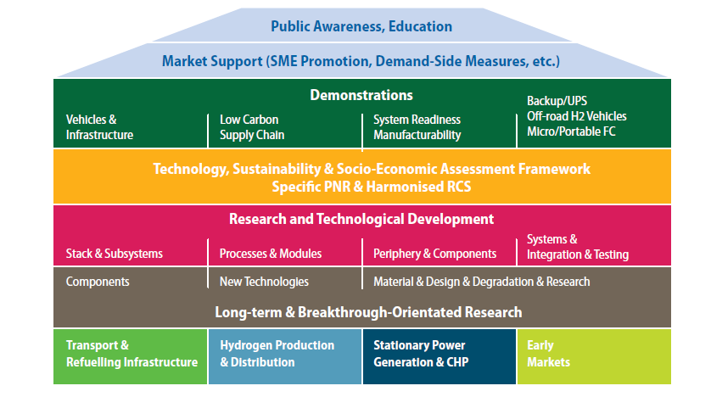
Multi-Annual Implementation Plan
2008 - 2013

Slide 3
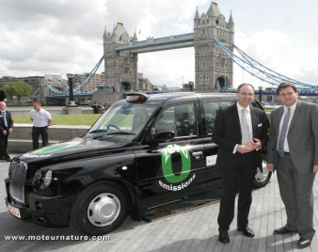
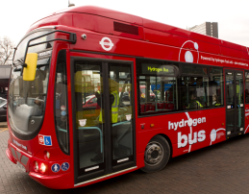
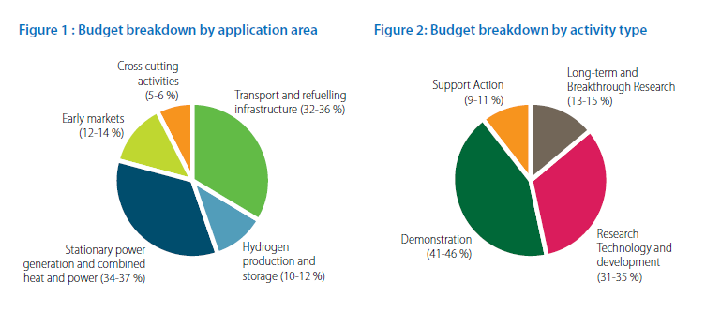
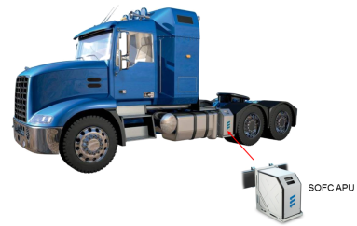
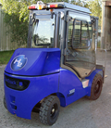
MAIP objectives
Budget distribution
Combined expected budget of 120M€

Slide 4
MAIP objectives
Technical objectives
Market application |  | 2010 baseline | 2015 mid-term | 2020 long-term
Cars: Vehicle PEM-FC System |  | >100 / 0.5M€ >1,000€/kW | >5,000 / <50k€ 100€/kW | 500,000 /<30k€ 50€/kW
Busses: Vehicle PEM-FC System |  | >10 / 2M€ >3,500€/kW | 500 / <1M€ <3,500€/kW | 1,000 / <500k€ <400€/kW
Hydrogen refuelling stations |  | <75 / 1 - 3 M€ (depending on size of filling station) | <300 / 0.6 - 2.5 M€ (depending on size of filling station) | >2000 / 0.6 - 1.6M€ (depending on size of filling station)
APU's | for truck applications (5kW) for aircraft applications (20-120kW) for maritime applications (50-500 kW) | 3,000€ | 1,000€ | 500€
 |  | Lab test units only | flight validation supply | early operation (hundreds) / 500 €/kW
 |  | single demonstrations | some tens / 3000-4000 €/kW | hundreds / <2000 €/kW
Heavy duty material handling vehicles |  | <50 units | <3,500€/kW fuel cell system | >1,500 units | <1,500€/kW fuel cell system Anticipating supported deployment from 2013+ | >20,000 units | <1,000€/kW fuel cell system Anticipating commercial introduction beyond 2015+

Slide 5
MAIP objectives
Cars:
Build up number of vehicles in the road.
INFRASTRUCTURE:
Sufficient and at cost
Buses:
Reduce the cost of the vehicles & fuel economy
APUs:
Technology validation
&
market identification
MHV:
Show business case.

Slide 6
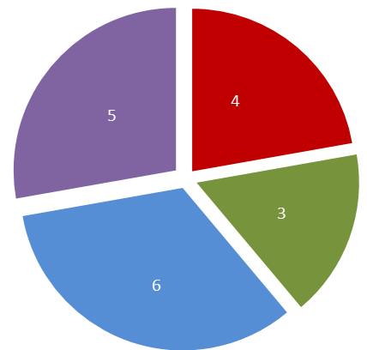
MAIP Coverage
  Budget distribution
    Combined financial contribution: 114.3M€(+18.0M€)
  Projects and budget
  Main technical achievements
52.6 M€
23.2 M€
64.6 (+32.8) M€
5
3 (+1)
26.7 (+18.0) M€
37.9 M€
18.2 M€
3
129.8 M€
46.4 M€
6
>150 cars
>45 buses
>400 MHV
4 APU applications
>20 filling points

Slide 7
Achievements
Cars
H2MOVES
19 cars / 1 station
HYTEC
40 cars / 2 stations
SWARM
90 cars / 3 stations
XXX
100 cars / 5 stations
2010
2013
2016
Increased fleets
Extended infrastructure
Reduction in vehicle cost

Slide 8
Achievements
Buses
Stakeholders to define commercialisa-tion pathway
CHIC
26 buses / 5 stations
HIGH V.LO-CITY
14 buses / 2 stations
HYTRANSIT
6 buses / 1 station
Bus Study
High interest and commitment
2010
2013
2016
Reduction in fuel consumption
Geographical expansion
Reduction in vehicle cost

Slide 9
Achievements
APUs
FCGEN
Truck /PEM
DESTA
Truck /SOFC
SAPIENS
RV /SOFC
PURE
Boat /PEM
HYCARUS
Airplane /PEM
SAFARI
Truck /SOFC
2010
2013
2016
Technology readiness
Application identification

Slide 10
Achievements
MHVs
FAILED
SHEL
10 FL / 3-4 sites
HyLIFT-DEMO
10 FL / 1 Tow truck
MobyPost
10 Postal Vehicles
HyLIFT-EUROPE
200 MHV
HAWL
200 FL
2010
2013
2016
System cost reduction
Increase in fleet size
Prove business model

Slide 11
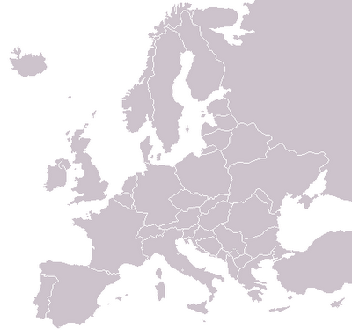
Achievements
Map of demonstration sites
Cars
Buses
MHV

Slide 12
Thank you for your attention !
Further info :
FCH JU : http://fch-ju.eu
NEW-IG : http://www.new-ig.eu
N.ERGHY : http://www.nerghy.eu

