Slide 1

Program Review Days 2013
Introduction to portfolio of Energy Demonstration projects
Mirela Atanasiu, Project Manager
http://www.fch-ju.eu/

Slide 2
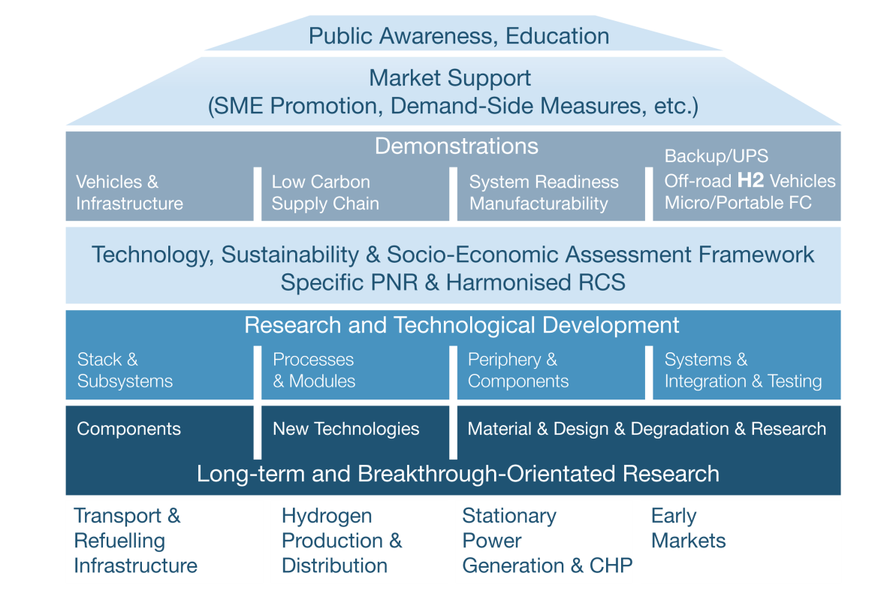
FCH for ENERGY: 89 projects
221 mill EUR committed by EU/FCH
RTD:
62 projects
DEMO:
27 projects
Field demonstration
7 projects
Validation of integrated
systems readiness
5 projects
Materials development
for cells, stacks and BoP
21 projects
Portable
7 projects
Operation diagnostics
and control
5 projects
Proof-of- concept
Systems
4 projects
Fundamentals of
Degradation
9 projects
H2 storage
3 projects
Components
Improvement
6 projects
Sustainable H2 production
22 projects
Technology Readiness Level, TRL

Slide 3
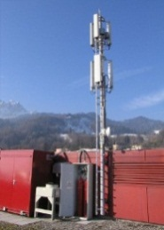
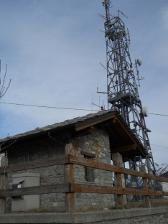
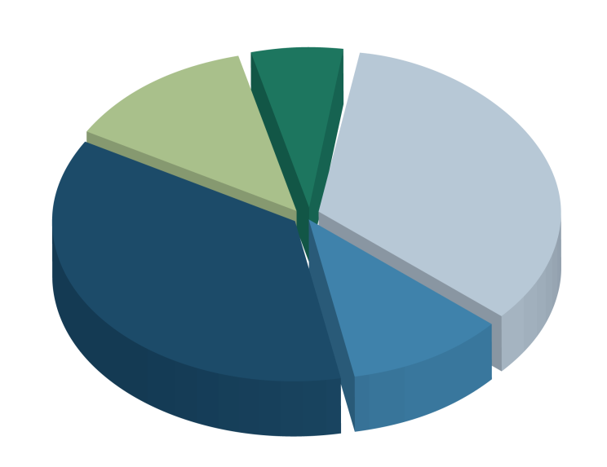
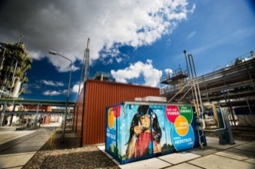
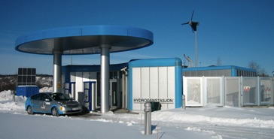
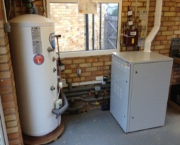

MAIP objectives (1)
Planned Budget
Currently distributed in 3 different application areas:
Hydrogen Production and Storage
Stationary applications and Micro-CHP
Early markets – Back-up power and off-grid systems
More than 50% of initial budget to be allocated to ENERGY oriented projects
Cross-Cutting
Activities (6-8%)
Early Markets
(12-14%)
Transportation & Refuelling infrastructure
(32-36%)
Stationary Power Generation & CHP (34-37%)
Hydrogen Production & Distribution (10-12%)

Slide 4
MAIP objectives (2)
Technical targets
Price of H2
delivered to station: 5€/kg
H2 production by electrolysis
Increase capacity to 3,0 t/d decentralised and
50 t/d centralised
Increase efficiency to 68-70%
Decrease price to 1,5-1,9 M€/(t/d)
 |  | Volume & cost
Application Area | Market application | 2010 baseline | 2015 mid-term | 2020 long-term
H2 production by biogas reforming
Increase capacity to 3,0 t/d
Increase efficiency to 67%
Decrease price to 2,5 M€/(t/d)
Hydrogen Production and Storage | Hydrogen delivered to retail station | - | 5 €/kg | 5 €/kg
 | Distributed production of hydrogen by water electrolysis | 1.5 t/d cap. | 65% eff. | 3.1 M€/(t/d) | 1.5 t/d cap. | 68% eff. | 2.8 M€/(t/d) | 3.0 t/d cap. | 70% eff. | 1.9 M€/(t/d)
 | Distributed production by reforming of biogas SMR (incl. purification) | 1.5 t/d cap. | 64% eff. | 4.2 M€/(t/d) | 1.5 t/d cap. | 64% eff. | 3.8 M€/(t/d) | 3.0 t/d cap. | 67% eff. | 2.5 M€/(t/d)
 | Total installed production capacity from renewables | - | - | 103 t/d
 | Centralized production of hydrogen by water electrolysis | - | - | 50 t/d cap. | 70% eff. | 1.5 M€/(t/d)
 | Centralized underground storage of hydrogen | - | - | 4000 t cap. | 0.006 M€/t
 | Distributed storage of gaseous hydrogen | 0.8 t cap. | 0.5 M€/t | 5 t cap. | 0.45 M€/t | 10 t cap. | 0.4 M€/t
 | Storage of hydrogen in solid materials | 3 t cap. | 5 M€/t | 5 t cap. | 1.5 M€/t | 10 t cap. | 0.85 M€/t
 | Total installed storage capacity of H2 produced from grid | - | - | 129 t
 | High capacity compressed H2 trailer | 0.6 t cap. | 0,55 M€/t | 1.3 t cap. | 0,55 M€/t | 1.6 t cap. | 0,4 M€/t
Installed storage capacity H2 from grid: 129 t
H2 storage
Increase capacity while decreasing price:
- Underground: 4000 t and 0,006M€/t
- Gaseous H2: 10 t and 0,4M€/t
Solid materials: 10 t and 0,85€/t
- Compressed H2: 1,6 t and 0,4 M€/t

Slide 5
MAIP objectives (3)
Technical targets
Micro-CHP:
Demonstrate at least 1,000 units
Decrease cost to 10,000 €/kWe by 2015
Increase durability to 40,000 h
Total efficiency > 80%
Electrical efficiencies >45% for power only units
 |  | Volume & cost
Application Area | Market application | 2010 baseline | 2015 mid-term | 2020 long-term
Stationary applications and CHP | Micro-CHP (residential), natural gas based |  | 1,000 units / 10,000 € per system (1kWe + household heat) Assuming supported deployment from 2013+ | 50,000 units / 5,000 € per system (1kWe + household heat) Anticipating commercial introduction beyond 2020
 | Industrial/commercial, H2 based | 1 MW / 4,500 €/kW | >5 MW / 3,000 €/kW Assuming supported deployment from 2013+ | >50 MW / 1,500 €/kW Anticipating commercial introduction beyond 2018
 | Industrial/commercial, natural gas based |  | >5 MW / 4,000 €/kW Assuming supported deployment from 2013+ | >100 MW / 2,000 €/kW Anticipating commercial introduction beyond 2018
Large CHP:
Demonstrate at least 5 MW
Decrease cost to 3,000-4,000 €/kW by 2015
Increase durability to 40,000 h
On-stream availability of 95% or higher
Back-up power:
Demonstrate at least 9,000 units
Decrease cost to 1,500 €/kW by 2015
Early Markets | Back-up power systems | 150 units | 5,000€/kW fuel cell system | 9.000 units | <1.500€/kW fuel cell system | 20.000 units | <800€/kW fuel cell system

Slide 6
MAIP Coverage
Budget committed 2008-2013
Total costs: 203 mill EUR
FCH contribution to ENERGY DEMONSTRATION Projects (incl validation/proof-of-concept/components):
98,8 mill EUR
27 projects

Slide 7
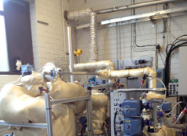
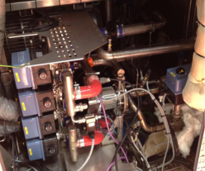
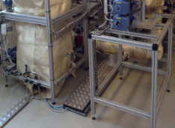
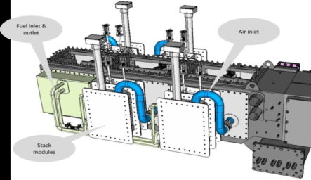


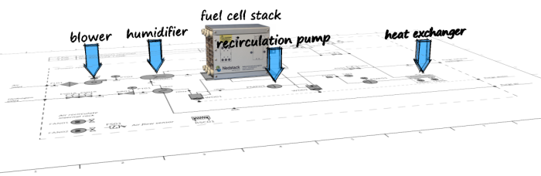


MAIP Coverage
Technology/Activities
Projects examples
ASSENT: development of fuel and water
management for SOFC systems
CATION: optimal process and mechanical solutions for the cathode and stacks subsystems
proof-of-concept CCHP plants based on SOFC fed by different typologies of biogenous primary fuels (locally produced), integrated by a process for the CO2 recovery
new multi-fuel membrane reformer for pure hydrogen production (5 Nm3/h) based on Catalytic Membrane Reactors
    CHP system based on ASC technology, at reduced stack-temperature of 650C and high electrical efficiency (min. 45%)
FluMaBack: Fluid Management component improvement for
Back-up fuel cell systems
SAPPHIRE: System Automation of PEMFCs with Prognostics and Health management
TriSOFC: low-cost durable low temperature (LT) SOFC tri-generation (cooling, heating and power) prototype
new DC/DC converter to use on-line electrochemical impedance spectroscopy (EIS) as diagnostic tool for back-up power and CHP applications

Slide 8
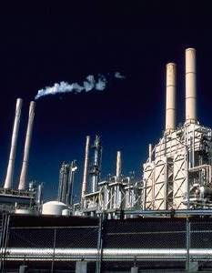
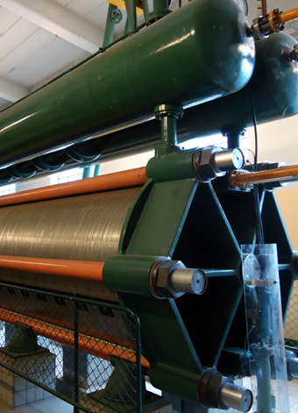
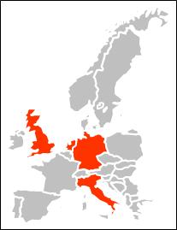
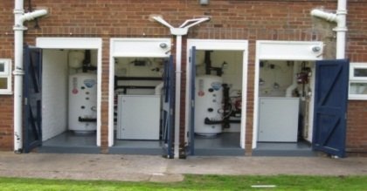
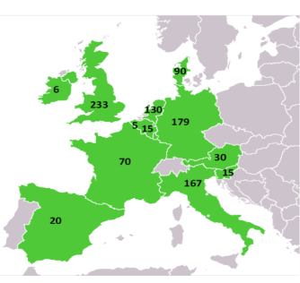


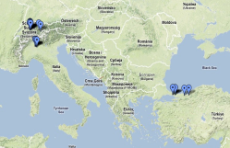


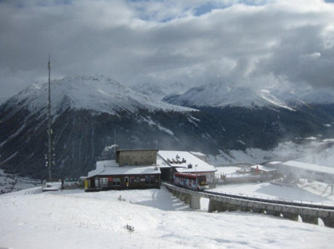
MAIP Coverage
Volumes
100 micro-CHP units (1 manufacturer, 4 countries)
960 micro-CHP units (9 manufacturers, 12 countries)
CLEARgen™Demo
1 MW industrial CHP unit /PEM based (in Europe – place tbc)
Research
POWER-UP
500 kW industrial CHP unit/alkaline based (in Germany)
1 MW alkaline electrolyser (coupled with wind energy, in Spain)
19 back-up and UPS units (3 countries)
18 live Radio stations (off-grid) in Italy
2010
2013
2016
Different climates/technologies/routes-to-market
Increased volumes
Cost reduction/Increased durability
Research

Slide 9
Future expectation
Proposal for a COUNCIL REGULATION
on the Fuel Cells and Hydrogen 2 Joint Undertaking
The general objective of the FCH 2 Joint Undertaking for the period of 2014-2024 is to develop a strong, sustainable and globally competitive fuel cells and hydrogen sector in the Union, in particular to:
reduce the production cost of fuel cell systems to be used in transport applications, while increasing their lifetime to levels competitive with conventional technologies
increase the electrical efficiency and the durability of the different fuel cells used for power production, while reducing costs, to levels competitive with conventional technologies
increase the energy efficiency of production of hydrogen from water electrolysis while reducing capital costs, so that the combination of the hydrogen and the fuel cell system is competitive with the alternatives available in the marketplace
demonstrate on a large scale the feasibility of using hydrogen as a competitive energy storage medium for electricity produced from renewable energy sources

Slide 10
FCH studies
Additional 2-3 mill EUR
to support programme planning/strategy
Studies on the commercialization of fuel cells and hydrogen technologies and competing technologies – ENERGY related studies:
Electrolysers techno-economic assessement – on-going study by E4tech
Distributed Generation technologies and role of Fuel Cells – industry coalition building stage !!!
Energy Storage and role of Hydrogen – industry coalition building stage !!!
Recommendations to help stimulate the policy and investment climate – what needs to happen to achieve the cost and volume targets required for commercialisation
- as input to the next FCH2 programming !!!
  For industry, next steps will include focus on tackling the remaining technical and cost-related barriers to achieve full commercialisation of mass market technologies.

Slide 11
Thank you for your attention !
Further info :
FCH JU (Programme Office) http://fch-ju.eu
NEW-IG http://www.new-ig.eu
N.ERGHY http://www.nerghy.eu

