Slide 1

2013 Program Review Days
Introduction
Jean-Luc Delplancke, Head of Program Unit
Fuel Cells and Hydrogen Joint Undertaking
November 2013
http://www.fch-ju.eu/

Slide 2


The FCH JU in the SET-Plan
SET plan
The European Industrial Bioenergy Initiative
The European CO2 Capture, Transport and Storage Initiative
The European Electricity Grid Initiative
The Fuel Cells and Hydrogen (FCH) Joint Technology Initiative
The Sustainable Nuclear Initiative
Energy Efficiency – The Smart Cities Initiative
The Solar Europe Initiative
The European Wind Initiative
Fuel cells technology is a key technology for Europe towards the 20-20-20 goal by 2020
Notes:
2

Slide 3



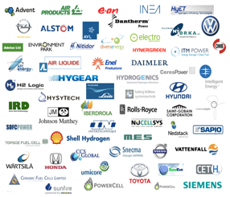
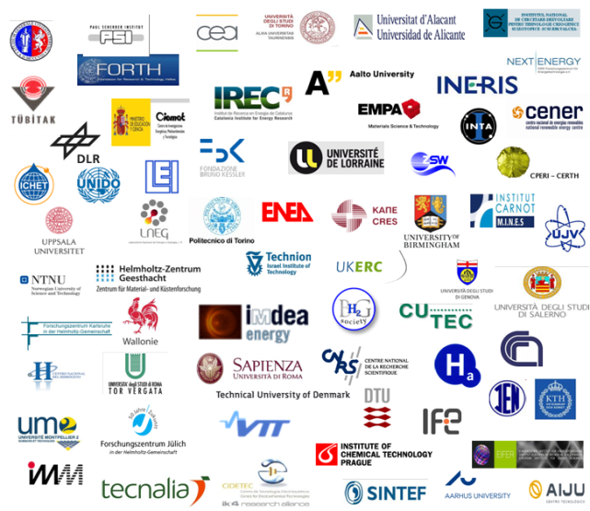
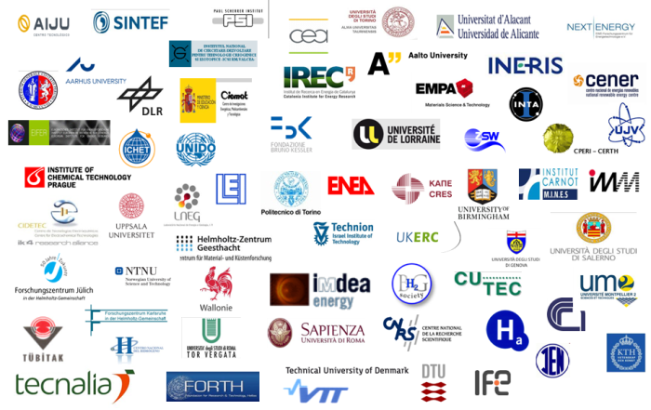
The FCH JU in the SET plan:
A strong public-private partnership
with a focused objective
Fuel Cells & Hydrogen Joint Undertaking
Industry Grouping
Close to 60 members
~ 50% SME
European Union represented by the European Commission
Research Grouping
Over 60 members
To accelerate the development of technology base towards market deployment
of FCH technologies
from 2015 onwards
The Joint Undertaking is managed by a Governing Board composed of representatives
of all three partners and lead by the Industry.
Notes:
The main space for FCH development in the EU is the FCH JU. A PPP between the EC and the FCH private sector, consisting of the research and industry community.
FCH JU 2008-2013 :
part of the SET-plan
Total budget of 940€M – shared by EC/Private Sector
etc

Slide 4
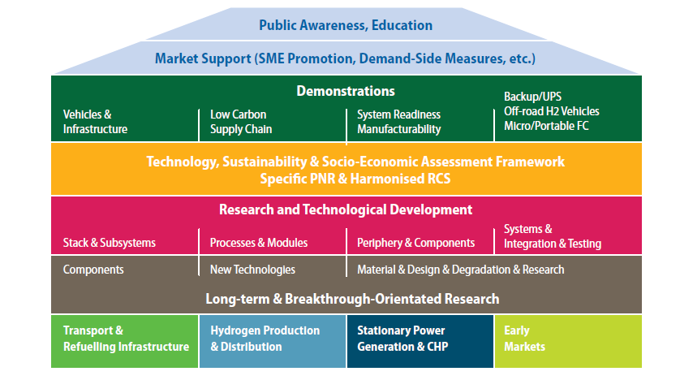
Multi-Annual Implementation Plan
2008 - 2013

Slide 5
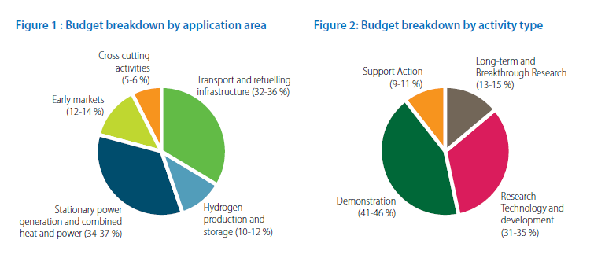
Funding distribution by application area:
Multi-annual Implementation plan

Slide 6
Overview
2008 | 2009 | 2010 | 2011 | 2012 | 2013 | 2014 | 2015 | 2016 | 2017
Horizon 2020
Council
regulation
Amend- ment
Auto-nomy
FP7
Call 2008
16 Projects
Call 2009
28 Projects
Call 2010
26 Projects
Call 2011
33 Projects
Call 2012
28 Projects
Call 2013-1
21 Projects
Car powertrain study
Call 2013-2
? Projects
Bus study
Stationary study

Slide 7
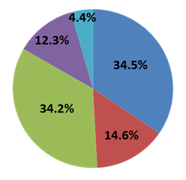
FCH JU contributions per call and activity area
(in €)

Slide 8
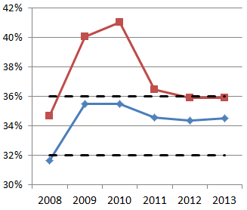
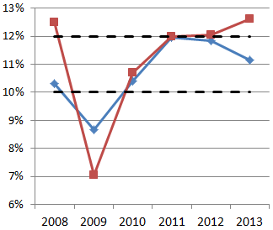
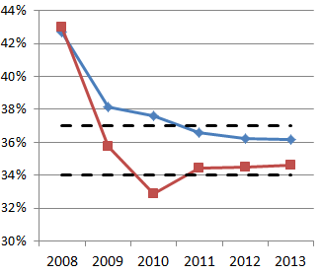
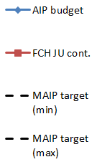
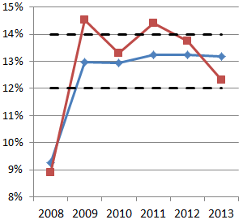
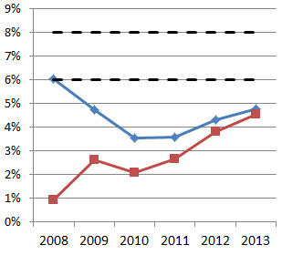
Multi-annual Implementation Plan coverage
Transport
Hydrogen Production
Stationary Applications
Early Markets
Cross-cutting

Slide 9
Programme participation per country
United Kingdom

Slide 10
Membership of the participants

Slide 11
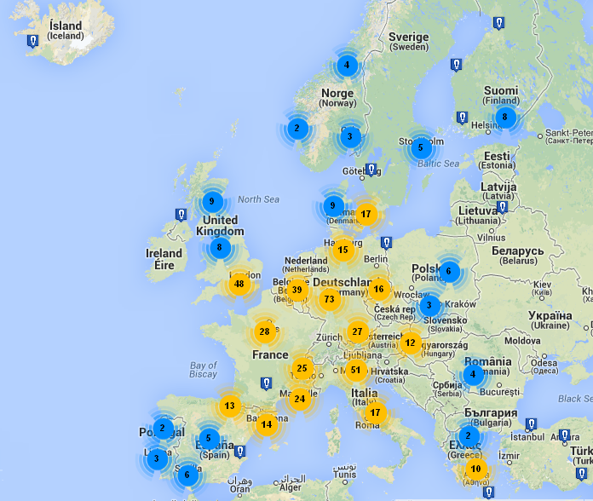
Calls 2008 - 2012
http://antonio-requena.freeiz.com/showclustermap.php
All Activity Areas
131 projects

Slide 12
Geographic origin of the participants

Slide 13
2013 Program Review Days
131 Projects for calls 2008-2012 >< 1,5 Days
New structure of the Program Review Days (PRDs) approved by the Governing Board
Input from the Scientific Committee Members
PRDs based on the proposed structure for FCH JU under Horizon 2020
Two main pillars: Energy – Transport and Cross-Cutting activities
Focus on Demonstration projects and RTD projects
Projects grouped inside panels
Poster presentations with selection of flagship projects oral presentations
Report to the Stakeholders General Asssembly by the SC members

Slide 14
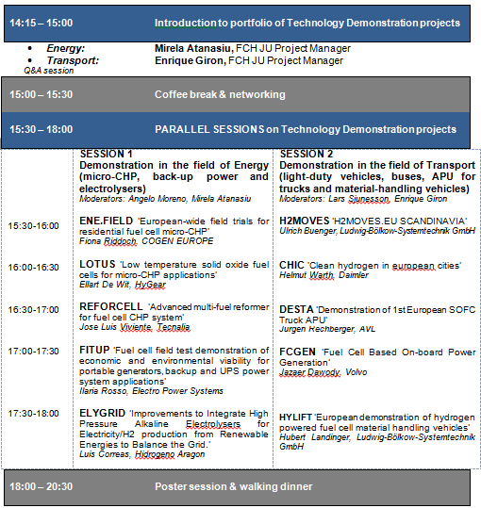
Agenda
Day 1

Slide 15
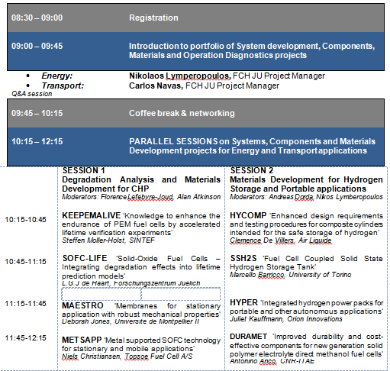
Agenda
Day 2 a.m.

Slide 16
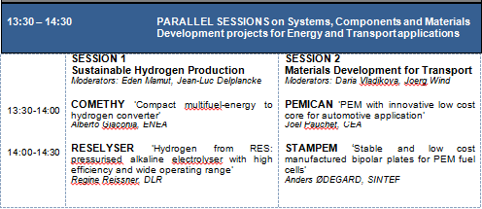
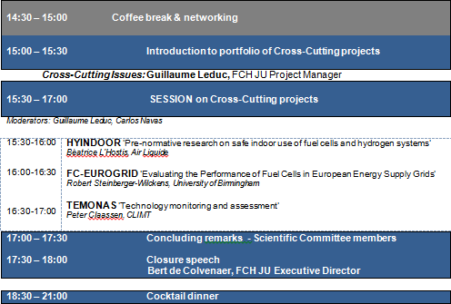
Agenda
Day 2 p.m.

Slide 17
Thank you for your attention !
Further info :
FCH JU : http://fch-ju.eu
NEW-IG : http://www.new-ig.eu
N.ERGHY : http://www.nerghy.eu

