Slide 1

Fuel cells and hydrogen
Joint undertaking
SOFC-Life
(256885)
L.G.J. de Haart
Forschungszentrum Jülich GmbH / IEK-9 / Germany
Programme Review Day 2013, Brussels, 11 & 12 November 2013

Slide 2

Project & Partnership description (1/1)
Solid Oxide Fuel Cells –
Integrating Degradation Effects into Lifetime Prediction Models
project data
reference | FCH JU 256885
start date | 01/01/2011
end date | 31/12/2013
duration | 36 months
total costs | 5.700.000 €
FCH JU funding | 2.400.000 €
 | 42 %
partners - research & university
DTU-EC | Denmark | EPFL | Switzerland
VTT | Finnland | EMPA | Switzerland
CEA | France | ZHAW | Switzerland
FZ Jülich | Germany | Imperial College | United Kingdom
IHTE | Russia
partners - industry
TOFC | Denmark | HTCeramics | Switzerland
EDF | France | HEXIS | Switzerland

Slide 3

Project objectives & approach (1/3)
Objectives
Understand the details of the major SOFC continuous degradation effects
Develop models that predict single degradation phenomena
Transfer the physical-chemical models to electrochemical models
Re-assemble the single effect models to a full SRU life-time prediction model
Approach
dis-assemble the SOFC single repeating unit to model elements
representing single degradation phenomena (anode and cathode compartment)
WP1: anode side phenomena
effect details
and models
WP4: stack test &
model application
WP3: modelling
WP2: cathode side phenomena
verification
validation

Slide 4
Project objectives & approach (2/3)
Approach
air exposed
w/ current
WP2: cathode side phenomena
temperature
gas composition
time
current
temperature
gas composition
time
f
f
stack repeating unit
WP1: anode side phenomena
fuel exposed
w/ current
result
changes in composition (phase)
and morphology
(post-test)
additional:
changes in resistance
(in-situ)

Slide 5
Project objectives & approach (3/3)
Main topics (degradation mechanism)
WP2: cathode side phenomena
the stability (chemical, kinetic and morphological) of state of the art cathode materials (impacting the cathode activity)
processes at the cathode-interconnect interface
(impacting electrical continuity and chemical composition of components, thus their electrochemical performance)
morphological change in the anode cermet
(impacting on anode activity and electrical continuity)
nickel-steel corrosion (impacting on electrical continuity and conductivity)
WP1: anode side phenomena

Slide 6
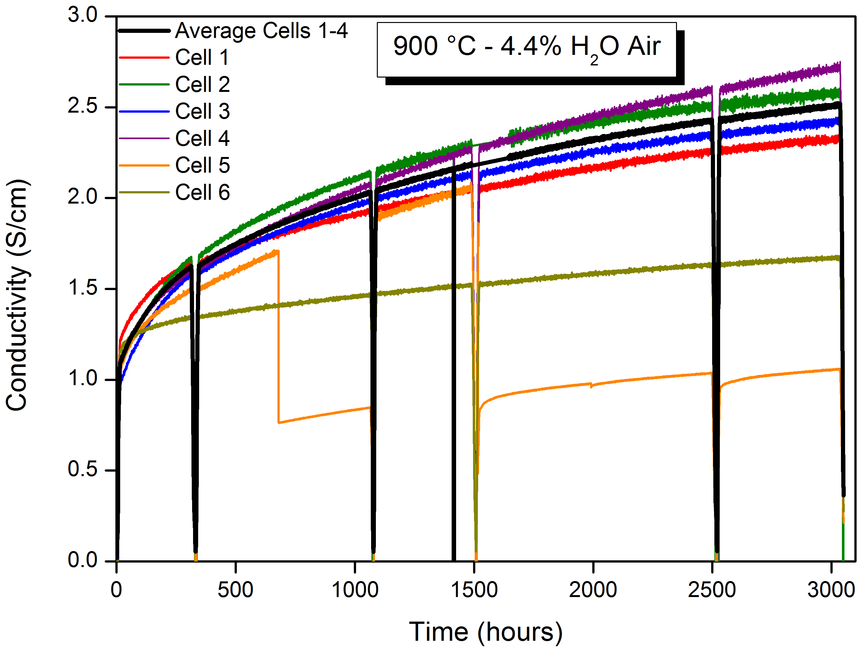
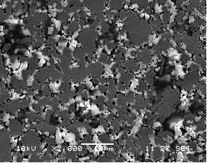
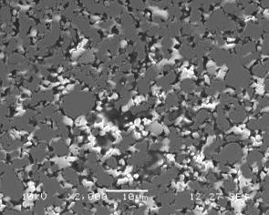
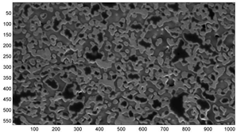
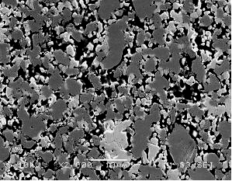
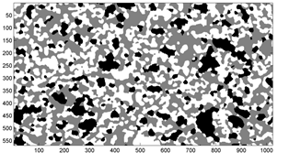

Project achievements (1/9)
Exposure tests of selected materials (combinations)
WP1: anode side phenomena
WP2: cathode side phenomena
300 h
1000 h
3000 h
Test durations: 0, 300, 1000 and 3000 h. Sample extraction for post-test analyses.

Slide 7
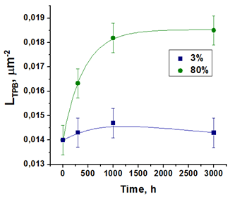
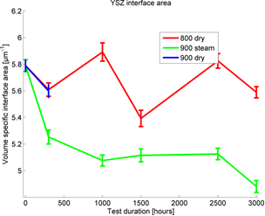
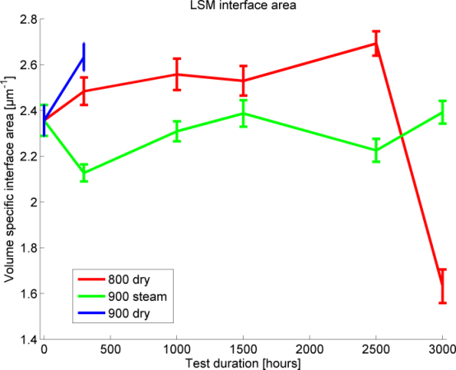
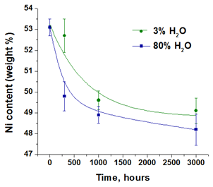
Project achievements (2/9)
Post-test analysis
WP1: anode side phenomena
WP2: cathode side phenomena
Ni content
TPB length
YSZ interface area
LSM interface area

Slide 8

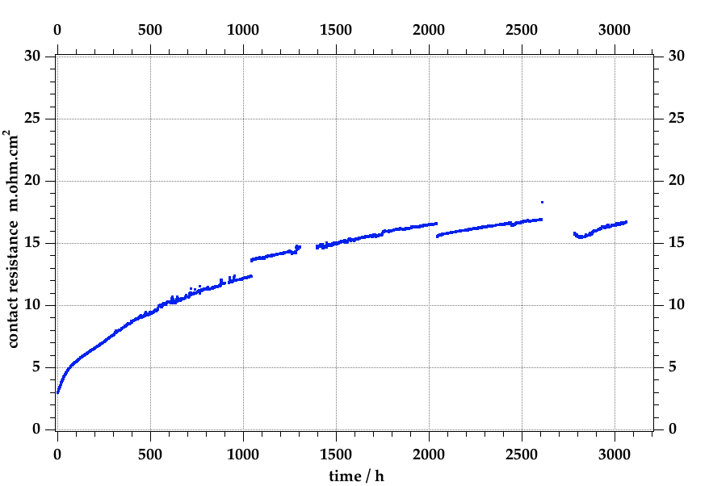
Project achievements (3/9)
WP2: cathode side phenomena
Cathode-Interconnect Interface
Crofer H alloy, exposed 3000h, 800°C
10 mm
300 h
LSM cathode
10 mm
spinel coating
Contact resistance loss
lifetime-prediction:
3 + 0.3√t(h) mohm.cm²
scale
3000 h
alloy

Slide 9
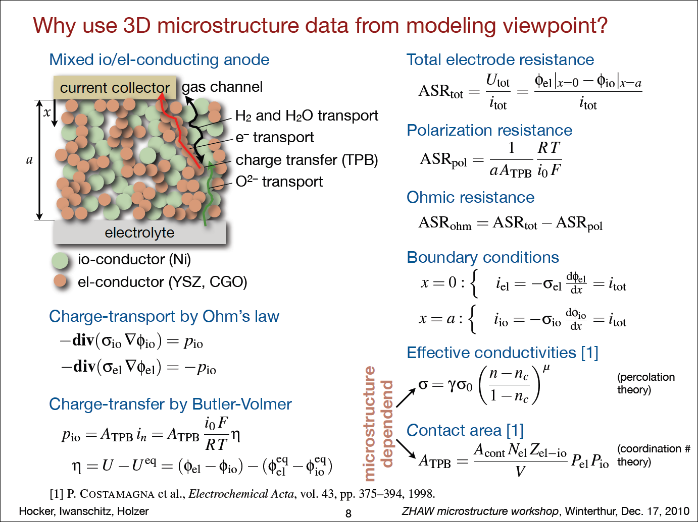

Project achievements (4/9)
WP3: modeling and verification
Input from microstructure analysis
anode side
Ni σ_{eff} ele
YSZ σ_{eff} ion
LSM
YSZ
cathode side
e⁻
Active TPB length
O₂
Simulated processes
O²⁻
e⁻
O₂
Output: prediction of electrode performance

Slide 10
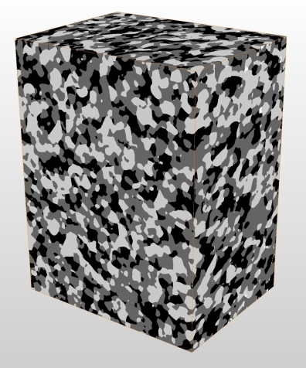
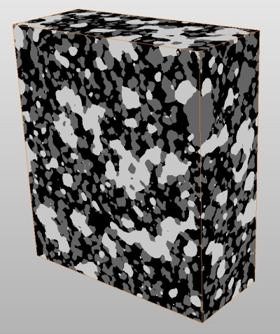
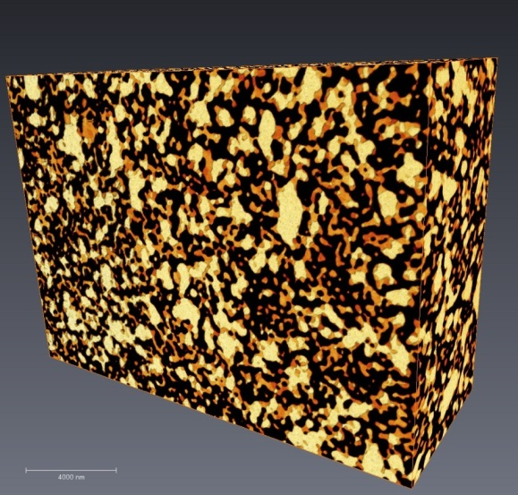
Project achievements (5/9)
WP3: modeling and verification
anode side
3D reconstruction by FIB/SEM tomography
cathode side
25.5 μm
26.2 μm
Microstructure quantification
19.4 μm
14.7 μm
22.9 μm
9.5 μm
19.5 μm
Fresh Ni-8YSZ volume of
25.5 x 19.4 x 14.7 µm3
Fresh LSM-8YSZ volume of
19.5 x 14.8 x 7.6 µm3

Slide 11
Project achievements (6/9)
WP3: modeling and verification
anode side
cathode side
Prediction of ASR performance (before and after degradation)
Electrode modeling in anodic and cathodic polarization
Anodic polarization
X = ASR measured by EIS
ASR-act
ASR-total
After Degradation
ASR-transp
Before Degradation
Cathodic polarization
The simulation provide total ASR and components of ASR
related to charge transport and TPB-reactions.
ASR_{total} predictions are in good agreement with EIS-measurements

Slide 12
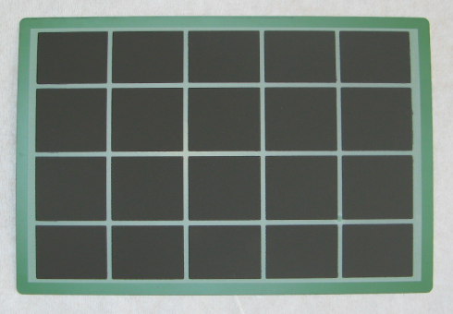
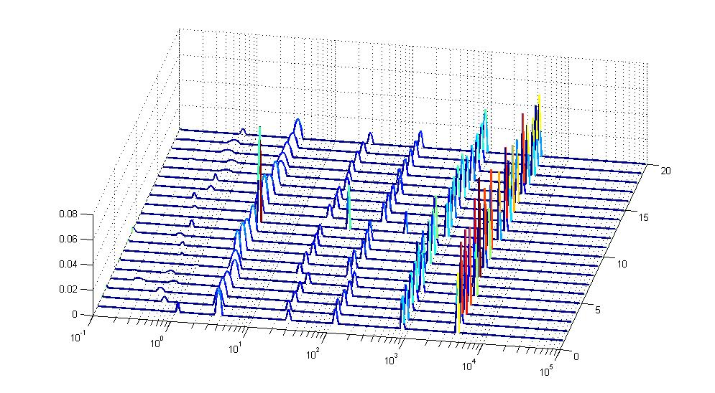

Project achievements (7/9)
WP3: modeling and verification
segmented 1-cell stack: 20 * 4 cm² electrode segments covering the whole flow field
1000 h tests (in H₂ and CH₄/H₂O) with periodical EIS allow to monitor local degradation processes
anode charge transfer
Fuel & Air
EIS
20 segments: DRT dataset
6 processes at well-defined frequencies identified on all 20 segments

Slide 13
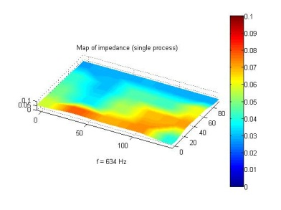
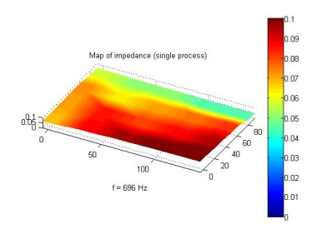
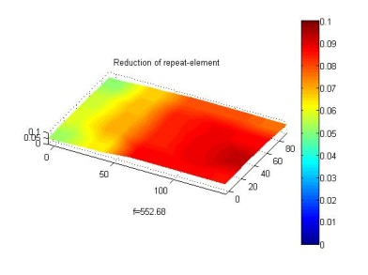
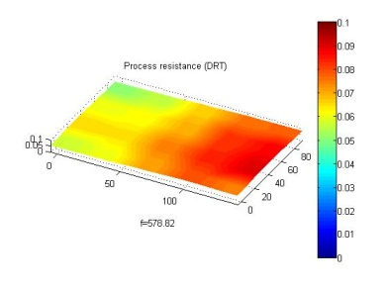
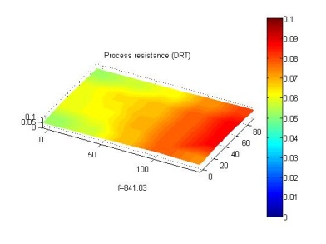
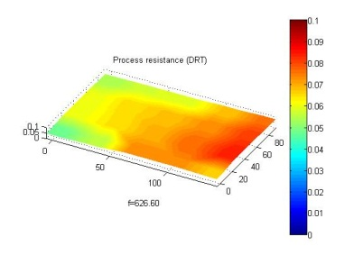
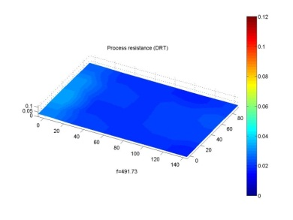
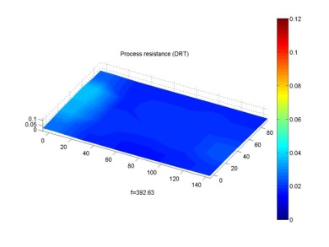
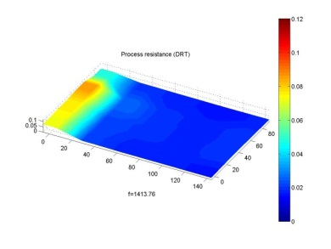
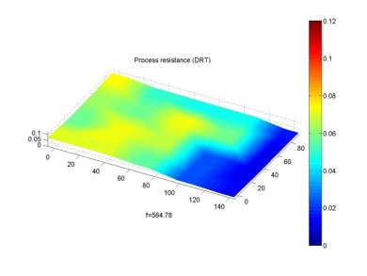
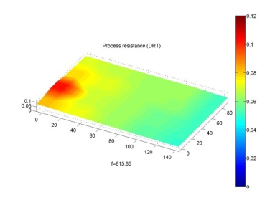
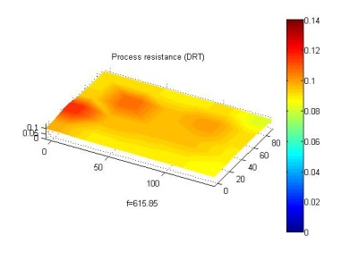
Project achievements (8/9)
WP3: modeling and verification
example of local monitoring of anode charge transfer process, >1000 h, in H₂ and CH₄/H₂O fuel
very different behavior (temporal and spatial) between the two cases
51
73
74
70
66
64 mohm.cm²
H₂
0h
100h
300h
600h
900h
1100h
CH₄ / H₂O
31
32
37
56
75
80 mohm.cm²

Slide 14
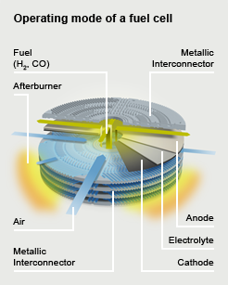
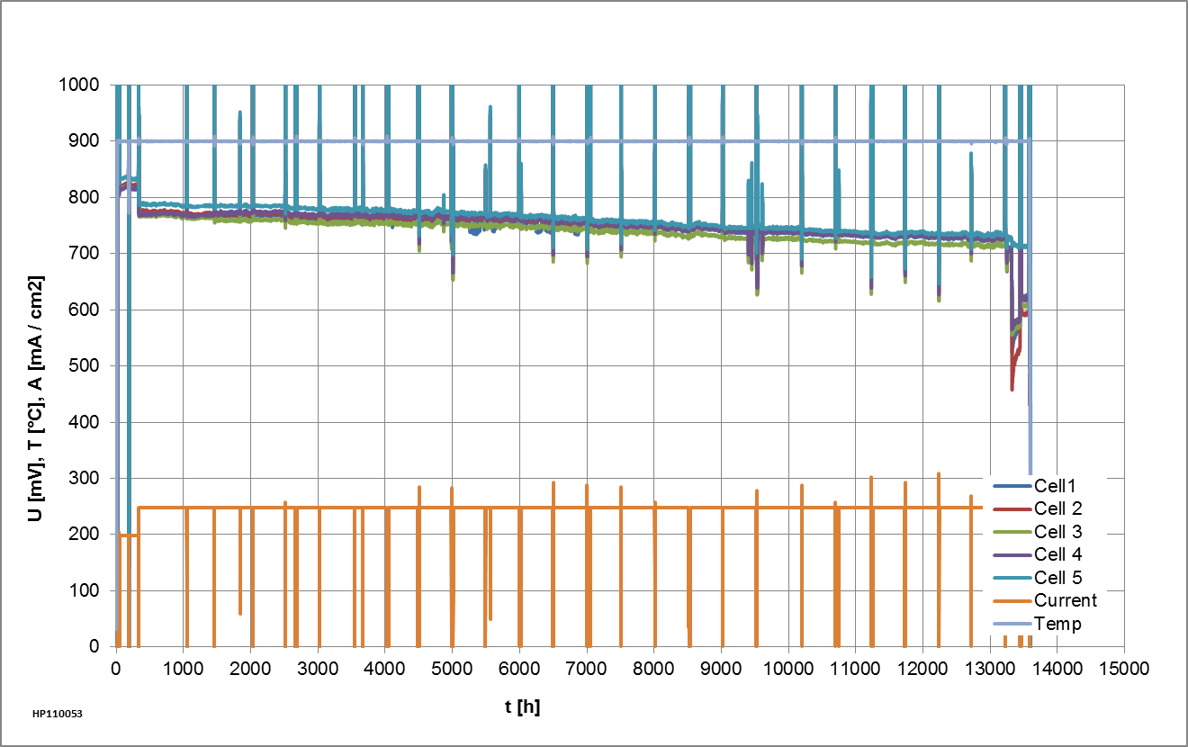
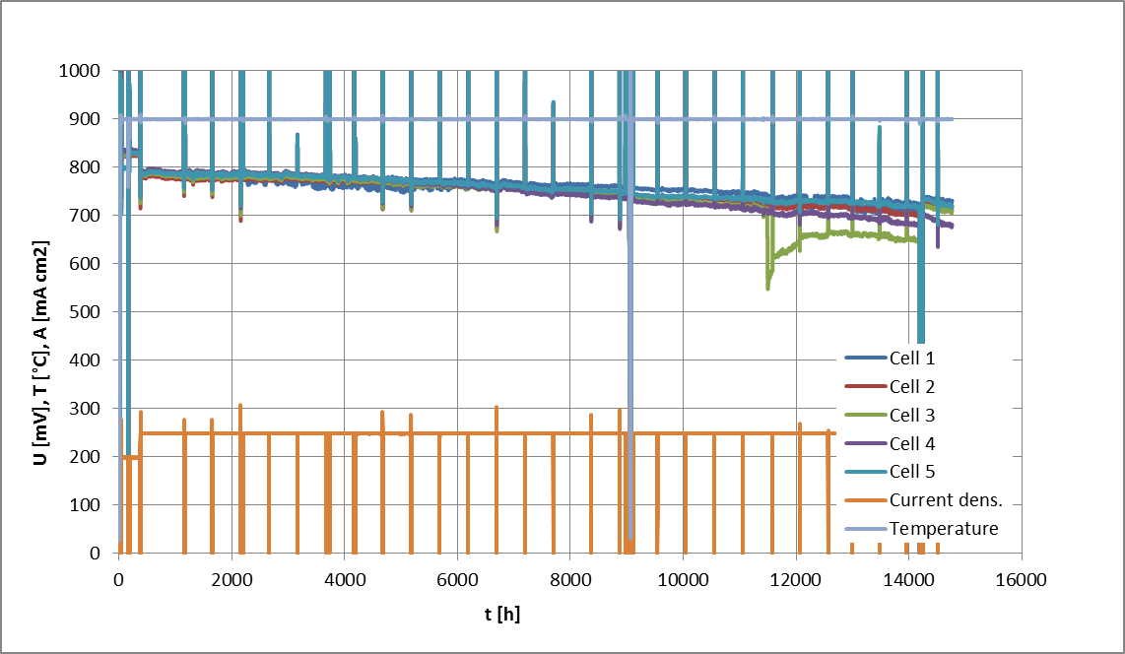

Project achievements (9/9)
WP4: stack test & model application
for Hexis ECS-type SOFC
Power density approx. 0.2 W/cm²; electrical efficiency approx. 37 % DC
Degradation approx. 4 mV, i.e. 0.5 % / 1000 h over 13000 h
Linear degradation, Fits well to the data measured on system level, as well as the model
No progressive degradation but, lab incident destroyed one, harmed the other

Slide 15
Self Assessment Summary (1/2)
Self Assessment Summary
Estimation of the probability that the project will achieve the objectives:
Understand the details of the major SOFC continuous degradation effects
  From the four themes investigated only processes at the cathode-interconnect interface can be considered to be a major contribution to the overall degradation observed in SRUs and stacks.
Objective is achieved.
Develop models that predict single degradation phenomena
  Microstructural parameters as function of operating conditions and time for cathodes and anodes have been extracted for use in the respective sub-models. Due to a limited number of experiments on the stability of the LSCF cathode as function of time no sufficient data is available for the implementation of this cathode in the model.
Objective will be partly achieved.

Slide 16
Self Assessment Summary (2/2)
Self Assessment Summary
Estimation of the probability that the project will achieve the objectives:
Transfer the physical-chemical models to electrochemical models
  Cellular automaton model developed to predict 3D microstructure evolution, and corresponding degradation of polarization resistance, of Ni/YSZ and Ni/CGO anodes and LSM/YSZ cathodes.
Objective will be achieved for the anodes and cathodes mentioned.
Re-assemble the single effect models to a full SRU life-time prediction model
Objective will most likely be achieved.

Slide 17
Alignment to MAIP/AIP (1/1)
Relevance to call & AIP 2009
Application area: Stationary power production and CHP
Topic: SP1-JTI-FCH.3.1: Degradation and lifetime fundamentals
SOFC-Life addresses:
basic research activities directed to degradation and lifetime fundamentals
of SOFC technology,
focusing on SOFC materials available and in industrial application today
(cf. MAIP section 3.4.3 page 15 - updated version adopted November 2011)

Slide 18
Relationships to Earlier and
Other Current Projects (1/1)
Relationship to Earlier and Other Current Projects
SOFC-Life
  builds on experiences and data collected
  in the projects Real-SOFC, SOFC600 and FlameSOFC,
  follows protocols from FCTES^{QA} when appropriate,
  and many others in which the partners have participated.
In turn protocols from SOFC-Life are being used in the project SCORED2.

Slide 19
Complementarity with Projects
from Other Programs (1/1)
Complementarity with Projects from Other Programs
Co-funding:
• VTT: (Finish) National Fuel Cell Technology Program (TEKES)
• IHTE: (National Russian Foundation for Fundamental Research)
• DTU-EC: Danish PSO-financed program (Top-up grant)
Participation in related / complementary projects:
• see above
• DTU-EC: SOFC Accelerated (Danish, EUDP); Towards Smart Grid Ready SOFC (Danish, ForskEl); METSAPP (EU)
• FZ Jülich: German project on SOFC Degradation to start June 2014

Slide 20
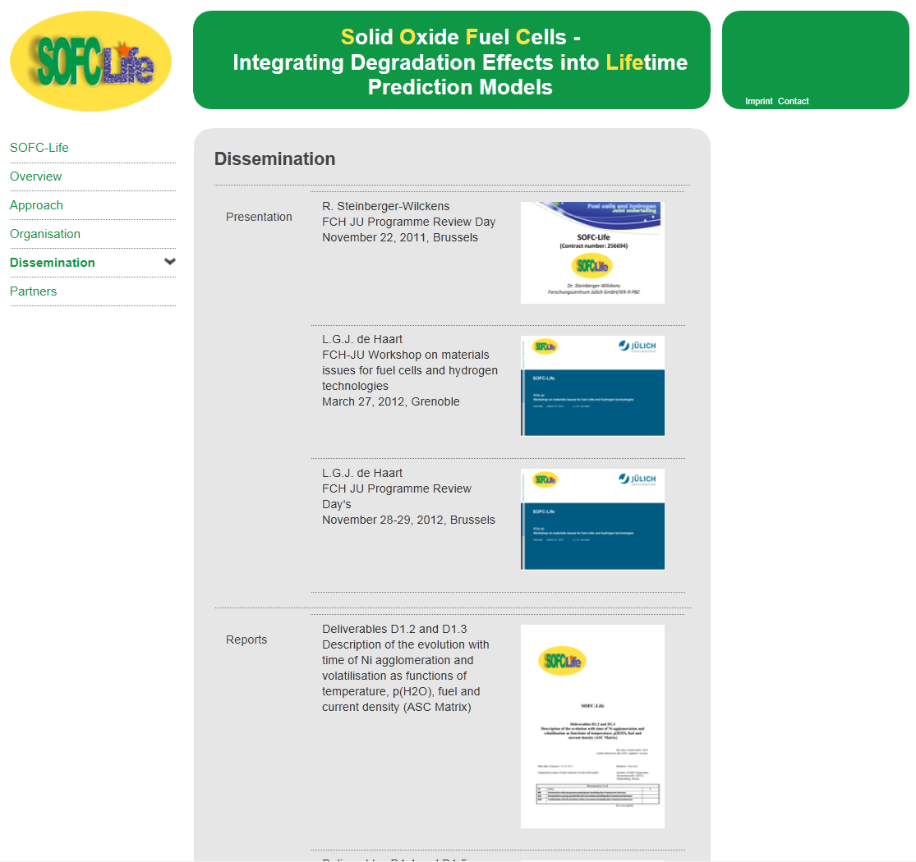
Cross-cutting, Dissemination
& Exploitation Activities (1/1)
Cross-cutting & Dissemination Activities
Publications,
conferences presentations
website www.sofc-life.eu

Slide 21
Cross-cutting, Dissemination
& Exploitation Activities (1/1)
Cross-cutting & Dissemination Activities
Publications,
conferences presentations
website www.sofc-life.eu
Exploitation & Post-Project Activities
direct use of results by participating industries and SMEs

Slide 22
Further RTD Activities (1/1)
Further RTD activities
Degradation models will require further refinement
to make them applicable to a wider range of cell types and operating conditions.
Basic understanding should be applied
to develop soundly based accelerated tests.

Slide 23
Fuel cells and hydrogen
Joint undertaking
Thank you for your attention
L.G.J. de Haart (e-mail: l.g.j.de.haart@fz-juelich.de)
Forschungszentrum Jülich GmbH / IEK-9 / Germany
Programme Review Day 2013, Brussels, 11 & 12 November 2013

Slide 24
Back-up: (1/2)
Microstructure factor (M-factor)
WP3: modeling and verification
Relationship between effective transport properties and microstructure
Porosity &
Tortuosity &
Constrictivity (δ)
Porosity &
Tortuosity (τ)
Porosity (ε)
Factor due to extra pathway lengths
Factor due to uneven path radii (bottlenecks)
L. Holzer et. Al., Journal of Materials Science 48(7): 2934-2952, 2013

Slide 25
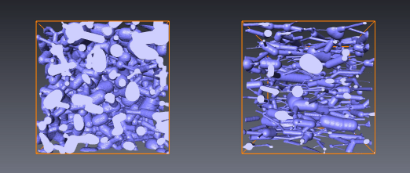
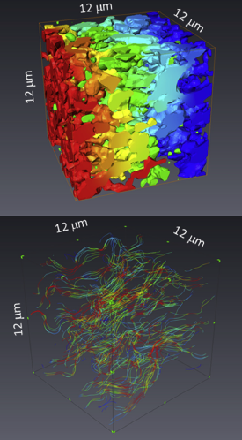
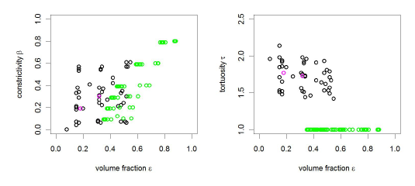
Back-up: (2/2)
Microstructure factor (M-factor)
WP3: modeling and verification
Relationship between effective transport properties and microstructure
investigated with virtual materials testing
a) More than 100 virtual microstructures with specific properties (ε, β, τ) are created with stochastic geometry.
c) Finite Element Modeling based on meshes from virtual microstructures is used to calculate the corresponding effective conductivities σ_{eff}
b) The virtual microstructures cover a wide range of microstructure parameters (ε, β, τ) :
d) The database from virtual testing provides the relationship between microstructure parameters (ε,τ,β) and effective transport properties (σ_{eff}).
Using statistical error minimization leads to the following relationship:
‘M-factor’
This expression can be used to describe effective electric and ionic conductivities as well as gas phase diffusivity

