Slide 1
PRD 2019
GUIDELINES & TEMPLATE

Slide 2
GENERAL GUIDELINES
Content
The presentation must focus on targets and current state of project achievements in relation to the contractual objectives and overall strategic context of FCH JU and its annual and multi-annual plans.
The presentation refers to the information provided in the self-assessment report, including:
as introduction: an overview and a summary with context, objectives, and position towards international state-of-art (SoA)
a main part with emphasis on advancement towards the objectives focusing on maximum 3 main aspects and actions planned
some slides about general activities such as main challenges, communication and dissemination activities

Slide 3
GENERAL GUIDELINES
SLIDE STRUCTURE - TIME SCHEDULE
THE PRESENTATION SHOULD LAST 15 MINUTES
Use the PowerPoint template of this presentation
Recommended (but not compulsory) font size for text is minimum 18 pt
Representative photo, images, figures etc. are encouraged (maximum 2-3 figures on a slide!)
Recommend around 10-16 slides:
1 title page
1 general info on the project
6 maximum on progress vs objectives/SoA (3 aspects)
1 on Risks & Challenges
1 on Communication activities
1 on Exploitation activities
Question for the audience
Some “optional slides” (Please choose 1-2 most relevant)
Graphic material
Please send the presentation to FCH JU by 2 November 2019
(email to prd@fch.europa.eu)

Slide 4
GENERAL GUIDELINES
HOW TO USE THE TEMPLATE
Please replace text in red with relevant information from the project and change its color to blue or grey
The text in green is used for instruction/explanations: please remove it
Please click on the comment boxes for further instructions on how to provide the information
The proposed “Optional slides” can be presented or should be removed from the presentation

Slide 5
USEFUL REFERENCES
  FCH JU Website
  Reference FCH JU documents (MAIP/AIPs and MAWP/AWPs):
    Multi-annual plans (MAIP/MAWP)
    Addendum to the FCH JU 2014-2020 AWP – New Document!
    Annual plans:
      2008-2013: AIPs
      2014-2020: AWPs
      Previous FCH JU Programme Review Days
  European Commission non-nuclear Energy Research (incl. FCH)
  FCH JU Industry Grouping: Hydrogen Europe
  FCH JU Research Grouping: Hydrogen Europe Research

Slide 6
ACRONYM
Project Title
Speaker Name Surname
Speaker Affiliation
Project Website
Email coordinator
Project LOGO
Programme Review Days 2019
Brussels, 19-20 November 2019

Slide 7
PROJECT OVERIVEW
Call year: [YYYY]
Call topic: [insert number and title of the call topic to which the proposal was originally submitted]
Project dates: [start date – end date]
% stage of implementation 01/11/2019: [… %]
Total project budget: […….. €]
FCH JU max. contribution: […….. €]
Other financial contribution: [……. €]
Partners: [list all partners]

Slide 8
PROJECT SUMMARY
Short project introduction describing
  Project Acronym, Full Title
  Objectives
  Global positioning vs international state-of the art
  Application and market area
  (Feel free to include pictures or figures)

Slide 9
PROJECT PROGRESS/ACTIONS – Aspect 1,2,3..
Example and explanation in the next slide
Achievement to-date
PROJECT START VALUE
PROJECT TARGET VALUE
25%
50%
75%
Please refer to the objectives/targets/KPIs set in the relevant multi-annual work plan (MAIP or MAWP) or in the topic description for the call for proposals to which you successfully applied (see the relevant annual plan - AIP or AWP - for reference) as well as the current SoA for ongoing similar activities, relevant to this aspect.
Please compare your projects achievements against the respective FCH JU targets and SoA. You are highly advised to use graphs and diagrams or tables (as a second option).
In addition:
Please explain briefly (orally or in bullet points) the performed activities and/or problems encountered to meet those targets as well as future steps to meet the targets
* If you would like to refer to a non measurable KPI which is important to your project please explain accordingly

Slide 10
Example and explanation of PROJECT PROGRESS/ACTIONS - Durability
Achievement to-date
2000h
12 V/h
6000h
1 V/h
25%
50%
75%
Status at month 17 of a 36 months project at date 01/11/2019
Example slide
% stage of implementation is the % of project duration (months) elapsed on 01/11/2019

Slide 11
Example and explanation of PROJECT PROGRESS/ACTIONS - Availability
95%
Achievement to-date
88%
97%
25%
50%
75%
Status at month 23 of a 36 months project at date 01/01/2018
Example slide
% stage of implementation is the % of project duration (months) elapsed on 01/11/2019

Slide 12
Risks and Challenges
Please refer to any risks, bottlenecks and challenges encountered in the course of the project as well as measures taken to mitigate the effects and improve performance/activities/results.
Please use text, graphs and digital material (pictures or videos) to explain and support your statements.

Slide 13





Communications Activities
Please include information about the project communication strategy, the latest communication activities and communication plans such as events, website, newsletters etc
You are highly advised to use pictures and/or videos from any communication activity performed.
Please also refer to the projects social media presence e.g. Facebook, LinkedIn etc
Please use the following icons:

Slide 14
EXPLOITATION PLAN/EXPECTED IMPACT
Exploitation
Please explain your exploitation strategy, plans and activities
For example: Exploitation of project findings, results and outcomes included in the project Description of Action or Description of Work (DoA or DoW), how and through which means, this is/will be implemented.
*For completing this section it is particularly important to include planned exploitation activities by individual industrial and research members of the project consortium.
Impact
Please explain the anticipated impact or realised impact

Slide 15
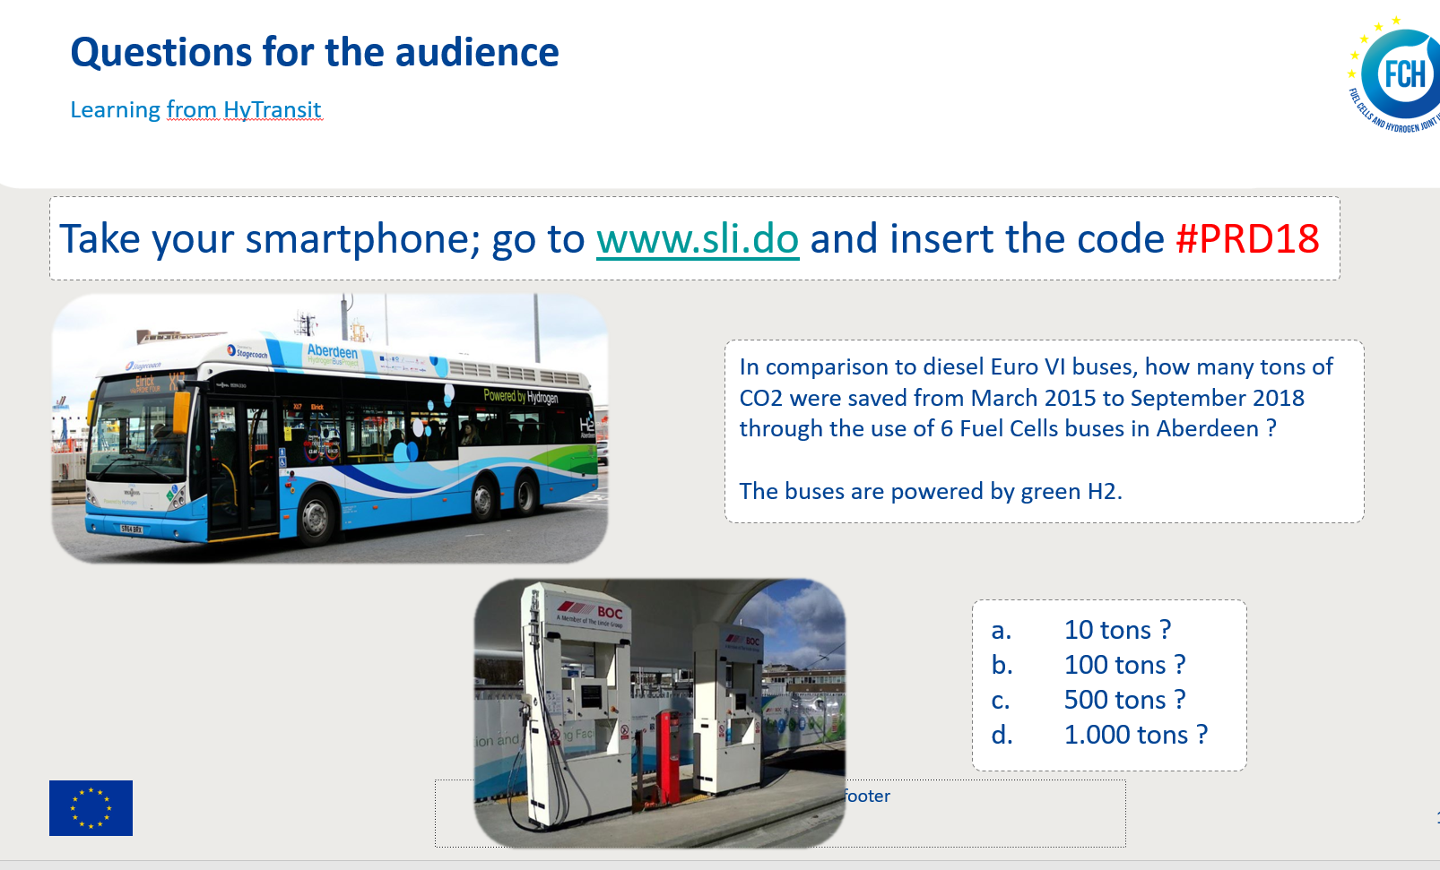
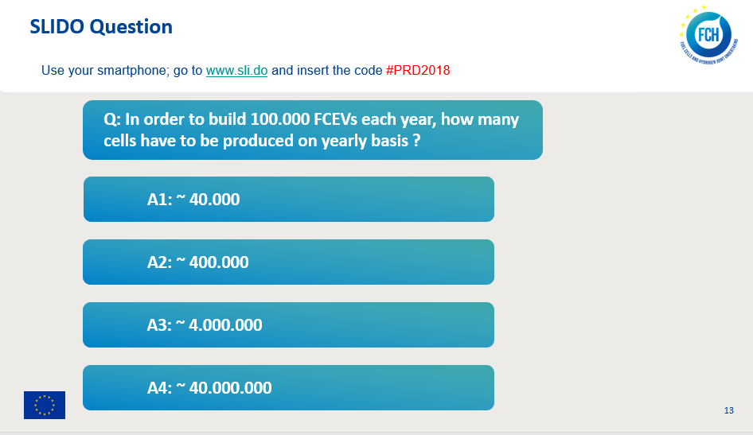
Question for the audience
Achievements from PROJECT ACRONYM
Take your smartphone; go to www.sli.do and insert the code #PRD19
Please include one multiple choice question for the audience relevant to your project’s achievements/learnings/activities. This question will be inserted in sli.do in advance of the event and will be answered by the audience during your presentation. Please provide one question with 3-4 possible answers, only one should be the correct. Please try to prepare a question that will be comprehensible and interesting for a wider audience. Please look at the following examples:

Slide 16
ACRONYM
Project Title
Speaker Name Surname
Speaker Affiliation
Project LOGO
Coordinator: coordinator@email.address
If different:
Speaker: speaker@email.address
Programme Review Days 2019
Brussels, 19-20 November 2019

Slide 17
OPTIONAL SLIDES
You can use any of the following slides and insert them inside the presentation, otherwise please delete them.

Slide 18
Dissemination Activities
Please include information as well as digital material (pictures, videos etc) from dissemination activities such as, conferences, technical workshops publications and patents
In addition :
Indicate the number of conferences/workshops organized by the project and that the project has attended
Specify the number of publications and give reference up to 2 most relevant ones
Please provide the total number of patents (and patents applications) and give full reference to up to 2
In addition, please refer to the public deliverables of the project

Slide 19
Horizontal Activities
Free slide illustrating activities on public awareness, training, RCS (Regulations, Codes and Standards), Life Cycle Analysis (LCA), Hydrogen Events and LEssons Learned (HELLEN) and contribution to cross-cutting activities or any other activities not mentioned in the previous slides.

Slide 20
SYNERGIES WITH OTHER PROJECTS AND PROGRAMMES
Interactions with projects funded under EU programmes
Project acronym/logo: Description of interactions, synergies and/or joint activities (if any) and relevant benefits obtained
Project acronym/logo: Description of interactions, synergies and/or joint activities (if any) and relevant benefits obtained
Interactions with national and international-level projects and initiatives
Project acronym/logo: Description of interactions, synergies and/or joint activities (if any) and relevant benefits obtained
Project acronym/logo: Description of interactions, synergies and/or joint activities (if any) and relevant benefits obtained

Slide 21
Icons/Tables and graphic material
Please feel free to use any of the icons, tables etc provided in the following slides to your presentation

Slide 22
Auxiliary Slides
Please select one or more slides/graphs/icons according to your needs and delete the rest

Slide 23

Simple Bar chart
Select graph > Right click > Edit data in Excel
Title comes here
Title comes here
Text here

Slide 24
Triple level Bar chart
Select graph > Right click > Edit data in Excel
Title comes here

Slide 25
Balloon text boxes with icons
Icons can be added according to the content
Title here
Content comes here
Title here
Content comes here
Title here
Content comes here
Title here
Content comes here

Slide 26
Square text boxes
Pictures can be added according to the content
  Title comes here
  content comes here
  Title comes here
  content comes here
  Title comes here
  content comes here
  Title comes here
  content comes here

Slide 27


Grid template
Insert icons as needed
MATERIAL HANDLING VEHICLES | FCH JU projects results 2015 | MAWP 2017 | MAWP 2017 Objectives
Specific FC System cost, €/kW @10kW |  | < | 1,500
Specific FC System cost, €/kW @10kW
>1,000,000 km driven since project started
>1,000,000 km driven since project started
>1,000,000 km driven since project started
>1,000,000 km driven since project started
>1,000,000 km driven since project started
>1,000,000 km driven since project started

Slide 28
Balloon text boxes
Icons can be added according to the content
  Content here
Content here
  Content here
  Content here
  Content here
  Content here

Slide 29

Arrow diagram
Icons can be added according to the content
Text can be inserted here
Title here
Text can be inserted here
Title here
Text can be inserted here
Title here
Text can be inserted here
Text can be inserted here
Title here

Slide 30



































Icons set #1

Slide 31












































Icons set #2

Slide 32
















































Icons set #3

