Slide 1











KeePEMalive
(GA no.: 245113)
FCH JU Programme Review Days 2013
Brussels, 12th November
Steffen Møller-Holst
SINTEF

Slide 2
Project & Partnership description
Part 0, slide 1 of 1
Knowledge to Enhance the Endurance of PEM fuel cells by Accelerated LIfetime Verification Experiments
Partner | Country | Category
SINTEF (coord.) | NO | Research
ECN | NL | Research
CNRS | FR | Research
EIfER | DE | Research
SEAS NVE | DK | Industry
IRD | DK | Industry/SME
FumaTech | DE | Industry
Tech. Univ. Graz | AU | University
JRC, Petten | NL | Research
SP1-JTI-FCH.2008.3.3:
Degradation and lifetime fundamentals
Start date: 1 January 2010
Duration: 42 months
Total Cost: € 2 874 206
FCH JU funding: € 1 264 582
Research Council
of Norway: € 284 800

Slide 3
Achievements in relation to the AIP/MAIP
Part 1, slide 1 of 7
KeePEMalive’s achievements in relation to the MAIP 2008 (AA-S):
Stationary Power Generation & CHP: | KeePEMalive activities/results match
"Substantial effort is needed to address lifetime requirements of 40,000 hours for cell and stack, as well as competitive costs, depending on the type of application.” “Long-term and breakthrough orientated research will concentrate on degradation and lifetime fundamentals related to materials and typical operation environments for all power ranges." | Substantial effort has been devoted to: studies of lifetime issues (~30 000 h), targeting increased durability. long-term and breakthrough oriented research, through which materials development has been carried out in parallel with the accelerated stress test program with focus on µCHP applications.

Slide 4
Achievements in relation to the AIP/MAIP
Part 1, slide 2 of 7
AIP08 Section 2.2 Specific topics for the 2008 Call for proposals:
“The emphasis of the application area Stationary Power Generation will be on long-term basic research to better understand degradation/failure mechanisms and the lifetime requirements of all technologically mature fuel cell stack types (SOFC, MCFC, PEMFC) for different fuels and levels of power.
For lifetime predictions, research is necessary to establish methodologies as well as tools for modelling, operational controls and diagnostics. Research should result in novel diagnostic and control tools and improvements of components and systems in terms of functionality, performance and lifetime.
KeePEMalive’s overall objectives include establishment of:
improved understanding of degradation and failure mechanisms for stationary PEM fuel cells, with special focus on µ-CHP applications
accelerated stress test (AST) protocols, sensitivity matrix and
a lifetime prediction model for stationary µ-CHP applications

Slide 5
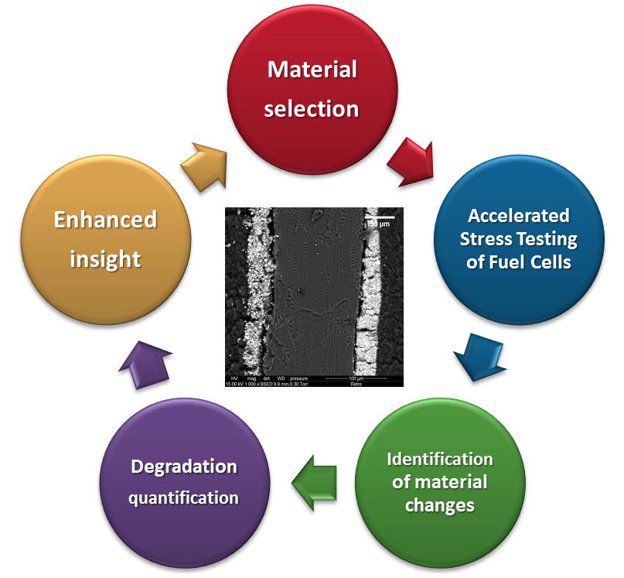
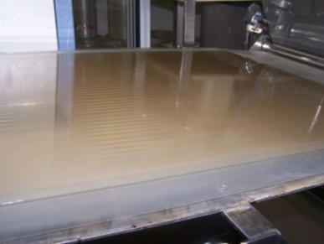
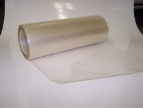

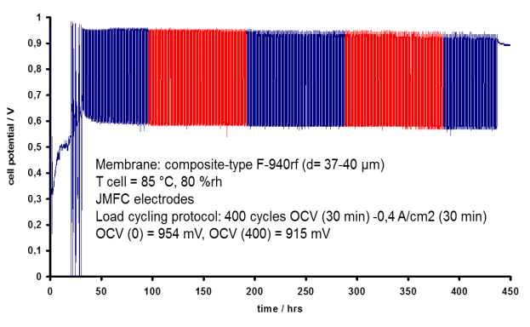
Achievements in relation to the AIP/MAIP
Part 1, slide 3 of 7
Material development and selection
Synthesis of 5 generations of PFSA based membranes
and characterization with respect to key properties.
Batch production scaled up to continuous membrane
series production in the range of 2000 m²/year.
In-house manufacturing of MEAs and stacks (IRD).
By introducing Ce-based radical scavengers (CNRS)
the stability of the membrane was enhanced.
Most stable and best performing cells were obtained
using reinforced membrane and a cathode catalyst
w/ improved dispersion on oxidant resistant support.
Series production at FumaTech
Stable MEA upon voltage cycling

Slide 6

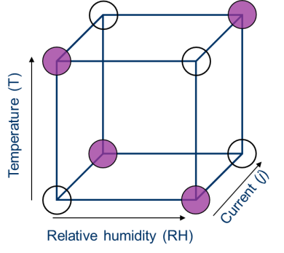
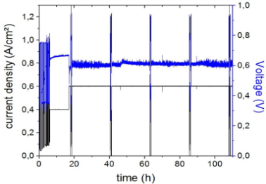
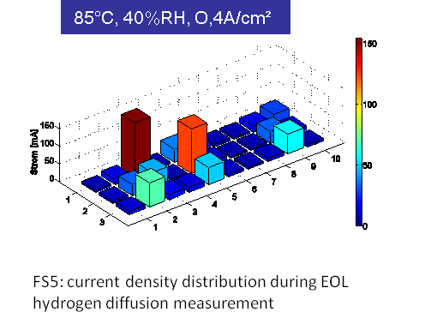
Achievements in relation to the AIP/MAIP
Part 1, slide 4 of 7
Fuel cell characterisation during operation (factorial designed experiments)
A set of Accelerated Stress Test (AST) protocols were developed & applied:
Continuous operation
Reformate operation
Dead end operation
Start-stop, shut-down
Fuel Starvation
Electric load cycling
Cell performance was mapped daily to identify degradation rate using:
Electrochemical Impedance Spectroscopy
Hydrogen cross-over & Cyclic Voltammetry
Carbon corrosion by NDIR Spectroscopy
Membrane degradation by Fluorine emission rates
Segmented cell to reveal localised degradation

Slide 7
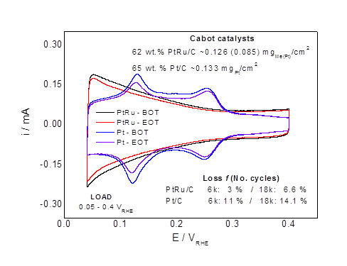
Achievements in relation to the AIP/MAIP
Part 1, slide 5 of 7
Identification of material changes
The following materials were subject to assessment:
Catalyst materials (SINTEF)
Catalyst layer surface & cross section (CNRS)
Membrane materials (CNRS, Fumatech)
and these MEA components' properties including e.g.,:
Mechanical strength, membrane (Yuong modulus)
Membrane Conductivity, Ohmic resistance…
Water-uptake, hydration number
Morphology, Microstructure
Catalyst agglomeration and migration by (SEM)
ElectroChemical Surface Area (ECSA) of electrodes

Slide 8
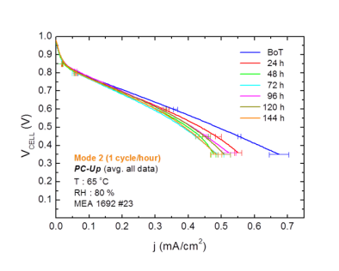
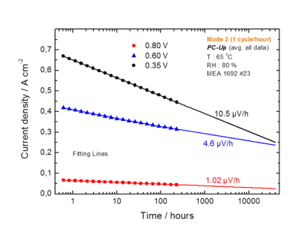
Achievements in relation to the AIP/MAIP
Part 1, slide 6 of 7
Quantification of degradation rates
Changes in performance with time were assessed
and the degradation rate was calculated.
Used fuel cell materials subject to stressing
conditions were compared to pristine materials
revealing corresponding material changes.
Statistical analyses has clearly shown that
degradation depends on several factors and
varies along the operation curve.
Key stressor identified:
Fuel Starvation and Voltage Cycling

Slide 9
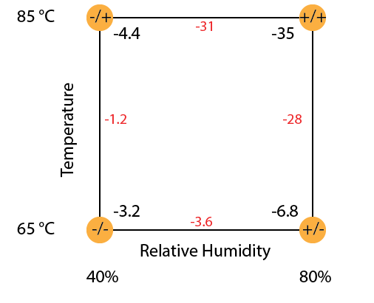
Achievements in relation to the AIP/MAIP
Part 1, slide 7 of 7
Degr.
rate (µV/h)
Enhanced insight/understanding
Degradation rates & corresponding material changes
Complexity of processes in PEM fuel cells was verified
Factors causing degradation are highly inter-related

Slide 10
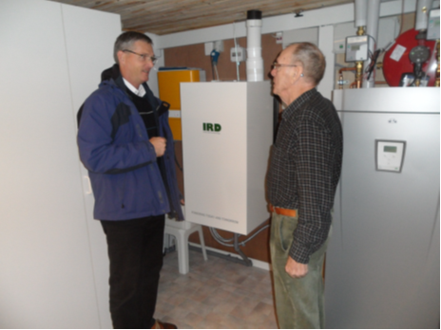
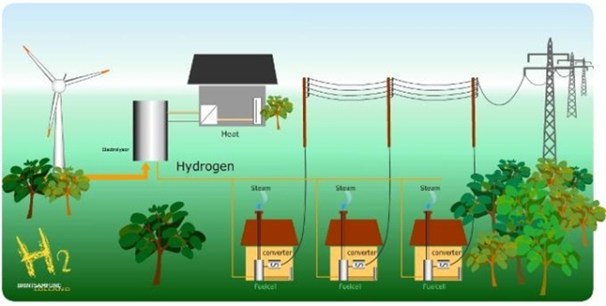


Complementary information
Part 2, slide 1 of 3
  Relationship to Earlier and Other Current Projects
Link to previous work on AST protocols performed in framework of FCTEST^{QA}
Contribution at DeCode workshop, Gothenburg, March 2011
Integration with Field test program at Lolland, Denmark:
Workshop, April 2013 @ SINTEF, Oslo, Norway: "Degradation of PEM Fuel Cells
- experience exchange & discussions"

Slide 11
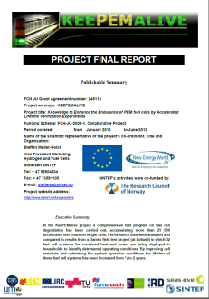
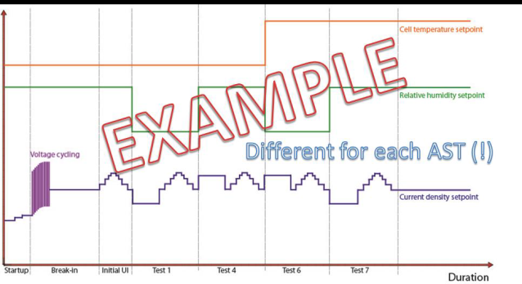
Complementary information
Part 2, slide 2 of 3
  Cross Cutting and Dissemination Activities
> 5 master students have received training in the project
The project has generated more than 20 oral presentations and 7 posters, some at major international conferences such as WHEC and ECS meetings.
Int. Summer School on Advanced studies of Polymer Electrolyte Fuel Cells, TU Graz, August 26th – September 1st, 2010
Master student lecture course, "The hydrogen community in Vestenskov", Montpellier, Jens Jacobsen, SEAS NVE, February 2012
Public Deliverables: Design Guide & Recommendations for Degradation Studies
Publishable Summary

Slide 12




Complementary information
Part 2, slide 3 of 3
  Recommendations towards the Program FCH2 JU
During the definition of the Topic Description, limit the scope of proposals from a "wish-list" to an adequate and manageable amount of work possible to achieve in one project within the (indicated) budgetary constrains
Include as a minimum requirement that knowledge exchange on a scientific level (workshops) is taking place between FCH2 JU projects with similar aims
All project proposals should contain optional paths
or off ramps and establish criteria (milestone
with Contingencies) if certain pre-requisites for
the progress are compromised or not fulfilled

Slide 13


Acknowledgements
Supported by
FCH JU under Grant Agreement no.: 245113
SINTEF's part of the project Co-funded by

