Slide 1


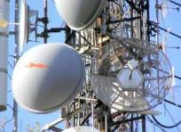
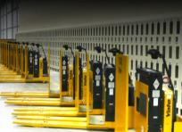

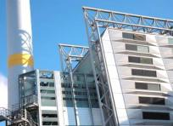
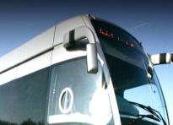

®
NASDAQ:BLDP  TSX:BLD
Progress in FCH Deployment in Europe and the World
John Sheridan, President & CEO
November 13, 2013

Slide 2
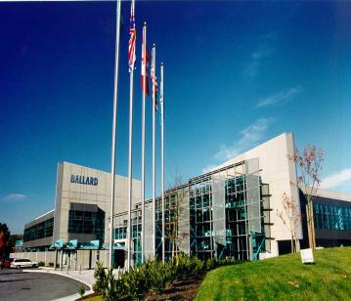
Who We Are
Global leader in clean energy PEM fuel cell products …
design, manufacturing & deployment
  ~2,400 ➔ Telecom Backup Power systems … 9MW’s of power
  >4,000 ➔ Material Handling stacks in Plug Power GenDriveTM systems
  … 10M hours of runtime
  180 ➔ Bus power modules … more than 4M miles of revenue service
355 employees
  HQ in Vancouver, Canada
  Product Engineering in Vancouver, USA
  & Denmark
  Manufacturing in Vancouver & Mexico
Ballard HQ facility – Vancouver, B.C., Canada

Slide 3






Fuel Cell Industry Momentum…
Proven product performance
Increased market awareness
Improved financial performance
Increasing ‘buy-in’ from global players
Years of investment & trials
Reduced product costs
Commercial value propositions
Environmental benefits
Product profitability: Hydrogenics, Fuel Cell Energy & Ballard
I N D U S T R Y T I P P I N G P O I N T

Slide 4
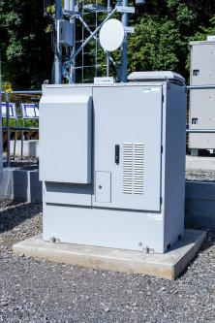




Telecom Backup Power
Growth underpinned by two distinct needs:
  Regular outages in regions with unreliable grids
  Emergency power in crisis situations
Future growth driven by:
  Need for extended duration run-time backup power
  Comprehensive product portfolio
  Strong channel partners
  New geographies, including China
Ballard ElectraGen™-ME fuel cell system installed by Nokia Solutions and Networks (NSN) at test site in Japan
Ballard Channel Partners - Sample | No. Systems Shipped to Partners
Cascadiant (Asia) | 500
NSN (Japan) | 350
Inala Technologies (S.Africa) | 300
Azure Hydrogen (China) | 170
Motorola (Europe) | 150
Precision Power & Air (CALA) | 145
TOTAL | ~2,400
Key End-Customers
Notes:
ElectraGen™-H2 products developed and manufactured in Denmark by Dantherm Power*
~350 ElectraGen™ systems installed in Europe, primarily along SINE network in Denmark
New distribution agreement with Eltel Networks Infranet

Slide 5


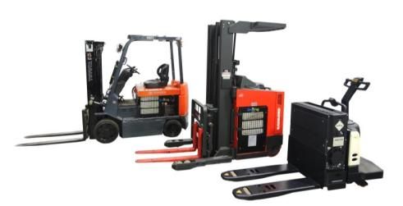

Material Handling
Plug Power has driven market adoption by leveraging productivity improvements in distribution centres
  Channel partner holds 85% share of N/American fuel cell powered forklift market
Future growth driven by:
  Continued penetration of N/American market
  Expansion into EU market
Ballard FCvelocity®-9SSL
Fuel Cell Stack
Ballard FCgen®-1020ACS
Fuel Cell Stack
Plug Power End-Customers - Sample | No. GenDrive’s® Deployed with End-Customer* | No. Sites*
Sysco | 680 | 6
Walmart | 500 | 3
P&G | 340 | 4
Mercedes Benz | 195 | 2
Kroger | 161 | 1
TOTAL | >4,000 | 44
Plug Power GenDrive® systems – powered by Ballard fuel cell stacks – are available for all classes of lift truck
Channel Partner
* Results reported by Plug Power
Notes:
MESSAGE POINTS
Deployments based on quantifiable economic value proposition …. Payback < 1.5 years, based on productivity gains
Central Grocers (Illinois) and Walmart (Alberta) have been the first to deploy at Greenfield sites
Other name brands are demonstrating systems: Sysco, P&G, BMW, Whole Foods
Relatively small volumes today, but strong growth trajectory …. exclusive supply arrangement with Plug

Slide 6
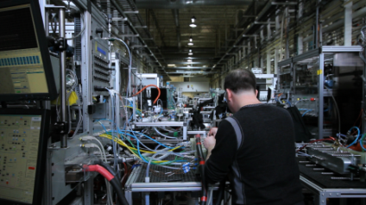
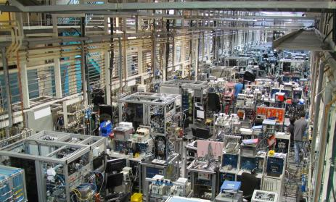



Engineering Services
Customers leveraging Ballard expertise to advance fuel cell development efforts
Underpinned by 4-year contract with Volkswagen AG ➔ C$60-100M value
    Fuel cell product design, testing & system integration for current VW fuel cell system & development of next-generation system
Future growth driven by:
    Auto & non-auto opportunities
Ballard development and test facility at Vancouver, B.C. headquarters
Key Customers

Slide 7

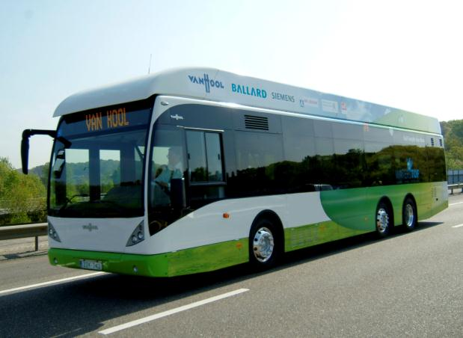
Bus
  Important market, supported by Government policy & funding initiatives
  Europe
    Ballard expects to power 40 of the 50 buses operating in Europe by 2014
    JTI leadership & funding support
  North America
    Whistler, BC
    CaFCP Bus Roadmap released in March – calling for 40 vehicles at 2 sites in California
  China
    Ballard contract with Azure Hydrogen for license to assemble bus modules in China; fuel cell stacks provided exclusively by Ballard
Key Customers
Van Hool bus equipped with Ballard fuel cell power module
Notes:
One of the London buses has exceeded 10,000 hours of operation without fuel cell stack replacement

Slide 8
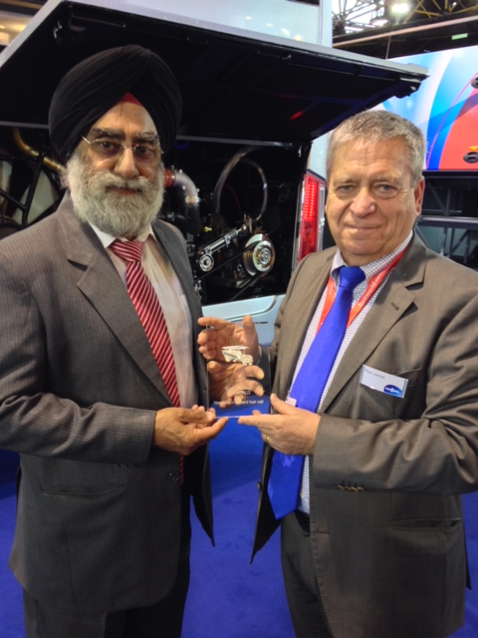
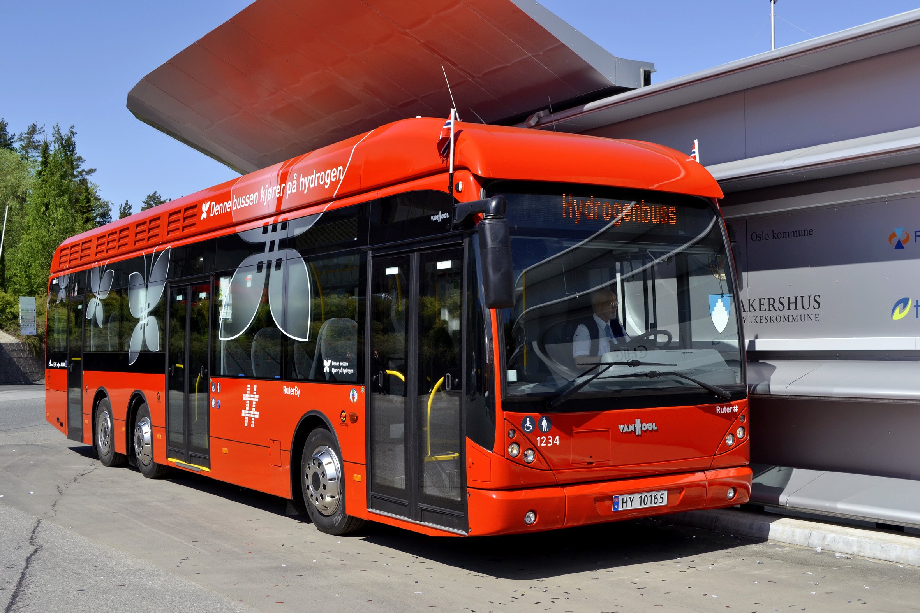
Van Hool & Ballard Collaboration
  Van Hool & Ballard working closely to advance fuel cell bus commercialization
  Future fuel cell bus design will integrate Ballard next-gen FCvelocity™-HD7 fuel cell module into Van Hool platforms
  Van Hool & Ballard will also explore opportunities beyond Europe, including the US
Van Hool & Ballard Presented with “Ecology
Award” at Kortrijk Busworld Europe Event
Van Hool bus equipped with Ballard fuel cell power module in Oslo

Slide 9

JTI Leadership
  More than 150 projects & 430 industry and research organizations have benefited from funding
  JTI has proven the right tool to:
    Coordinate objectives
    Pool resources
    Advance technology
  Results to date include:
    Technical advancements in materials performance, durability, and cost reduction for energy & transportation applications
    Early market introduction of forklift and backup power applications

Slide 10
®
NASDAQ:BLDP  TSX:BLD
THANK YOU

