Slide 1
Fuel Cell Based On-board Power Generation [FCGEN]
(277844)
Jazaer Dawody, Volvo Technology

Slide 2
Project & Partnership description
  Project name:
  Fuel Cell Based On-board Power Generation
  Project acronym: (FCGEN)
  Programme: Seventh Framework programme of the European union
  Project coordinator: Jazaer Dawody, Volvo Technology
  Grant agreement no. : (277844)
  Start date: 2011-11-01
  End date: 2014-10-31
  Project budget : 10 338 414 €
  FCH JU contribution: 4 342 854 €
Partners
Volvo Technology AB (Volvo), Sweden
Powercell Sweden AB (Powercell), Sweden
Forschungszentrum Juelich GMBH (Jülich), Germany
Institut Jozef Stefan (JSI), Slovenia
Centro Ricerche Fiat SCPA (CRF), Italy
Institut fuer Mikrotechnik Mainz GMBH (IMM), Germany
Johnson Matthey PLC. (JM), United Kingdom
Modelon AB (Modelon), Sweden

Slide 3
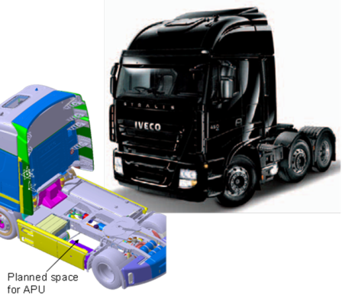
Project targets in relation to the AIP/MAIP
Project objectives
To develop and demonstrate a proof-of-concept complete fuel cell based 3 kW_{(net el.)} auxiliary power unit in a real application, on-board a truck.
To further develop key components and subsystem technologies that have been advanced by the project partners in previous collaborations and move them closer towards commercially viable solutions.
Issues | 3 kW Diesel APU
Durability (hours) | 20000
Cost (Euro/kW) | ≤ 1000
Efficiency | ≈ 30%
Weight (kg) Volume (L) | 125 300

Slide 4

Project achievements in relation to the AIP/MAIP
-
  Relevance to MAIP targets, Topic: 3.4.1, 2008 – 2013
  Demonstrations of increased efficiency of on-board power generation and reduce CO₂ emissions and local pollutions.
  Research, development and proof-of-concept demonstration of APU systems for on-board power generation.
  Demonstrated feasibility of using logistic fuels.
  Demonstrated fuel processing technology for logistic fuels.
  Defined requirements for fully integrated systems in the specific application.
Last year targets

Slide 5
Initial versus actual workflow
Actual
Initial
1/11/2011
Design phase (6 months)
System design
Vehicle interface and communication
Component development phase
(12 months)
Component manufacturing and testing
Component and CS optimization
System integration and system testing phase (18 months)
Fuel processor integration and testing
APU system integration and testing in laboratory
Control system architecture
BoP component purchasing, optimization and testing
CS development and testing
APU performance demonstration on-board a vehicle
1/5/2012
1/11/2013
1/11/2013

Slide 6


Project achievements in relation to the AIP/MAIP
APU system overview
Reformer
Air
Catalytic
Start-up Burner
Air
Catalytic
Start-up Burner
Fuel
Desulphuriser
Catalytic
After Burner
Exhaust
Catalytic
After Burner
Air
Steam
CO clean-up
PrOx
CO clean-up
(WGS)
Water
PEM FC stack
Power conditioning
APU

Slide 7
Project achievements in relation to the AIP/MAIP
FP system
Jülich, IMM, JM, Powercell, JSI and Volvo
Catalytic Start Burner (CSB):
  Successful verification of the functionality of the CSB and heat exchanger array.
Reformer:
  Optimized catalyst delivered by JM
  Reactor design, optimization and testing with logistic diesel by Jülich
  Further system optimization was needed to secure PEM quality reformate.
Desulphuriser: ZnO pellets provided by JM, reactor design and manufacturing by IMM and on-going work for the development of new structure ZnO
Water Gas Shift (WGS) and Preferential Oxidation(PrOx):
  Catalyst coating by JM
  µ-reactor technology for WGS & PrOx from IMM
  Testing of single WGS and PrOx as well as WGS + PrOx
  with BoP-components from JSI
Catalytic After Burner (CAB):
  Optimized catalyst delivered by JM
  Reactor design and system testing for anode off gas oxidation and steam generation by Jülich

Slide 8
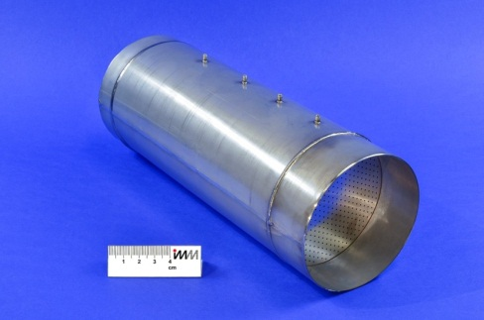
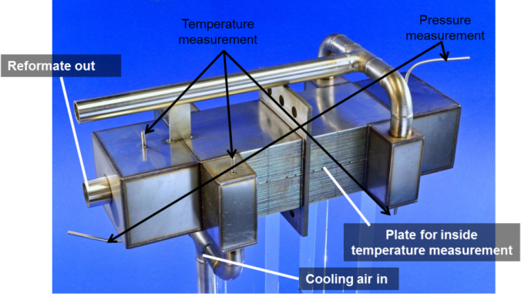
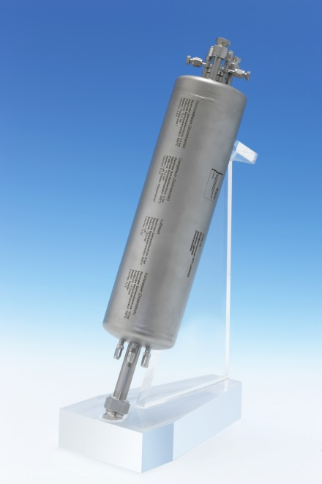
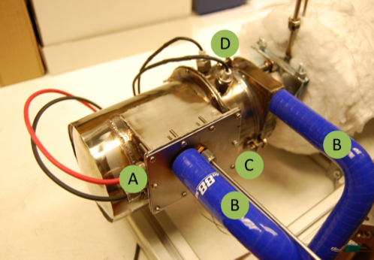
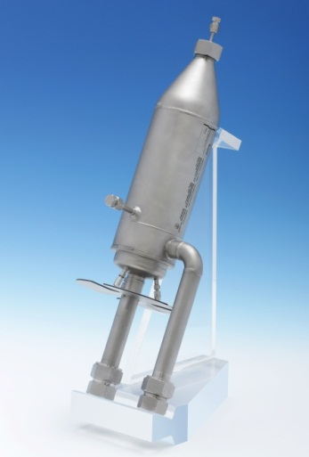
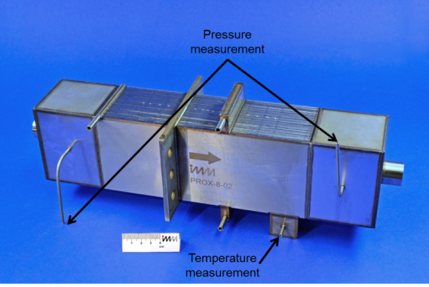
Project achievements in relation to the AIP/MAIP
Fuel Processor (FP) development
FP components ready for system integration
Desulphurizer (DS)
IMM + JM
Water gas shift (WGS)
IMM + JM
Reformer
Jülich + JM
Catalytic start burber (CSAB)
Powercell
Catalytic after-burner (CAB)
Jülich + JM
Preferential oxidation (PrOx)
IMM + JM

Slide 9
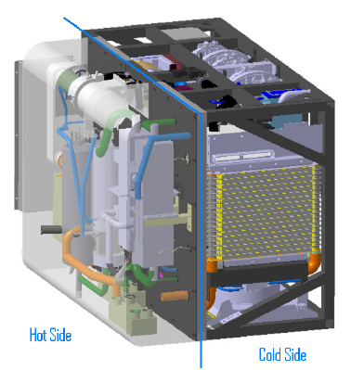
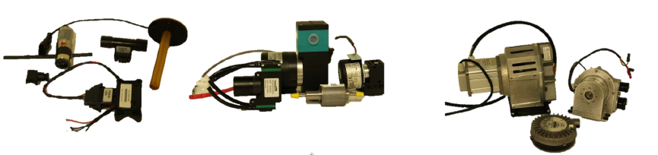
Project achievements in relation to the AIP/MAIP
BoP optimization and System integration
Powercell
Market screening, purchasing and testing of BoP sub-system (air, coolant, and process water) components.
Development of a CAD system packaging. The compact APU box consists of a hot side part for FP reactors and a cold side part for FC sub-system and BoP components.

Slide 10
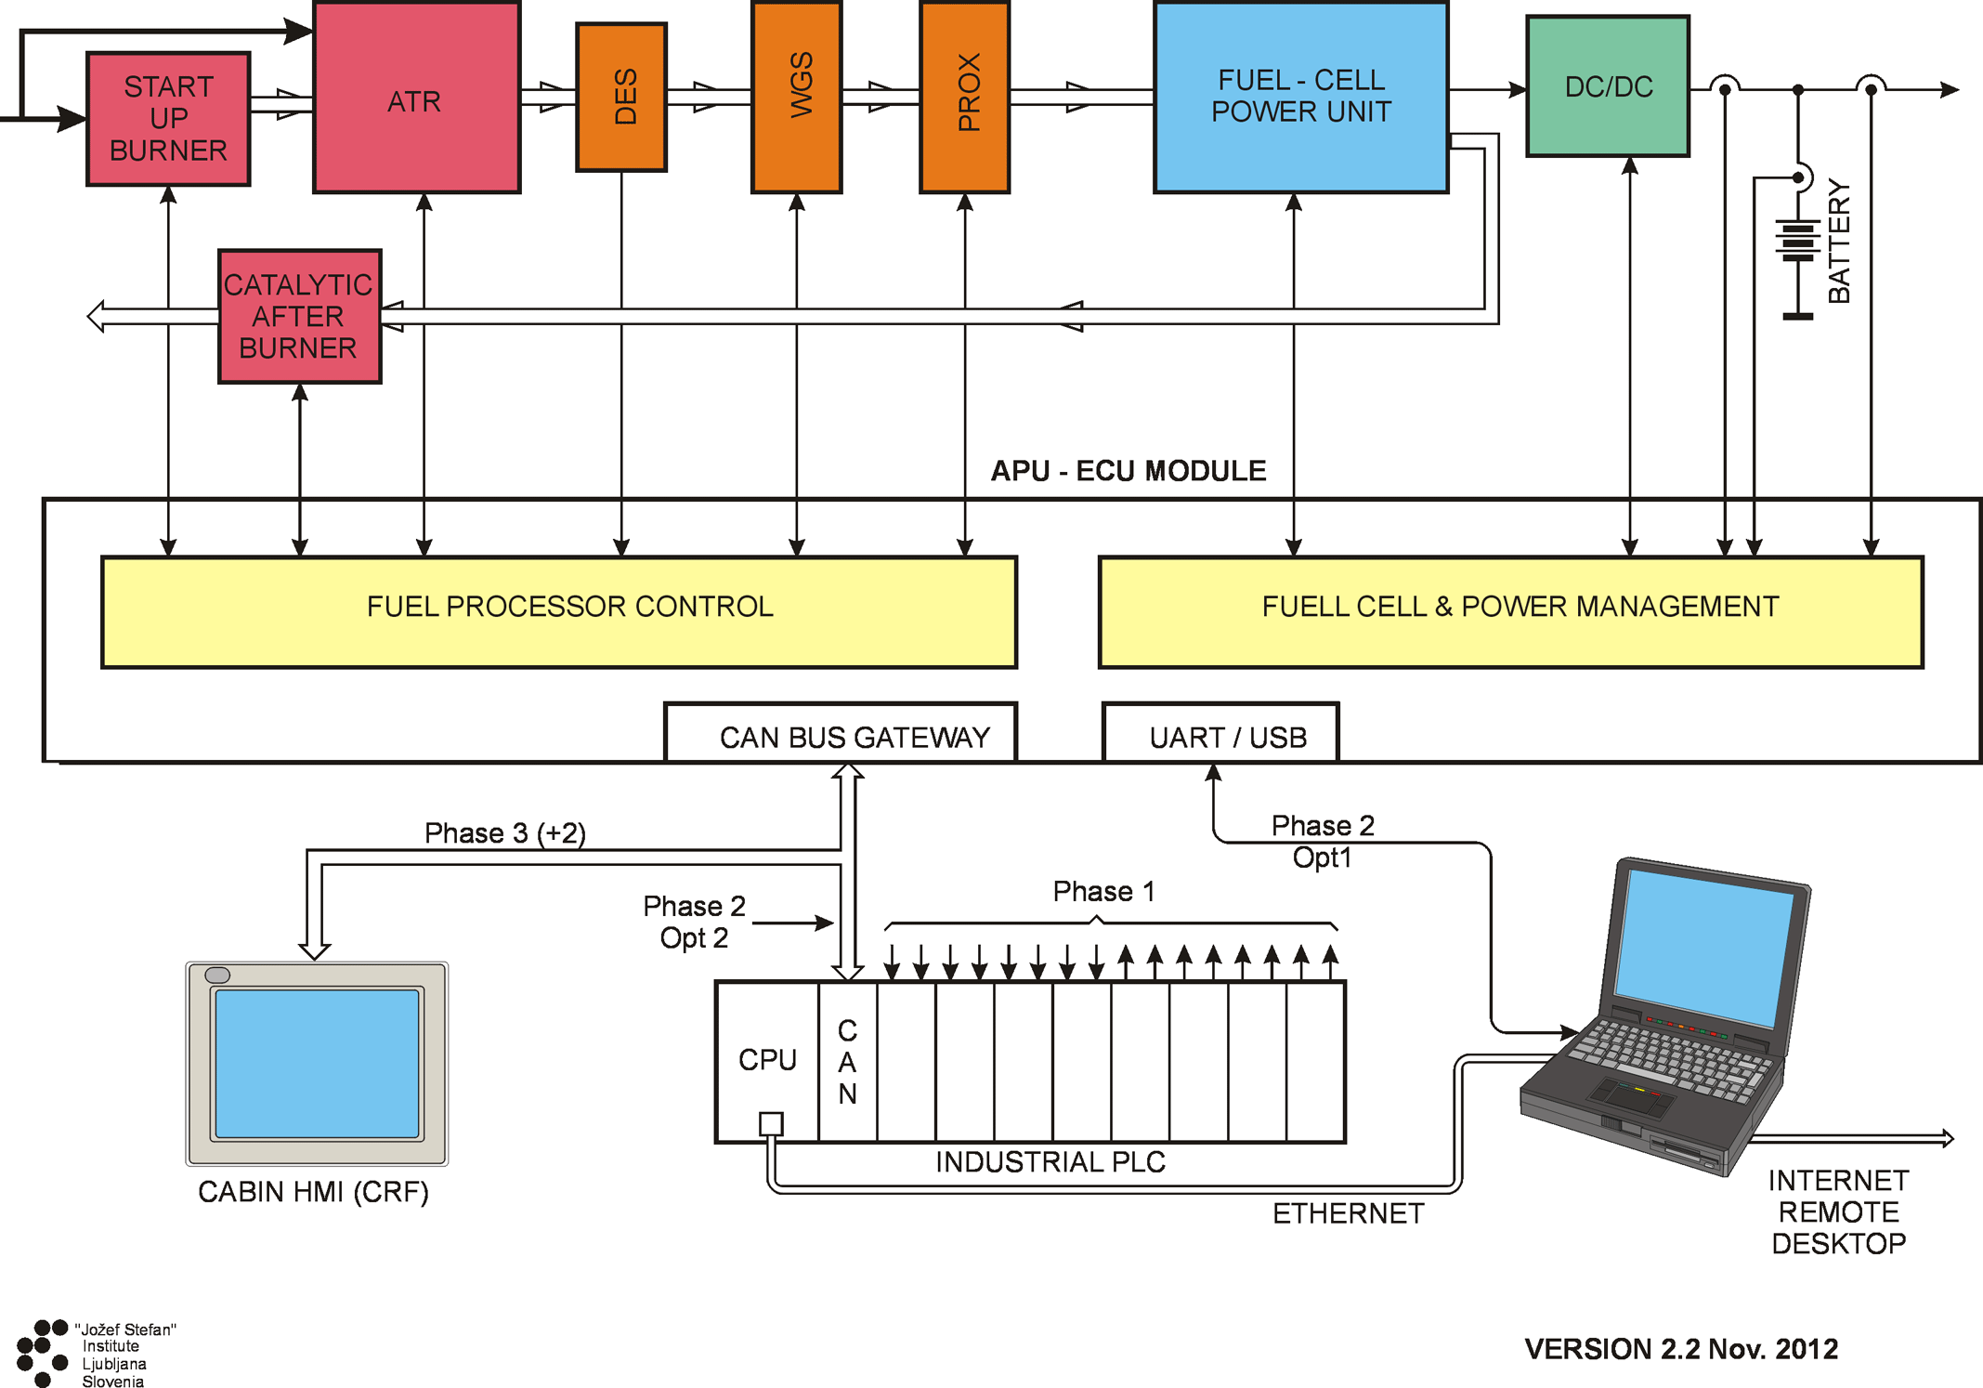
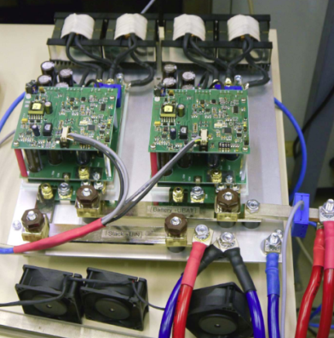
Project achievements in relation to the AIP/MAIP
Control system and power conditioning
JS!
Control system:
  4-level hierarhical structure
  19 dedicated control function blocks
  15 PID control loops
  58 sensors, 36 actuators (8 valves, 28 pumps, compressors, etc.)
  Comprehensive HMI for APU commisioning and testing
Power conditioning
  Supply all APU BoP actuators
  Convert variate stack output voltage to battery-bus voltage level
  Provide APU power complying to high safety standards
  Protect FC stack from failures/disturbances on load side
DC/DC converter

Slide 11
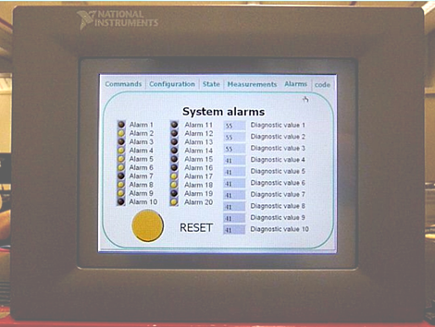
Project achievements in relation to the AIP/MAIP
Vehicle interface and Communication
CRF, JSI
    Vehicle interface details specified according to the preliminary APU integration safety analysis and the components progress.
    The communication dataset has been defined and the HMI has been implemented on a NI touch panel.
    Demonstration vehicle prepared and physical position for the APU defined.
vehicle interface
HMI

Slide 12
Expected project achievements at the end of the project
Successful demonstration of power generation via the FCGEN APU on-board an IVECO long distance tuck (STRALIS ) at stand still conditions with fuel efficiency slightly below 30% and NO_{x}, NMHC, CO and sulphur species emissions < 1 ppm.
The developed system will not achieve the cost, weigh and volume targets, but will be able to provide guidelines and possible technical solutions to reduce the system cost, volume and weigh in next generation prototype.

Slide 13
Bottlenecks, risks and problems
As it was difficult to find all optimal BoP components in the market and due to the lack of experiences at the supplier’s sites to develop BoP components for FC-APU for mobile applications, it is likely that some of these components will fail during the prototype testing and prevents the project from achieving some of the objectives and targets.

Slide 14

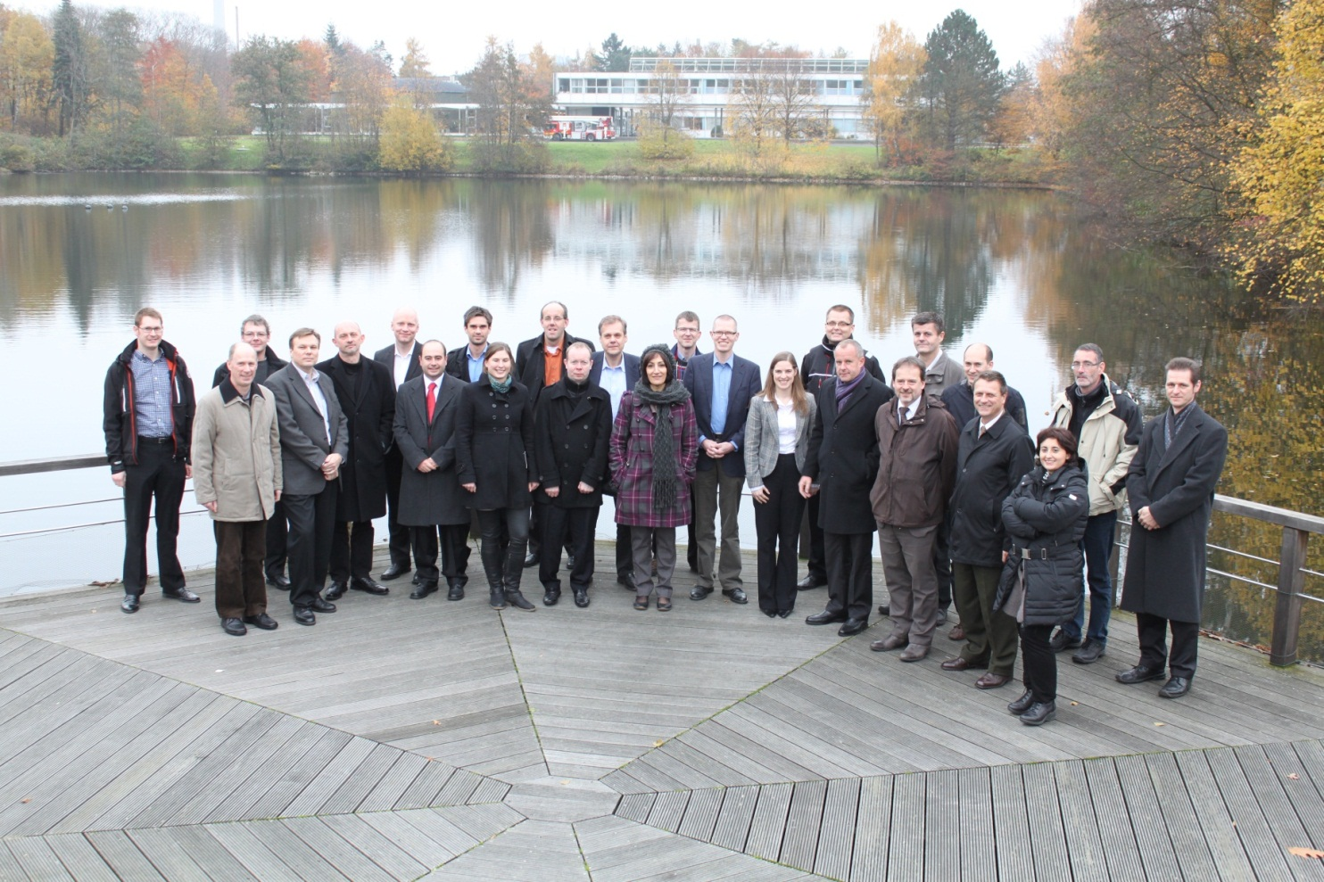







Many thanks to the fantastic FCGEN working team
Many thanks to your kind attention

